Slide 1
An Arduino Workshop; part 2
A Microcontroller, using Sumobot juniors

Slide 2
Notes
This material has been put together by the Outreach coordinator of the School of Engineering and Computer Studies (SECS) at Victoria University of Wellington (VUW), New Zealand.
It is free to distribute and pass on to all who may find it useful.
The author of this presentation and supporting documents can be reached at: john.barrow@vuw.ac.nz

Slide 3
Learning Objectives
Students can configure and use an ultrasonic sensor (from an earlier lesson 13, exercise 24) to extend their sumo-bot robot

Slide 4
Blocks of code part 4
random exploration:
https://github.com/kaiwhata/nodebots_howto/blob/master/ultrasound_explorer/ultrasound_explorer.ino

Slide 5
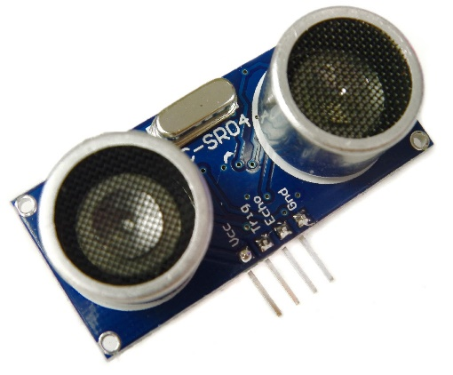
Advanced coding
Add sensors, pick one:
Ultra-sonic (The HC-SR04)
Analog Infra-red
(spin random amount – its how roombas explore a room)
They can be sourced from sites such as:
http://www.trademe.co.nz/Browse/Listing.aspx?id=1140370126
https://nicegear.co.nz/sensors/ultrasonic-range-measurement-module-hcsr04/ Part Number: NG-12558
The equivalent at Jaycar: http://www.jaycar.co.nz/p/XC4442 SKU: 10024

Slide 6
Working example

Slide 7
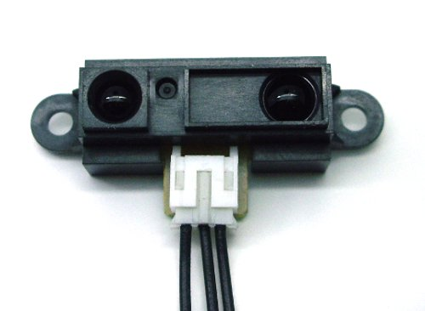
Steps after this
Sumo-bot competition
Try other sensors
LEGO sumo-bots
Make your own sumo-bot - thingiverse.com
Build you own robot
Explore IR and Ultra-sonic sensors and motors with a makerbot
Make your own robot from instructables, github, thingiverse…

Slide 8
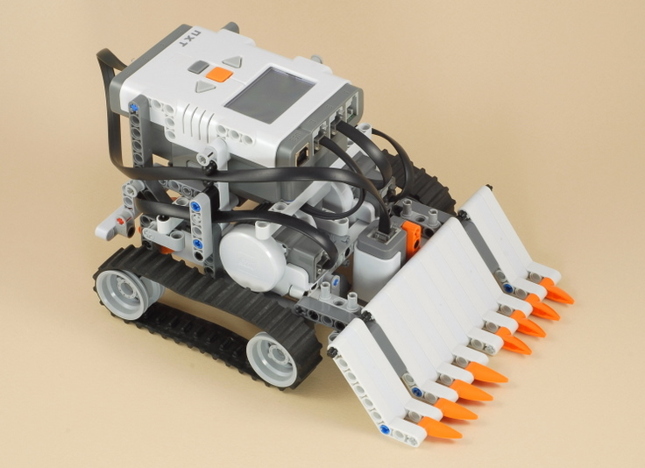
Sumo-bot with LEGO

Slide 9
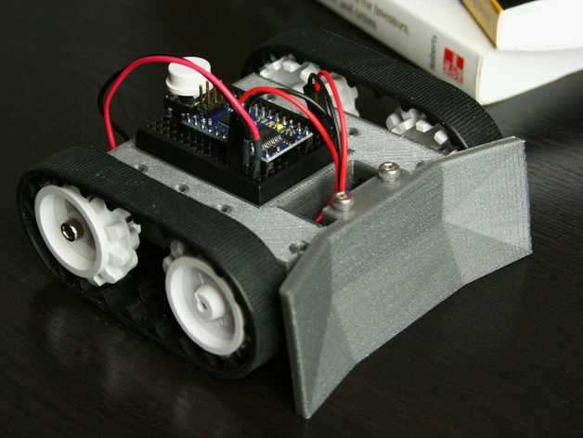
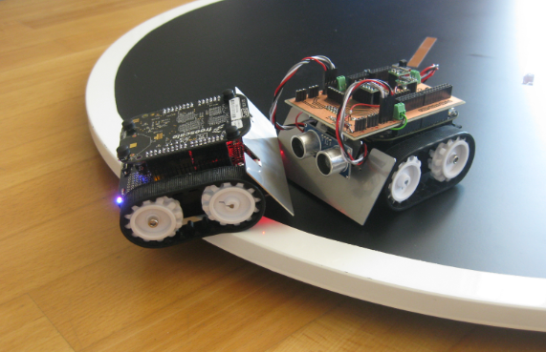
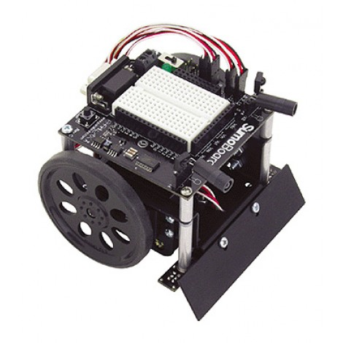
Or maybe…
Thingiverse
~$90 NZD
http://www.active-robots.com/robots/sumo-bots

Slide 10
Sample code – from Sumobots Junior on github
To run the ‘semi-official’ sample code for the Sumbot Jr you will first need to install NODE.JS and GIT
Open a terminal application and clone this repository:
Git clone https://github.com/makenai/sumobot-jr
Navigate to the code folder:
Cd code_example
Install code dependencies:
npm I
Run the code:
Node sumobot.js
NOTE: This involves installing other software, therefore more knowledge and more fussing around, thus we have sample code provided to circumvent this, just use our code….

Slide 11
Links
https://www.youtube.com/watch?v=BB0vihv9ylM (cat customization)
https://www.youtube.com/watch?v=0Q3hrKUwxDM (best site to watch)

