Slide 1
An Arduino Workshop; part 2
A Microcontroller, using Sumobot juniors

Slide 2
Notes
This material has been put together by the Outreach coordinator of the School of Engineering and Computer Studies (SECS) at Victoria University of Wellington (VUW), New Zealand.
It is free to distribute and pass on to all who may find it useful.
The author of this presentation and supporting documents can be reached at: john.barrow@vuw.ac.nz

Slide 3
Learning Objectives
Students learn to build a practical project, assembling and wiring a basic robot
It should be assembled now, and this lesson (and next) it should be wired up tests of the code run

Slide 4
Nodebots – Sumobot junior
https://github.com/makenai/sumobot-jr

Slide 5
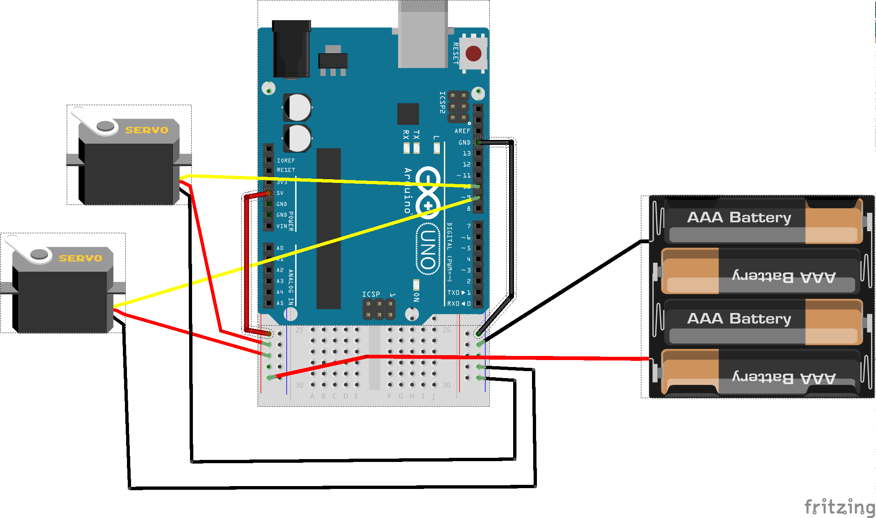
Testing: Non-soldering wiring diagram
Test with the ‘Drive forward ‘code/sketch

Slide 6
Wiring
Motors:
Red wire to battery
Black wire to ground
‘Driving wire’ to pins 9 & 10

Slide 7
The basic code
Tethered
Step 1 – drive forward
Step 2 – turn left/right
Step 3 – Bind to key press
Step 4 – Sensors (untethering)

Slide 8
Blocks of code part 1 & 2
Drive forward code:
https://github.com/kaiwhata/nodebots_howto/blob/master/sumobot_drive_forward/sumobot_drive_forward.ino
Turning code:
https://github.com/kaiwhata/nodebots_howto/blob/master/sumobot_turn/sumobot_turn.ino

Slide 9
Blocks of code part 3
serial control:
https://github.com/kaiwhata/nodebots_howto/blob/master/keyboard_control.ino

