Slide 1
An Arduino Workshop; part 2
A Microcontroller, using Sumobot juniors

Slide 2
Notes
This material has been put together by the Outreach coordinator of the School of Engineering and Computer Studies (SECS) at Victoria University of Wellington (VUW), New Zealand.
It is free to distribute and pass on to all who may find it useful.
The author of this presentation and supporting documents can be reached at: john.barrow@vuw.ac.nz

Slide 3
Learning Objectives
Students start to assemble a sumo-bot chassis

Slide 4
We’re making a robot here Morty…

Slide 5
Nodebots – Sumobot junior
https://github.com/makenai/sumobot-jr

Slide 6
Parts costs
Battery holder, Product Code: BH0030 on surplustronics $1.40
4 AA Batteries
2 Zip ties, rubber bands, some wire leads, Velcro strip or dots
Hot glue gun + glue (for the wheels)
Small bread board, Product Code: SA0060 on surplustronics $5
Genuine Arduino Uno, Product Code: MOD0280 on surplustronics $16.50
SpringRC SM-S4303R Continuous Rotation Servo, Model: 1248 on robokits $18.62 (like the like Futaba S148)
Ball Caster with 1/2" (12.7 mm) Plastic Ball Model: 952 on robokits $2.86

Slide 7
The parts:

Slide 8
Assembly steps 1-3
Peel them first
They will only fit one way! You cannot use 2 left hand side panels for example.
Make sure the wholes are correctly aligned (top and bottom panels)

Slide 9
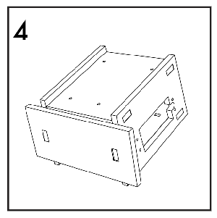
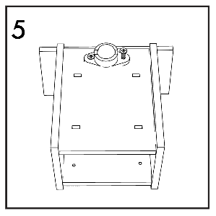
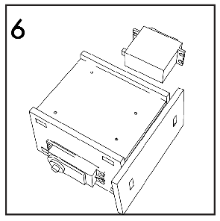
Assembly steps 4-6
The 360 servo motors only fit one way, make sure you have the right pieces assembled.
For the ball caster use the hot glue gun (if required)

Slide 10
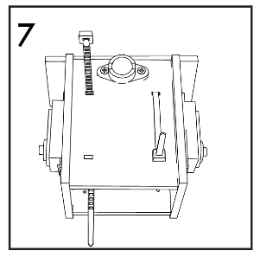
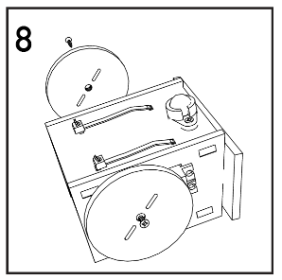
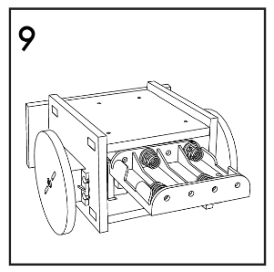
Assembly steps 7-9

Slide 11
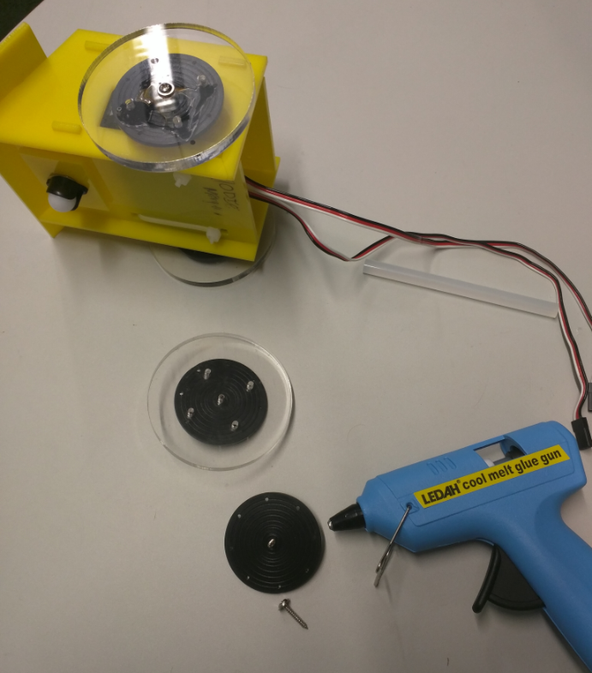
Hot glue gun for the wheels
Affix the connector for the wheel to the servo with a hot glue gun
Make sure it is centred correctly
Put a screw through the middle
Squirt the glue
Stick together
Remove thee screw
Fit to the servo
Screw it into place

