Slide 1
Servo’s and Motor’s with Arduino
A Microcontroller

Slide 2
Notes
This material has been put together by the Outreach coordinator of the School of Engineering and Computer Studies (SECS) at Victoria University of Wellington (VUW), New Zealand.
It is free to distribute and pass on to all who may find it useful.
The author of this presentation and supporting documents can be reached at: john.barrow@vuw.ac.nz

Slide 3
Learning Objectives
Students can configure and use a servo
Students can configure and use a motor
Students can explain the difference between a 180, 360 degree servo
Students can explain the difference between a motor and a servo

Slide 4
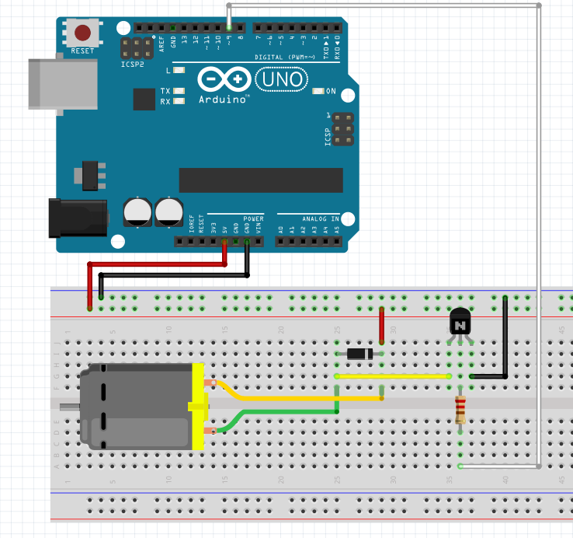
Exercise 27 - Motors
<File>, <Examples>
<SIK_Guide_Code_32>
<Circuit_12>
Open the serial monitor and enter a speed from 0-255, explore the speed settings

Slide 5
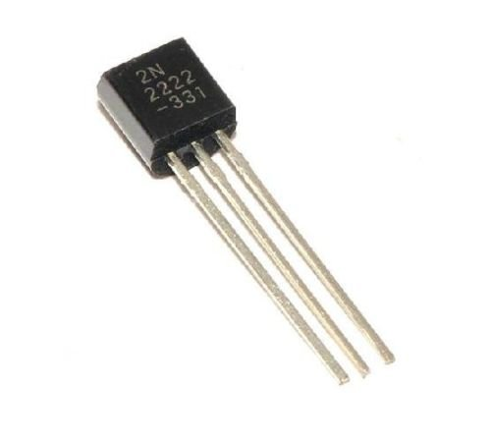
Notes on the circuit
Arduinos don’t have enough power to run motors (50-100mA)
We need to add a 2N222 transistor (not the temp sensor!!)
Transistor is a solid state switch, taking a small signal and making it larger
We need to add a Diode – to prevent a V spike
Emitter(E) pin to GND
Base(B) to pin 9
Collector(C) to GND on the motor

Slide 6
Sketch in your journal
A rough picture of a DC motor, a servo, a Stepper motor
Some notes about them
This way you can recognise them in future

Slide 7
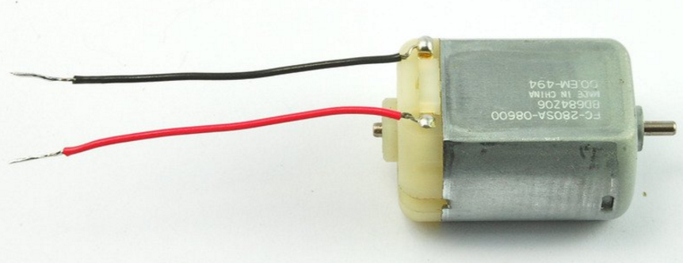
Information about DC motors
DC (Direct Current) Motors are two wire (power & ground), continuous rotation motors.
The speed of DC motors is controlled using pulse width modulation (PWM), a technique of rapidly pulsing the power on and off. The percentage of time spent cycling the on/off ratio determines the speed of the motor, e.g. if the power is cycled at 50% (half on, half off), then the motor will spin at half the speed of 100% (fully on). Each pulse is so rapid that the motor appears to be continuously spinning with no stuttering.
https://www.quora.com/What-is-the-difference-between-a-DC-motor-a-servomotor-and-a-stepper-motor

Slide 8
Information about Servos
Servo motors are generally an assembly of four things:
DC motor
Gearing set
Control circuit
Position-sensor (usually a potentiometer).
The position of servo motors can be controlled more precisely than those of standard DC motors, and they usually have three wires (power, ground &). Power to servo motors is constantly applied, with the servo control circuit regulating the draw to drive the motor.
PWM is used for the control signal of servo motors. However, unlike DC motors it’s the duration of the positive pulse that determines the position, rather than speed, of the servo shaft.
https://www.quora.com/What-is-the-difference-between-a-DC-motor-a-servomotor-and-a-stepper-motor

Slide 9
Inside a servo:

Slide 10
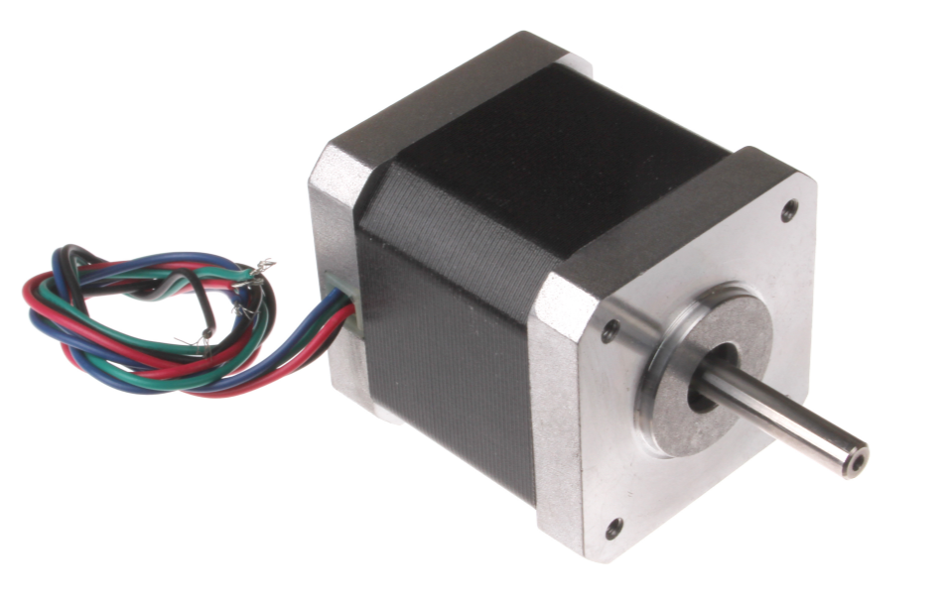
Information on stepper motors
Stepper motors utilizes multiple toothed electromagnets arranged around a central gear to define position.
Stepper motors require an external control circuit or micro controller (e.g. a Raspberry Pi or Arduino) to individually energize each electromagnet and make the motor shaft turn.
https://www.quora.com/What-is-the-difference-between-a-DC-motor-a-servomotor-and-a-stepper-motor

Slide 11
More on stepper motors

Slide 12
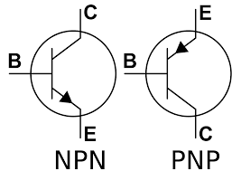
Homework
https://en.wikipedia.org/wiki/Bipolar_junction_transistor#NPN
Read about NPN BJT Transistor, make some notes in your journal
Note the EBC configuration
NPN – ‘Not Pointing iN’
BJT – Bipolar Junction Transistor
Make some notes about a flyback diode:
https://learn.digilentinc.com/Documents/390

