Slide 1
Sensors with Arduino
A Microcontroller

Slide 2
Notes
This material has been put together by the Outreach coordinator of the School of Engineering and Computer Studies (SECS) at Victoria University of Wellington (VUW), New Zealand.
It is free to distribute and pass on to all who may find it useful.
The author of this presentation and supporting documents can be reached at: john.barrow@vuw.ac.nz

Slide 3
Learning Objectives
Students can configure and use a temperature sensor
Students can configure and use an Ultrasonic sensor

Slide 4
Exercise 22 – Temperature sensor
The SIK kit has 2 sensors that look the same, the tmp36 and the 222
Use the tmp36
If you use the 222 then when you look at the serial monitor it will have negative numbers displayed (for project 7)

Slide 5
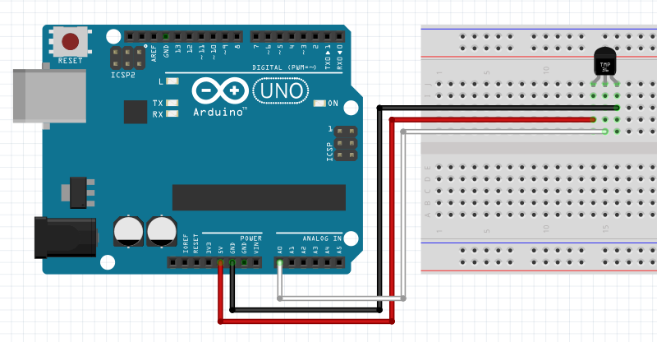
Fritzing diagram
Note the facing of the sensor and the connectors
<File>, <Examples>, <SIK_Guide_Code_32>, <Circuit_07>

Slide 6
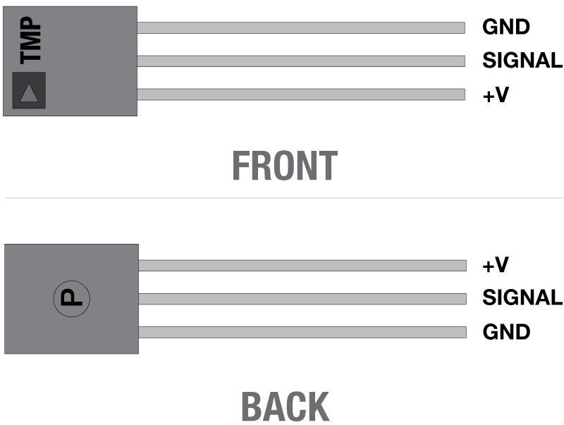
Reading the temperature sensor:
Flat face
Curved face

Slide 7
Notes on the code
Should be familiar by now
The conversion from an analog reading to temperature is the most interesting part:
Analog reads 0-1023 (LOW – 0v, to HIGH, 5v)
Convert this reading to a percentage (relating the range 0-1023 to 0-5v)
Using a datasheet specific to each temperature sensor type convert the reading to temperature

Slide 8
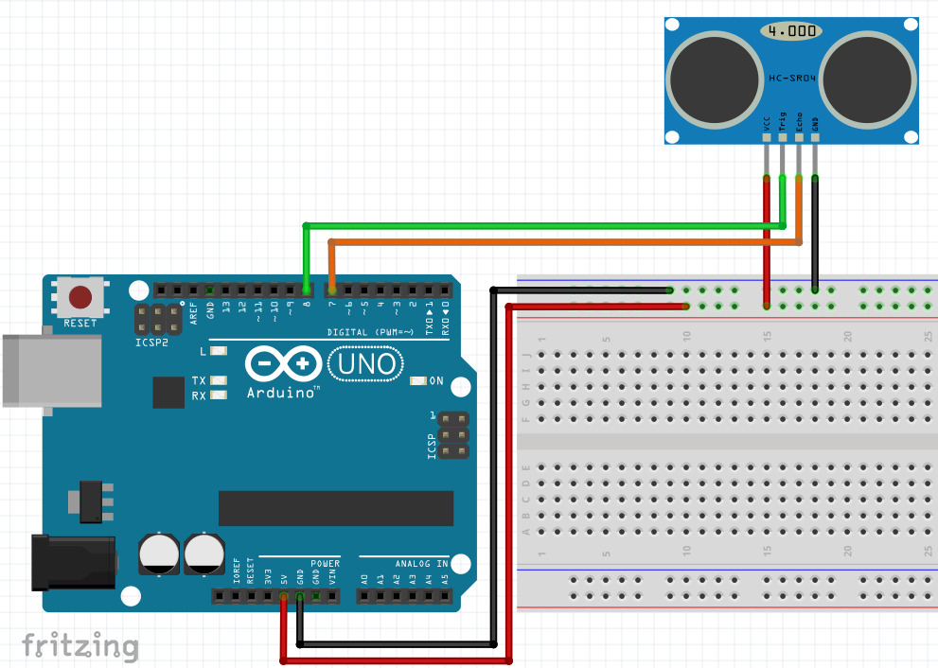
Exercise 23 – Ultrasonic sensor
HC-SR04 has 4 connectors:
VCC – Power
Trig – Trigger
Echo – receive
4 GND – ground
Measuring angle: 15º
Ranging distance: 2cm-4cm

Slide 9
Write the code
void setup() {
Serial.begin(9600);
pinMode(trigPin,OUTPUT); //set the trigger to pulse
pinMode(echoPin, INPUT); //set the echo to read the pulse return
}
float distanceCm(){ //define a new function, in 2 parts, one for the trigger (pulse) and one for the echo (return)
digitalWrite(trigPin, LOW); //set to zero to start
delayMicroseconds(3); //rapid pulses
digitalWrite(trigPin, HIGH);
delayMicroseconds(5);
digitalWrite(trigPin, LOW);
float tUs = pulseIn(echoPin, HIGH);
float t = tUs / 1000.0 / 1000.0 / 2.0; //convert microseconds to seconds
float d = t*v; //distance = time x velocity
return d*100; //to give a result in cm
}
void loop() {
int d=distanceCm();
Serial.println(d, DEC);
delay (200);
}
// Exercise 23
// Sourced from p58 Kimmo and Tero Karvinen, Make: Getting started with sensors, p58
// HC-SR04 Ultrasonic sensor for distance
int trigPin = 8; //When set to HIGH this will trigger the sensor to emit a pulse
int echoPin = 7; //the echo pin will lsiten for the response to the triggers pulse
float v=343.21+0.6*20;
// the speed of sound is 343.21 meters per second at 20 degrees C
// the calc also sets the temp as 20 degrees C
// for a slight gain in accuracy - what is the room temperature and what is the speed of sound at that temp?

Slide 10
Running the code
Teacher can email the code to you
USB key
Copy from screen…
Write, compile, upload…
Open the serial monitor and wave your hand over the sensor
Test it, explore

Slide 11
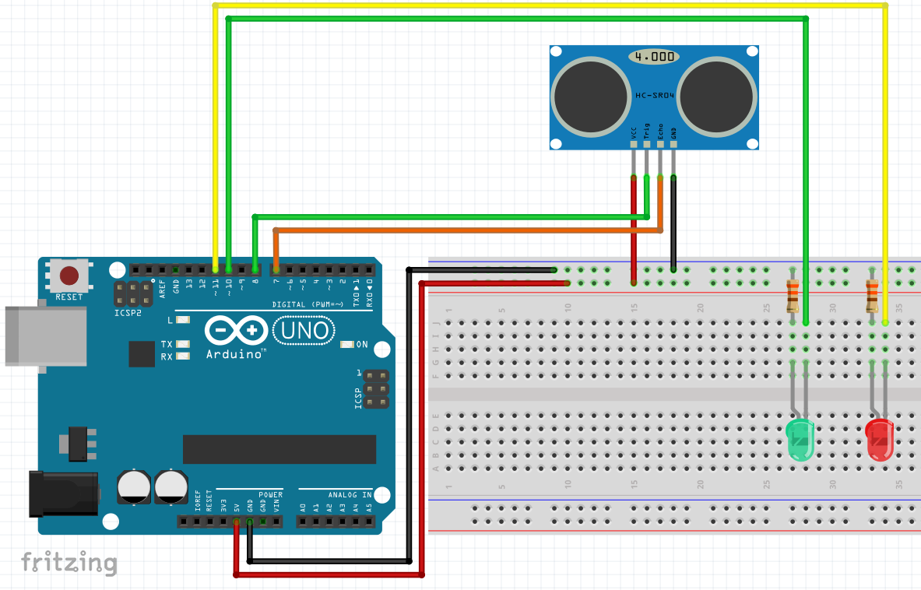
Exercise 24 - Add two LED’s, Stop/Go

Slide 12
The code:
void loop() {
long duration, distance;
digitalWrite(trigPin, LOW);
delayMicroseconds(2);
digitalWrite(trigPin, HIGH);
delayMicroseconds(10);
digitalWrite(trigPin, LOW);
duration = pulseIn(echoPin, HIGH);
distance = (duration/2) / 29.1;
if (distance < 10) { // This is where the LED On/Off happens
digitalWrite(led1,HIGH); // When the Red condition is met, the Green LED should turn off
digitalWrite(led2,LOW);
}
else {
digitalWrite(led1,LOW);
digitalWrite(led2,HIGH);
}
if (distance >= 200 || distance <= 0){
Serial.println("Out of range");
}
else {
Serial.print(distance);
Serial.println(" cm");
}
delay(500);
}
// Exercise 24
// Using HC-SR04 Ping distance sensor to activate 2 LED's
// LED1 = Red on Pin 11, LED2 = Green on Pin 10
#define trigPin 8
#define echoPin 7
#define led1 11
#define led2 10
void setup() {
Serial.begin (9600);
pinMode(trigPin, OUTPUT);
pinMode(echoPin, INPUT);
pinMode(led1, OUTPUT);
pinMode(led2, OUTPUT);
}

Slide 13
Notes on the code
What's different?
What does that mena?
Why?

