Slide 1
Sensors with Arduino
A Microcontroller

Slide 2
Notes
This material has been put together by the Outreach coordinator of the School of Engineering and Computer Studies (SECS) at Victoria University of Wellington (VUW), New Zealand.
It is free to distribute and pass on to all who may find it useful.
The author of this presentation and supporting documents can be reached at: john.barrow@vuw.ac.nz

Slide 3
Learning Objectives
Students can configure and use an IR Sensor and interpret its sensor reading
Students can configure and use a flexiforce sensor

Slide 4
Exercise 20 – IR sensor
Using IR proximity to detect objects

Slide 5
First exploration
<File>, <Examples>, <0.1 Basics>, <AnalogReadSerial>
Then open the serial monitor (which is where?)
Wave your hand over the IR sensor
What do you see?
What does it mean?
How could you use the numbers shown in the serial monitor?

Slide 6
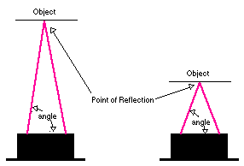
Exploring further
<File>, <Examples>, <0.5 Control>, <IfStatementConditional>
Wave your hand over the IR sensor
What happens?
Why, what range?
Varying the ‘const int threshold’ will vary its sensitivity not its range

Slide 7
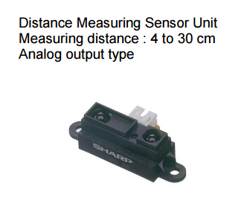
Different types
Check the datasheet for performance
Look up a datasheet online, for example:
http://www.sharp-world.com/products/device/lineup/data/pdf/datasheet/gp2y0a41sk_e.pdf

Slide 8
Exercise 21 - Flexiforce
flexiforce to measure pressure
Open the serial monitor and watch what happens when you flex the sensor

Slide 9
Flexi-force script
/*
Flex Sensor and LEDs created by ScottC on 23rd May 2011
updated on 16/05/2012.
Exercise 21
-----------------------------------------------------*/
//Flex Sensor Pin (flexPin)
//the analog pin the Flex Sensor is connected to
int flexPin = 0;
int flexposition;
void setup() {
for (int i=4; i<14; i++){
pinMode(i, OUTPUT); //sets the led pins 4 to 13 to output
}
}
void loop(){
//Ensure to turn off ALL LEDs before continuing
for (int i=4; i<14; i++){
digitalWrite(i, LOW);
}
Serial.begin(9600);
Serial.println("sensor: ");
Serial.print(flexposition);
flexposition = analogRead(flexPin);
/* Read the flex Level
Adjust the value 130 to 275 to span 4 to 13
The values 130 and 275 may need to be widened to suit
the minimum and maximum flex levels being read by the
Analog pin */
int flexReading = map(analogRead(flexPin), 130, 275, 4, 13);
// int flexReading = map(analogRead(flexPin), 200, 450, 4, 13); authors modified code line
// Make sure the value does not go beyond 4 or 13
int LEDnum = constrain(flexReading, 4, 13);
/*Call the blink function: this will turn the LED on for 10 milliseconds, and keep it
off for only 1 millisecond. You can change the blink rate by changing these values,
however, I want a quick response time when the flex sensor bends, hence the small
values. LEDnum determines which LED gets turned on.*/
blink(LEDnum, 10,1);
}
// The blink function - used to turn the LEDs on and off
void blink(int LEDPin, int onTime, int offTime){
// Turn the LED on
digitalWrite(LEDPin, HIGH);
// Delay so that you can see the LED go On.
delay(onTime);
// Turn the LED Off
digitalWrite(LEDPin, LOW);
// Increase this Delay if you want to see an actual blinking effect.
delay(offTime);
}
http://arduinobasics.blogspot.co.nz/2011/05/arduino-uno-flex-sensor-and-leds.html

Slide 10
What does it work like?
A variable resistor
The more it bends the higher the resistance

Slide 11
Notes on the code
Using the serial monitor:
We need to specify a comm link:
Serial.begin(9600);
Then we need to choose what we print to the serial monitor:
Serial.println("sensor: ");
//println at the end sets a carriage return (new line)
Serial.print(flexposition);
flexposition = analogRead(flexPin);

Slide 12
Alternative exercise – Flex Sensor and Servo
Read through the SIK script
<File>, <Examples>, <SIK_Guide_Code_32>, <Circuit_09>

