Slide 1
Audio tools with Arduino
A Microcontroller

Slide 2
Notes
This material has been put together by the Outreach coordinator of the School of Engineering and Computer Studies (SECS) at Victoria University of Wellington (VUW), New Zealand.
It is free to distribute and pass on to all who may find it useful.
The author of this presentation and supporting documents can be reached at: john.barrow@vuw.ac.nz

Slide 3
Learning Objectives
Students can configure and use Mozzi to extend sound effects with Arduino
Students can configure and use audacity to modify sound files they create

Slide 4
Mozzie
http://sensorium.github.io/Mozzi/

Slide 5
Blurb from the Mozzie web site
Currently your Arduino can only beep like a microwave oven. Mozzi brings your Arduino to life by allowing it to produce much more complex and interesting growls, sweeps and chorusing atmospherics. These sounds can be quickly and easily constructed from familiar synthesis units like oscillators, delays, filters and envelopes.
You can use Mozzi to generate algorithmic music for an installation or performance, or make interactive sonifications of sensors, on a small, modular and super cheap Arduino, without the need for additional shields, message passing or external synths

Slide 6
Libraries
Libraries are a collection of code that makes it easy for you to connect to a sensor, display, module, etc. For example, the built-in LiquidCrystal library makes it easy to talk to character LCD displays. There are hundreds of additional libraries available on the Internet for download. The built-in libraries and some of these additional libraries are listed in the reference. To use the additional libraries, you will need to install them.
Download from Mozzi (top right hand side)
To add a zipped file <Sketch>, <include library>, <add .Zip library>
<Sketch>, <include library>, <Manage Library>, <Mozzi>

Slide 7
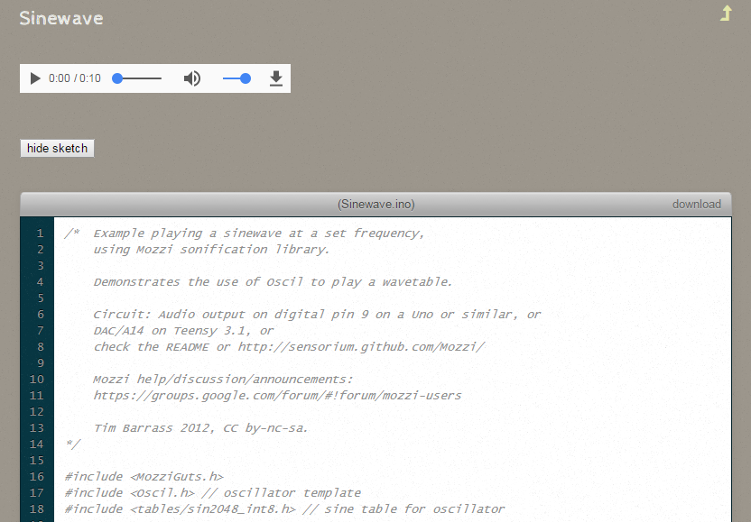
Mozzi web site
Go to examples
Explore some of the sketches

Slide 8
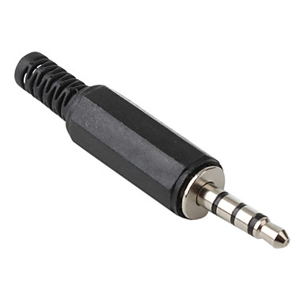
Mozzi output
To hear Mozzi, connect a 3.5mm audio jack with the centre wire to the PWM output on Digital Pin 9 on Arduino, and the ground to the Ground on the Arduino. Use this as a line out which you can plug into your computer and listen to with a sound program like Audacity.

Slide 9
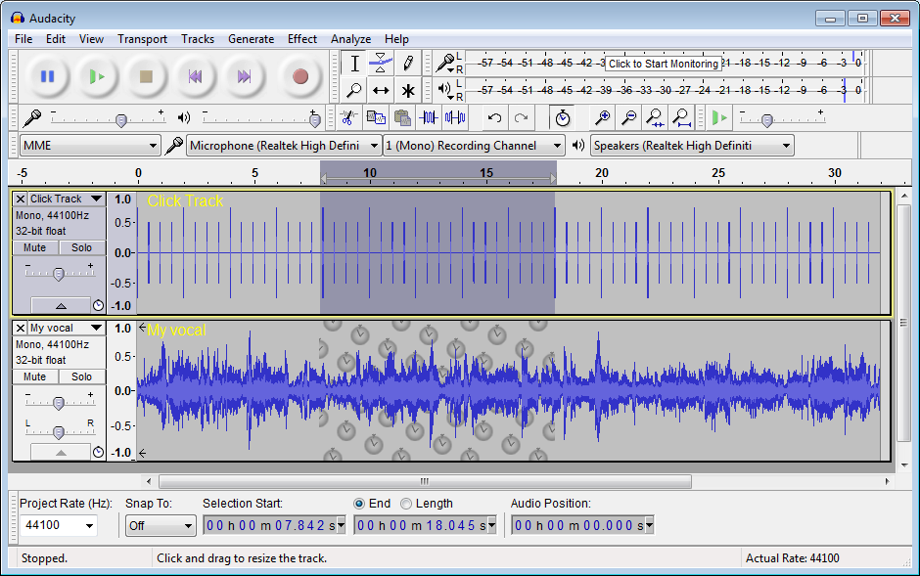
Audacity
http://www.audacityteam.org/

Slide 10
Audacity
With this software you can modify sound files
Use Mozzi to generate sounds
Use Audacity to modify them
Explore, see what you can come up with.
This lesson is more about introducing you to these tools so that if you wish to more in this field you know where to start

