Slide 1
Last of the LED’s and Arduino
A Microcontroller

Slide 2
Notes
This material has been put together by the Outreach coordinator of the School of Engineering and Computer Studies (SECS) at Victoria University of Wellington (VUW), New Zealand.
It is free to distribute and pass on to all who may find it useful.
The author of this presentation and supporting documents can be reached at: john.barrow@vuw.ac.nz

Slide 3
Learning Objectives
Students can configure and use a LDR’s
Students learn that the parameters for the LDR are important
Students can draw comparisons to variable resistors such as Pot’s

Slide 4
Photoresistor (LDR)
LDR – Light Dependant Resistor, also called a photoresistor
They work in a similar fashion to Pot’s (a variable resistor)

Slide 5
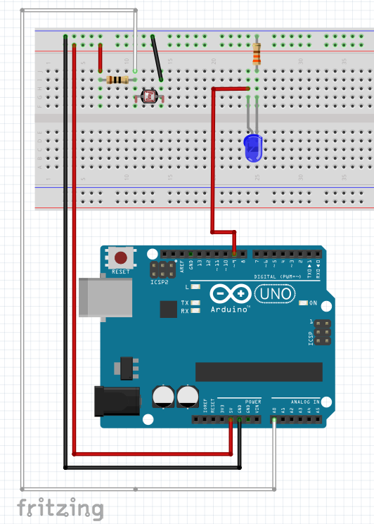
Exercise 15 - LDR circuit
Note that the 2 resistors are different Ω (10K by the LDR and 330 for the LED)
Once you have configured the circuit and uploaded the script place your finger tip over the LDR intermittently
<File>, <Examples>, <SIK_Guide_Code_32>, <Circuit_06>

Slide 6
Notes on the code
Did it work?
I found when I ran this I couldn’t see much difference
To trouble shoot we opened the serial monitor and looked at its readings, so we could see how the LDR responded to touch.
We then added a line of code to improve what was going on
Find this section:
void manualTune()

Slide 7
Add this line:
Read the section, it explains what kind of modifications may be needed and why
Add this:
lightLevel = map(lightLevel, 120, 470, 0, 255);
Comment out the original map
So it looks like:
//lightLevel = map(lightLevel, 0, 1023, 0, 255);
lightLevel = map(lightLevel, 120, 470, 0, 255); //edited version
lightLevel = constrain(lightLevel, 0, 255);

Slide 8
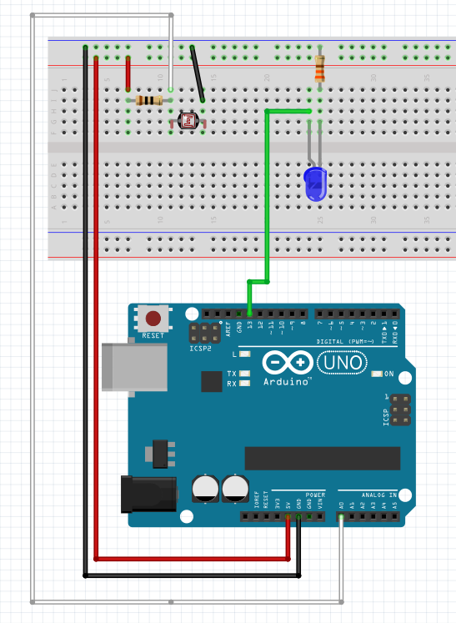
Exercise 16 - LDR flicker
Will write our own script (next slide)

Slide 9
LDR flicker code
// LDR - Exercise 16
// blink faster in the dark and slower in the light
// sourced from p49 Karvinen, Kimmo & Karvinen, Tero. 'Make: Getting started with Sensors'
// This sketch was also used for a pot
// to do so change photoPin to potPin
int photoPin=A0;
int ledPin=13;
int x=-1; //0..1023
void setup() {
pinMode(ledPin, OUTPUT);
}
void loop() {
x=analogRead(photoPin);
digitalWrite(ledPin, HIGH);
delay(x/10);
digitalWrite(ledPin, LOW);
delay(x/10);
}

Slide 10
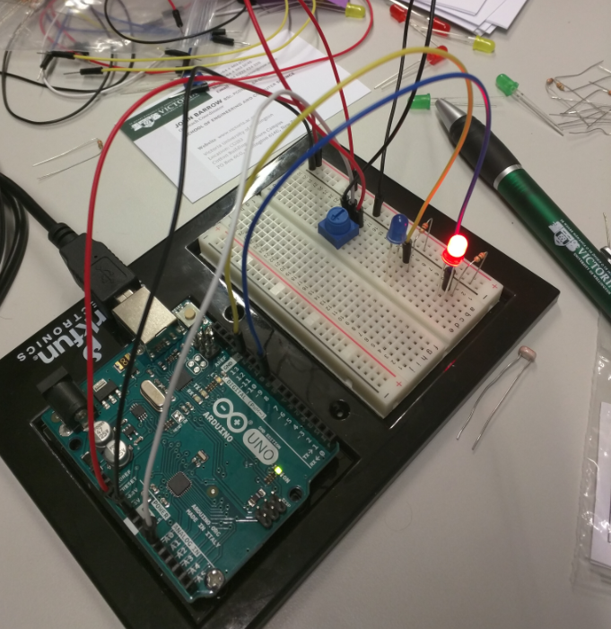
Authors experiment
All circuits in the exercises have been tested
I swapped the LDR for a Potentiometer
10KΩ resistor not required
Shifted the connectors for the pot:
A0 to the Pot centre pin
GND to connector 3 on the pot
5v to connector 1 on the pot
Now the pot adjusts the blink rate
I didn’t change the script
(you could swap photoPin for potPin in the script, but no need – a name is a ‘handle’ for us, the circuit doesn’t care)

