Slide 1
Continuing with LED’s and Arduino
A Microcontroller

Slide 2
Notes
This material has been put together by the Outreach coordinator of the School of Engineering and Computer Studies (SECS) at Victoria University of Wellington (VUW), New Zealand.
It is free to distribute and pass on to all who may find it useful.
The author of this presentation and supporting documents can be reached at: john.barrow@vuw.ac.nz

Slide 3
Learning Objectives
Students can configure and use multiple LED’s with a chase effect (McRoberts project 5 or in this project SIK circuit 4)
Students can configure and use a chase effect using a POT (from a previous lesson)

Slide 4
Exploring concepts – trouble shooting
Check it is plugged in, powered on (connected) and the board type and com port has been set
Blink test – confirms all is good (pin on the PCB will blink, if the LED doesn’t => faulty LED)
LED pins in the right way around?
Then check your physical connections
Make sure components aren’t touching each other and creating short circuits (this often happens with the resistors)
Still not working? Get a working blink test with a resistor and LED – then swap connectors to test them

Slide 5
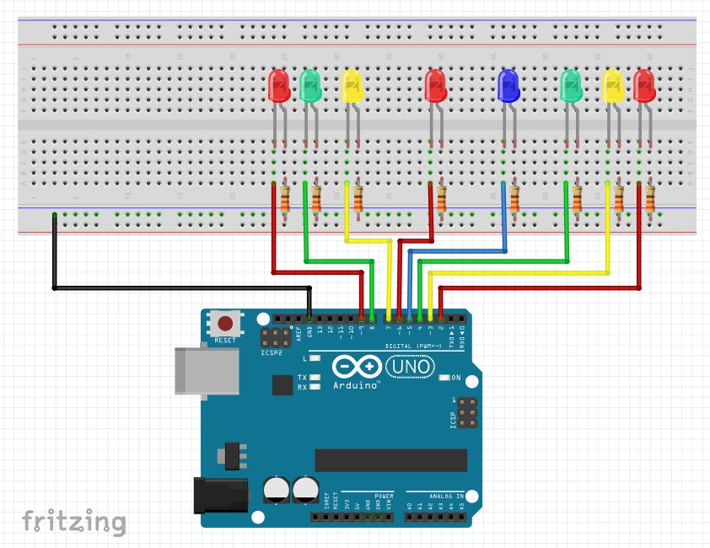
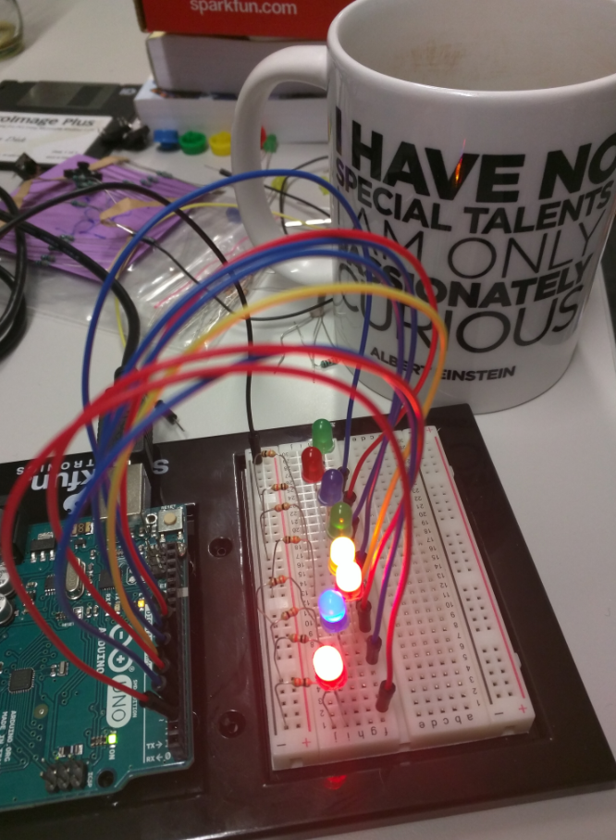
Exercise 13 - Multiple LED’s with chase effect
<File>, <Examples>, <SIK_Guide_Code_32>, <Circuit_04>

Slide 6
Notes on the code
An array lets you store a group of variables (int ledPins[] = {2,3,4,5,6,7,8,9};) creating an index. The index count starts at zero (this is is an index from 0 to 7)
We're using the values in this array to specify the pin numbers that the eight LEDs are connected to. LED 0 is connected to pin 2, LED 1 is connected to pin 3, etc.
Every for() loop has three statements separated by semicolons (;):
Something to do before starting
A test to perform; as long as it's true, keep looping
Something to do after each loop (increase a variable)

Slide 7
Notes on the code
So start at index = 0, add one each loop, when it reaches 8 (as we have 7 in our index) proceed with the next block of code
index++ - after a variable means "add one to it".
for(index = 0; index <= 7; index++) – go up through the LED’s turning on
for(index = 7; index >= 0; index--) – go down through the LED’s turning off

Slide 8
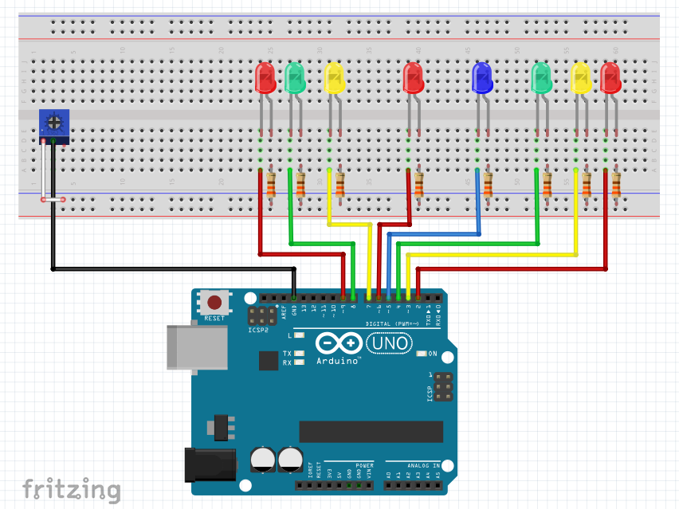
Exercise 14 - Interactive LED Chase effect
Add a Pot
Where do the LED’s draw power from?
Why the digital GND rather than the analog GND?
The Pot is a variable resistor, what is it doing here?

