Slide 1
More on LED’s with Arduino
A Microcontroller

Slide 2
Notes
This material has been put together by the Outreach coordinator of the School of Engineering and Computer Studies (SECS) at Victoria University of Wellington (VUW), New Zealand.
It is free to distribute and pass on to all who may find it useful.
The author of this presentation and supporting documents can be reached at: john.barrow@vuw.ac.nz

Slide 3
Learning Objectives
Students can explain more of the IDE’s tools
Students can configure and use a pull up resistor (button)
Students can configure and two buttons (pull down)
Students can configure and use a button with a traffic light configuration (combining the last lesson and this lesson on buttons)

Slide 4
More on the IDE
As we progress lets explore a few more things about the IDE before moving on
Serial monitor has what is called a ‘baud’ rate, which relates to how many characters it sends
9600 baud = 9600 bits
There is 8 bits (1 byte) per character
So 9600/8 = 1200 bytes or characters per second
Before the routers we use in our homes we had modems (MOdulator DEMmodulator’s) which worked like phones dialling up connections, this is what the serial monitor is using to connect.

Slide 5
IDE – tools menu
Autoformat in the tools menu colour codes your sketch to help you trouble shoot it
Archive sketch in the tools menu compresses the file in a ZIP format
Burn bootloader in the tools menu we can use, when connecting with the ISCP pins, to permanently burn the code to the chip
Why would burn a chip in and do this? This leads to…
Library – a collection of code you can include in your sketch to enhance the functionality of your project (we will start using more libraries later).

Slide 6
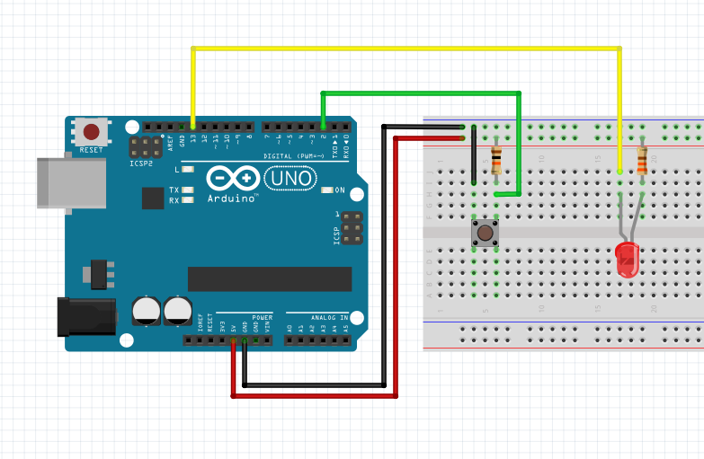
Exercise 10 - Push Button (Pull up resistor)
<File>, <examples>, <0.2 digital>, <button>

Slide 7
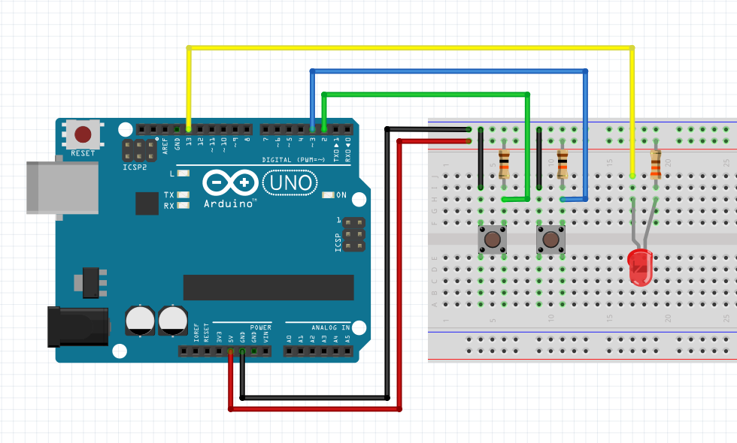
Exercise 11 - Push Buttons
<File>, <Examples>, <SIK_Guide_Code_32>, <Circuit_05>

Slide 8
The code, note this…
// check if the pushbutton is pressed.
// if it is, the buttonState is HIGH:
if (buttonState == HIGH) {
// turn LED on:
digitalWrite(ledPin, HIGH);

Slide 9
Notes on concepts in the code:
A == B means "EQUIVALENT". This is true if both sides are the same.
A && B means "AND". This is true if both sides are true.
A || B means "OR". This is true if either side is true.
!A means "NOT". This makes anything after it the opposite (true or false).

Slide 10
Buttons
A button is a tactile switch, which ca be a pull up or pull down resistor
Pull down – when the button is pushed the electricity takes the path of least resistance (there is 2 resistors in a button, one with a much higher resistance than the other) and 5v passes through, otherwise it will ground and you get 0v
Pull up – press the button it will ground = 0v
We have used these already – the Arduino has built in 20kΩ resistors on the pin connections which we activate with software;
To activate an internal pull-up we set pinMode to and INPUT and set it to HIGH with a digitalWrite

Slide 11
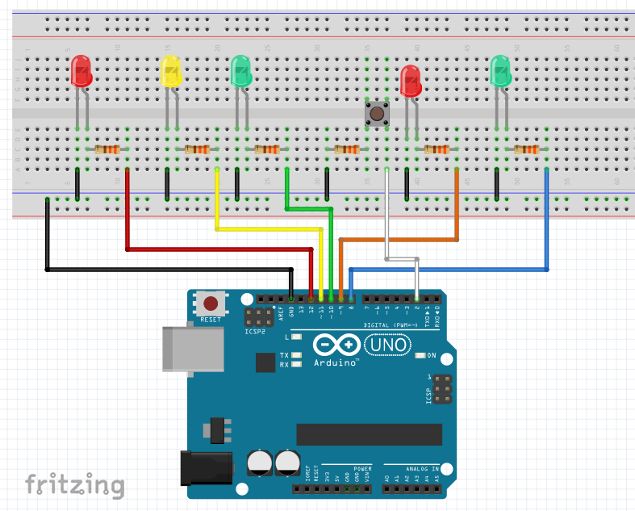
Exercise 12 - Traffic light with button

Slide 12
Traffic light with button Script
//Exercise 12 - Traffic light with button
// Sourced from McRoberts, Michael. 'Beginning Arduino. 2nd Ed.' Project 4
int carRed = 12; // assign the car lights
int carYellow = 11;
int carGreen = 10;
int pedRed = 9; // assign the pedestrian lights
int pedGreen = 8;
int button = 2; // button pin
int crossTime = 5000; // time alloyoud to cross
unsigned long changeTime; // time since button pressed
void setup() {
pinMode(carRed, OUTPUT);
pinMode(carYellow, OUTPUT);
pinMode(carGreen, OUTPUT);
pinMode(pedRed, OUTPUT);
pinMode(pedGreen, OUTPUT);
pinMode(button, INPUT); // button on pin 2
// turn on the green light
digitalWrite(carGreen, HIGH);
digitalWrite(pedRed, HIGH);
}
void loop() {
int state = digitalRead(button);
/* check if button is pressed and it is over 5 seconds since last button press */
if (state == HIGH && (millis() - changeTime) > 5000) {
// Call the function to change the lights
changeLights();
}
}
void changeLights() {
digitalWrite(carGreen, LOW); // green off
digitalWrite(carYellow, HIGH); // yellow on
delay(2000); // wait 2 seconds
digitalWrite(carYellow, LOW); // yellow off
digitalWrite(carRed, HIGH); // red on
delay(1000); // wait 1 second till its safe
digitalWrite(pedRed, LOW); // ped red off
digitalWrite(pedGreen, HIGH); // ped green on
delay(crossTime); // wait for preset time period
// flash the ped green
for (int x=0; x<10; x++) {
digitalWrite(pedGreen, HIGH);
delay(250);
digitalWrite(pedGreen, LOW);
delay(250);
}
// turn ped red on
digitalWrite(pedRed, HIGH);
delay(500);
digitalWrite(carYellow, HIGH); // yellow on
digitalWrite(carRed, LOW); // red off
delay(1000);
digitalWrite(carGreen, HIGH);
digitalWrite(carYellow, LOW); // yellow off
// record the time since last change of lights
changeTime = millis();
// then return to the main program loop
}

Slide 13
Notes on the code:
More on int’s:
Unsigned long changeTime – This is a data type variable as we need a wider range of numbers than an integer can give us on an Arduino.
Why use different ones? They take up differing amounts of memory in the Arduino and we are limited in how much memory we have
Atmega 168 has 1KB, ATmega328 has 2Kb of SRAM
Integer can go from -32,768 to 32,767
An unsigned long can go from -2,147,483,648 to 2,147,483,647
What types of data variables are there? See the table…

Slide 14
Data Type | RAM | Number Range
Void keyword | N/A | N/A
Boolean | 1 byte | 0 to 1 (True/false)
Byte | 1 byte | 0 to 255
Char | 1 byte | -128 to 127
Unsigned char | 1 byte | 0 to 255
Int | 2 byte | -32768 to 32767
Unsigned int | 2 byte | 0 to 65535
Word | 2 byte | 0 to 65535
Long | 4 byte | -2147483648 to 2147483647
Unsigned long | 4 byte | 0 to 4294967295
Float | 4 byte | -3.4028253E+38 to 3.4028235E+38
Double | 4 byte | -3.4028253E+38 to 3.4028235E+38
String | 1 byte + x | Array of chars
array | 1 byte + x | Collection of variables

