Slide 1
Exploring lighting effects with LED’s and Arduino
A Microcontroller

Slide 2
Notes
This material has been put together by the Outreach coordinator of the School of Engineering and Computer Studies (SECS) at Victoria University of Wellington (VUW), New Zealand.
It is free to distribute and pass on to all who may find it useful.
The author of this presentation and supporting documents can be reached at: john.barrow@vuw.ac.nz

Slide 3
Learning Objectives
Students can explain the basic concepts of random number generation, seeds, increments & constrains
Students can explore colour outputs based on RGB tones from 0 to 255

Slide 4
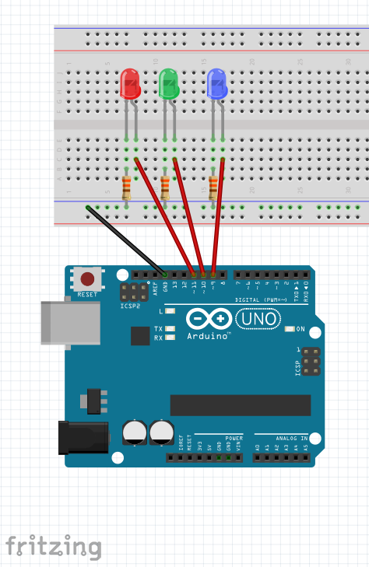
Exercise 8 - RGB Mood lamp
Try a white paper cylinder around the
LED’s for a better visual effect
(maybe even put some pictures on it,
or cut some shapes into it)

Slide 5
RGB Mood lamp script
//Exercise 8 RGB Mood lamp
// Sourced from McRoberts, Michael. 'Beginning Arduino. 2nd Ed.' Project 8
float RGB1[3];
float RGB2[3];
float INC[3];
int red, green, blue;
int RedPin = 11
int GreenPin = 10
int BluePin = 9
void setup() {
randomSeed(analogRead(0));
RGB1[0] = 0;
RGB1[1] = 0;
RGB1[2] = 0;
RGB2[0] = random(256);
RGB2[1] = random(256);
RGB2[2] = random(256);
}
void loop() {
randomSeed(analogRead(0));
for (int x=0; x<3; x++) {
INC[x] = (RGB1[x] - RGB2[x])/256; }
for (int x=0; x<256; x++) {
red = int(RGB1[0]);
green = int(RGB1[1]);
blue = int(RGB1[2]);
analogWrite (RedPin, red);
analogWrite (GreenPin, green);
analogWrite (BluePin, blue);
delay(100);
RGB1[0] -= INC[0];
RGB1[1] -= INC[1];
RGB1[2] -= INC[2];
for (int x=0; x<3; x++) {
RGB2[x] = random(556)-300;
RGB2[x] = constrain(RGB2[x], 0, 255);
delay(1000);
}
}

Slide 6
Notes on the RGB script
randomSeed create a random number (Arduino’s however are bad at this, its not so random, a short coming of being a digital computer).
The ‘seed’ sets a starting point to start counting from (in this case uses random noise on pin A0)
Once we have a ‘seed’ we use the random function to generate a number from 0 to 255 (or any number range we set)
INC – increment, to gradually change the values
Colours – we use RGB for computer and TV screens

Slide 7
Colours
Red | Green | Blue | Colour
255 | 0 | 0 | Red
0 | 255 | 0 | Green
0 | 0 | 255 | Blue
255 | 255 | 0 | Yellow
0 | 255 | 255 | Cyan
255 | 0 | 255 | Magenta
255 | 255 | 255 | White

Slide 8
Notes on the code
Once we have a colour we need to make sure it isn’t a faded colour
Random(556)-300 – We are trying to force primary colours so as to avoid washed out shades
Constrain(RGB2[x], 0, 255)); - this constrains the results of the above line to a range of 0 to 255 (no negatives) tp push it back into the visible range of colours we want

Slide 9
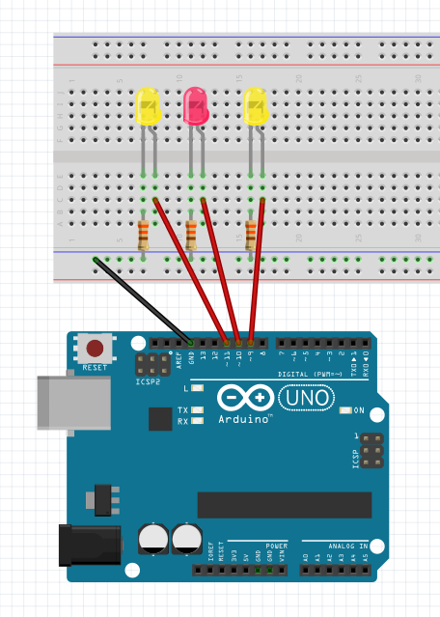
Exercise 9 - LED Fire effect

Slide 10
Fire effect script
// Exercise 9 - Fire effect
// Sourced from McRoberts, Michael. 'Beginning Arduino. 2nd Ed.' Project 9
int ledPin1 = 9;
int ledPin2 = 10;
int ledPin3 = 11;
void setup()
{
pinMode(ledPin1, OUTPUT);
pinMode(ledPin2, OUTPUT);
pinMode(ledPin3, OUTPUT);
}
void loop()
{
analogWrite(ledPin1, random(120)+135);
analogWrite(ledPin2, random(120)+135);
analogWrite(ledPin3, random(120)+135);
delay(random(100));
}

Slide 11
Notes on the code:
Random(120)+135 -> this gives us a random value, plus a value to ensure that the LED’s are bright
The delay in milliseconds is also random, between ON and 100ms to create the flicker effect

