Slide 1
Exploring more with LED’s and Arduino
A Microcontroller

Slide 2
Notes
This material has been put together by the Outreach coordinator of the School of Engineering and Computer Studies (SECS) at Victoria University of Wellington (VUW), New Zealand.
It is free to distribute and pass on to all who may find it useful.
The author of this presentation and supporting documents can be reached at: john.barrow@vuw.ac.nz

Slide 3
Prior knowledge (Year 10 science)
Voltage, Current, Resistance and Ohm’s law
https://learn.sparkfun.com/tutorials/voltage-current-resistance-and-ohms-law
What is a circuit
https://learn.sparkfun.com/tutorials/what-is-a-circuit
Working with wire
https://learn.sparkfun.com/tutorials/working-with-wire
Reading schematics
https://learn.sparkfun.com/tutorials/how-to-read-a-schematic

Slide 4
Learning Objectives
Students can identify and understand resistors
Students can use three different lighting effects:
A simple traffic light
Explore PWM which is used in the next lesson

Slide 5
Exploring a relevant topic; resistors
Resistors (revision of Year 10 electronics)
What do they do?
Colour coded so we can read them
K = kilo = 1,000 (thousand)
M = mega = 1,000,000 (million)
Tolerance = how accurate
What happens when they ‘resist’ = energy given off as heat
Think of it as approximately a pipe that restricts how much voltage can flow through a circuit

Slide 6
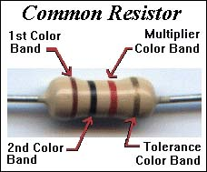
The Gold or Silver band is always set to the right, then you read from left to right. Sometimes there will be no tolerance band -- simply find the side that has a band closest to a lead and make that the first band.
Tolerance Rating
Red = 2%
Gold = 5%
Silver = 10%
No band = 20%
So gold band to the right, then read it: Brown, Black, Red, Gold:
So the maths is first digit, second digit, third digit (if noted) with the multiplier being the number of zero’s….
1, 0, 100, 5% tolerance = 1000 Ω (or 1K Ω)

Slide 7
The rules for reading resistors
Orient the resistor so you can read the stripes properly.
You should read the stripes from left to right.
If noted, set the tolerance band (gold or silver normally) to the right.
No tolerance band? - the first stripe is the one that's closest to one end of the resistor (often it is thicker). If this stripe is on the right side of the resistor, turn the resistor around so the first stripe is on the left.
Look up the color of the first stripe to determine the value of the first digit.
Look up the color of the second stripe to determine the value of the second digit.
Look up the color of the third stripe to determine the multiplier.
Multiply the two-digit value by the multiplier to determine the resistor's value.

Slide 8
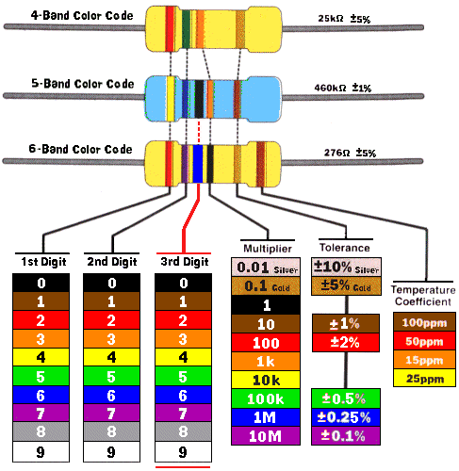
2, 5, x1000, ± 5% = 25kΩ
4, 6, 0 x1000, ± 1% = 460kΩ
2, 7, 6, x1, ± 5% = 276Ω

Slide 9
Get an APP calculator!
Electrodroid (Android, Windows, Blackberry phones)
http://electrodroid.it/electrodroid/
iCircuit
http://icircuitapp.com/

Slide 10
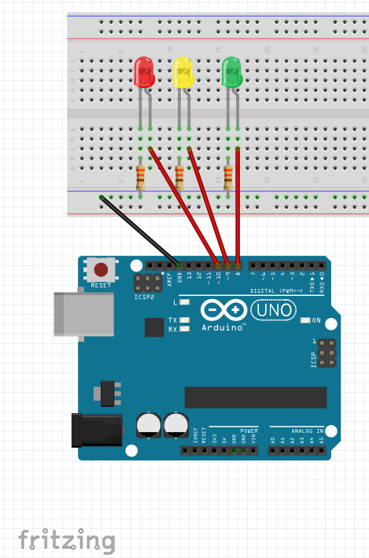
Exercise 6 - Simple Traffic light

Slide 11
Simple Traffic lights script
//Exercise 6 - Simple Traffic light
// Next lesson will add a button to this, for a pedestrian crossing type of effect
// Sourced from McRoberts, Michael. 'Beginning Arduino. 2nd Ed.'
int ledDelay = 10000; //delay between changes
int redPin = 10;
int yellowPin = 9;
int greenPin = 8;
void setup() {
pinMode(redPin, OUTPUT);
pinMode(yellowPin, OUTPUT);
pinMode(greenPin, OUTPUT);
}
void loop() {
digitalWrite(redPin, HIGH); //turn the light red on
delay(ledDelay); //wait 10 seconds as per the ledDelay time
digitalWrite(yellowPin, HIGH); //turn the yellow on
delay(2000); //wait 2 seconds
digitalWrite(greenPin, HIGH); //turn the green on
digitalWrite(redPin, LOW); //turn the red off
digitalWrite(yellowPin, LOW); //turn the yellow off
delay(ledDelay); //delay in milliseconds
digitalWrite(yellowPin, HIGH); //turn the yellow on
digitalWrite(greenPin, LOW); //turn the green off
delay(2000); //delay in milliseconds for 2 seconds
}

Slide 12
Notes on the code:
Basically an expanded and more complicated Blink sketch
We use ‘int’ (integers) to set names for things
We then call those ‘int’ names in the code later

Slide 13
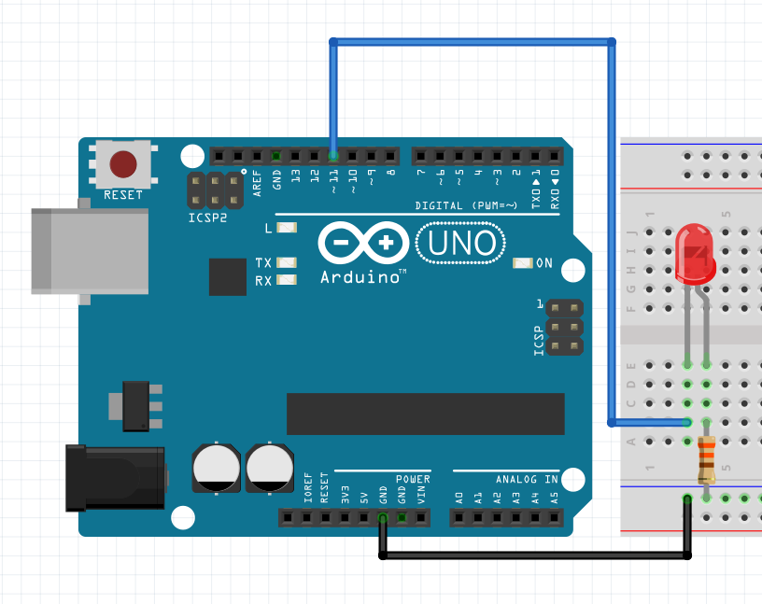
Exercise 7 - PWM – Pulse with Modulation
Note: we are using Pin 11
It is noted with a ~
This is a PWM connector
Out of Pins 8-13 which ones could we use?

Slide 14
PWM script
//Exercise 7 using PWM (Pulse width modulation)
// Sourced from McRoberts, Michael. 'Beginning Arduino. 2nd Ed.' project 7 Pulsating lamp
int ledPin =11;
float sinVal;
int ledVal;
void setup() {
pinMode(ledPin, OUTPUT);
}
void loop() {
for (int x=0; x<180; x++) {
//convert degrees to radians then obtain a Sin value
sinVal = (sin(x*(3.1412/180))); //note the value for Pi for converting to radians
ledVal = int (sinVal*255); //note the 255 for converting to computer binary based numeracy
analogWrite(ledPin, ledVal);
delay(25);
}
}

Slide 15
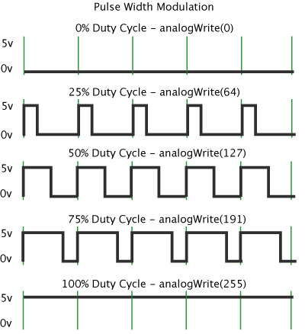
Notes on the code:
PWM - Pulse Width Modulation, or PWM, is a technique for getting analogue results with digital means.
https://www.arduino.cc/en/Tutorial/PWM
A call to analogWrite() is on a scale of 0 - 255, such that analogWrite(255) requests a 100% duty cycle (always on)

Slide 16
Notes on the code:
Float – floating point data type (more on this 2 lessons)
Sinval – Sine wave value
Sin() is an inbuilt mathematical function for the Arduino
Ledval – will hold the integer value to send out to the PWM pin (which pin?)
We need to ‘cast’ the floating point into an integer, basically we drop the decimal places
A very short delay time means it appears continuous to the human eye

