Slide 1

Raspberry Pi
A microcontroller
Raspberry Pi 2 Model B V1.1
RPi

Slide 2
Computer in your hand
A microcontroller (sometimes abbreviated µC, uC or MCU) is a small computer on a single integrated circuit containing a processor core, memory, and programmable input/output peripherals. The majority of microcontrollers in use today are embedded in other machinery, such as automobiles, telephones, appliances, and peripherals for computer system.
A system on a chip (SoC) combines the required electronic circuits of various computer components onto a single, integrated chip (IC).
The difference between a SoC and a microcontroller often times is defined by the amount of random access memory (RAM).
A SoC is capable of running its own operating system.
Sooner or later you just need more power! (Arduino vs RPi)

Slide 3
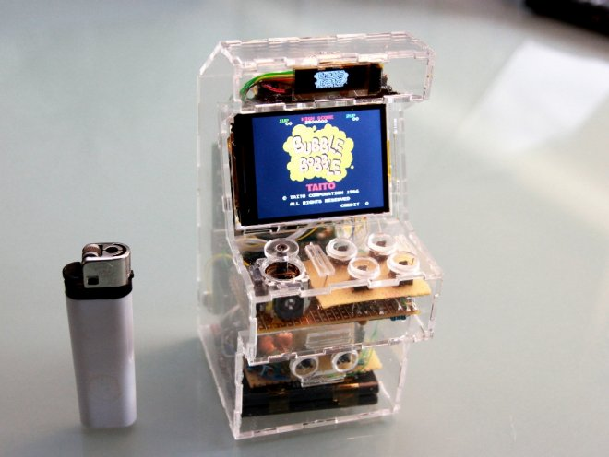
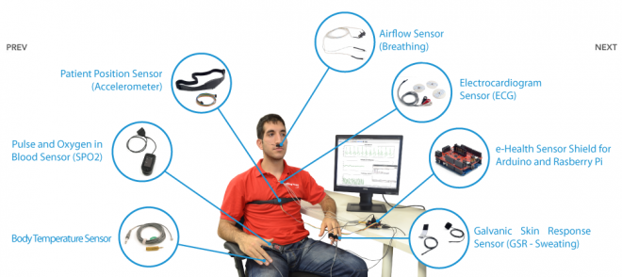
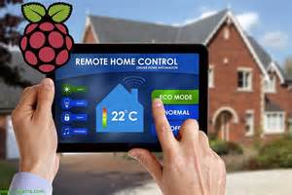
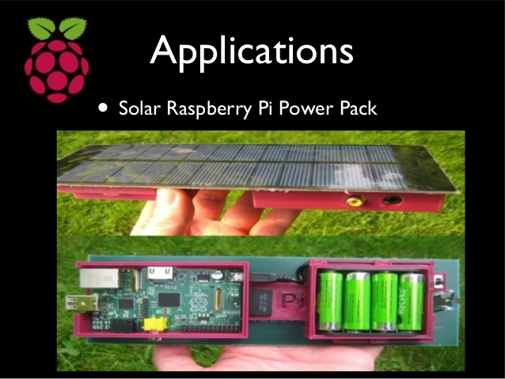
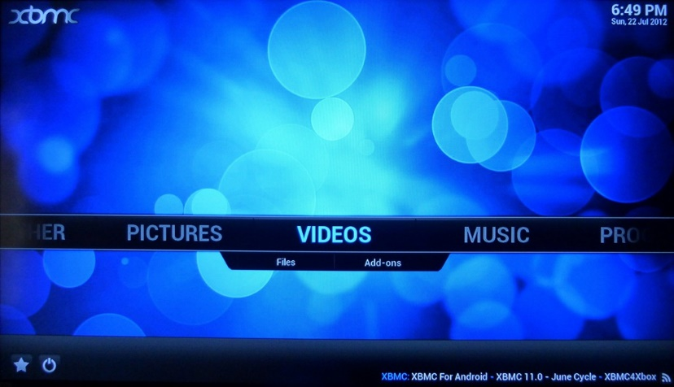
What can I do with rpi?

Slide 4
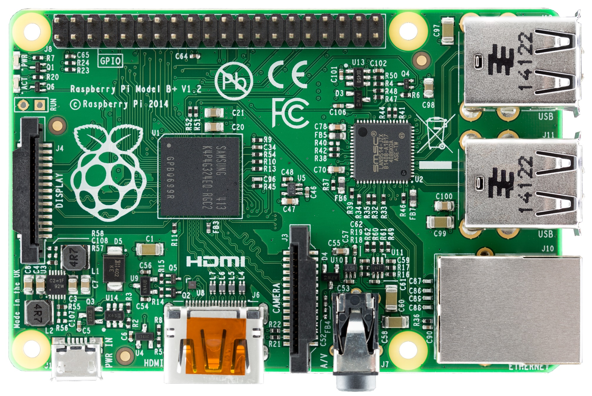
40 GPIO (Input /Output)
SOC – System On a Chip
(Broadcom BCM2836) + 1GB RAM
Mounting hole
SMSC LAN9514 USB Ethernet controller
Power & activity LED’s
Close RUN header to reset Pi
4 USB ports
DSI Display Connector
SD Card (underneath)
Switching regulator for less power consumption
10/100 T Base Ethernet port
Power - Micro USB 5v
HDMI Digital video out
CSI Camera Connector
4 Pole 3.5mm jack
(stereo audio & composite video)

Slide 5
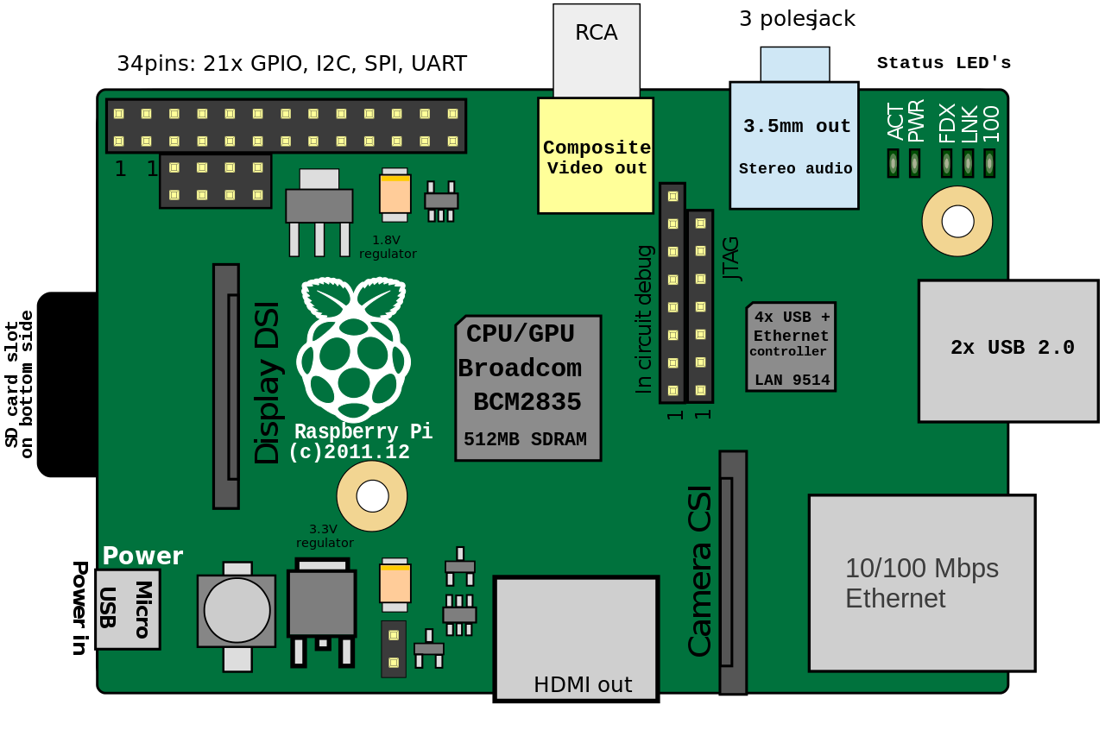
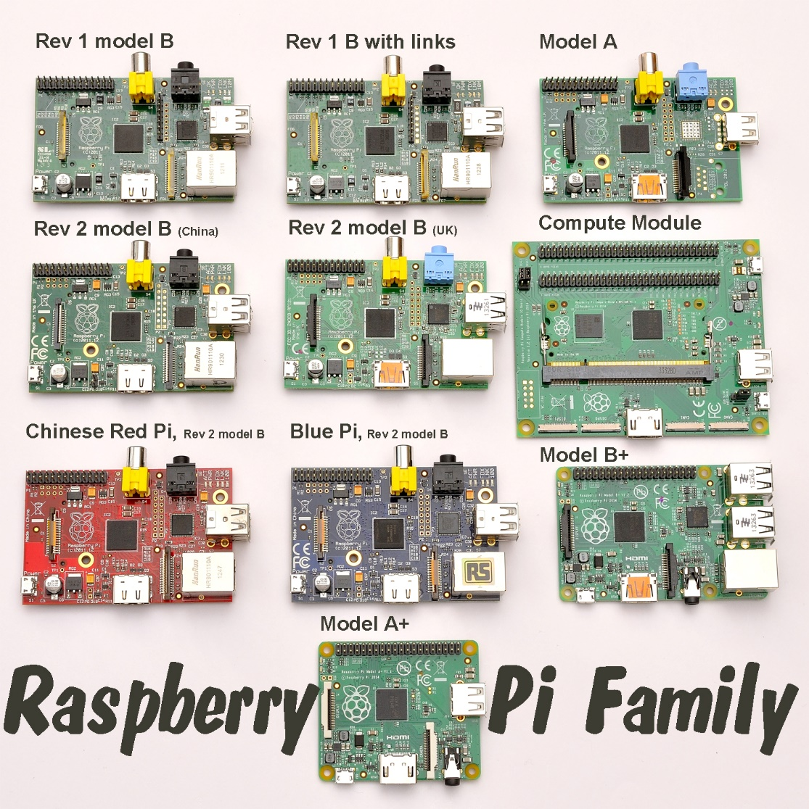
Older Pi models

Slide 6
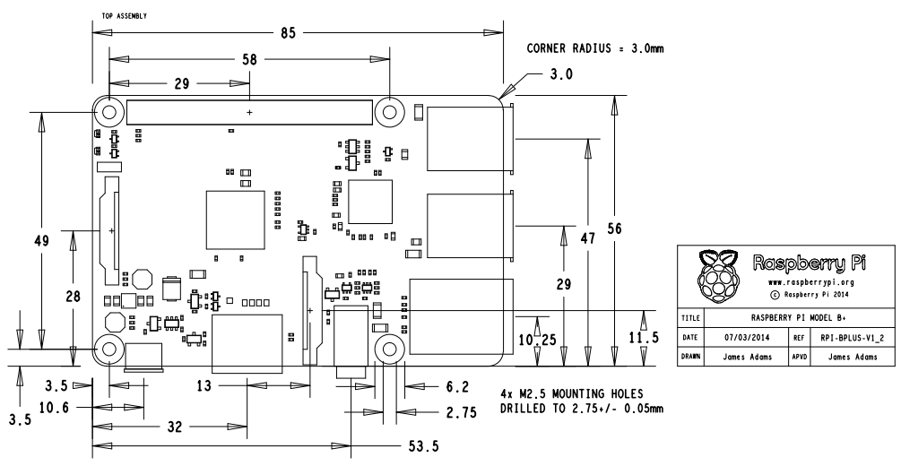
85mm x 56mm

Slide 7
Power
Can be powered by 4 AA batteries
We recommend rechargeable batteries
They produce less voltage and better meet the power feed requirements of the RPi

Slide 8
Starting it up
Insert prepared SD card (already done) with OS installed
Connect HDMI to monitor
Connect RCA if HDMI not available
Connect a USB keyboard and mouse
Connect to a network (Ethernet or wireless USB)

Slide 9
login
Standard user = pi
Standard password = raspberry

Slide 10
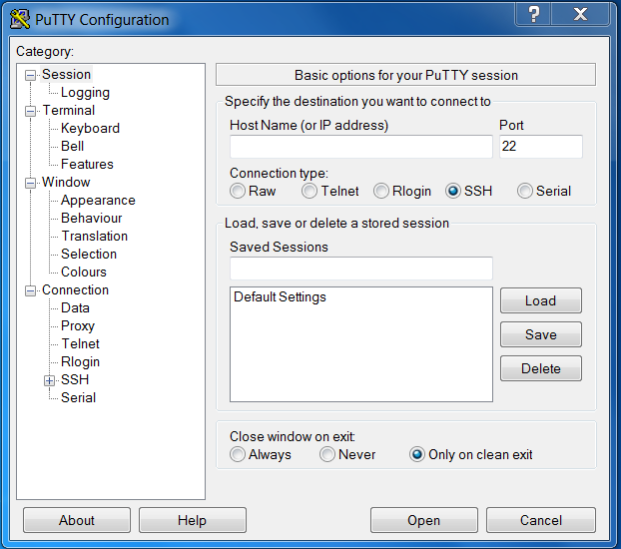
Connecting to the RPi

Slide 11
Enable ssh
Enter sudo raspi-config in the terminal
Then navigate to ssh
Hit Enter and select Enable or disable ssh server.

Slide 12
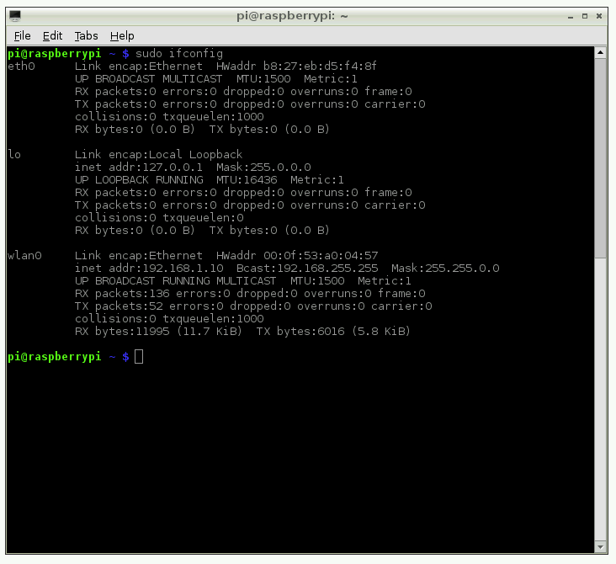

Where’s my pi?
Find out the IP address of your Raspberry. In case you have access to the console you can also type the following command:
sudo ifconfig
Fing

Slide 13








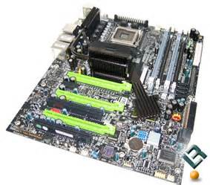

So what are we looking at?
The Desktop environment
The Shell
Kernel
Applications

Slide 14
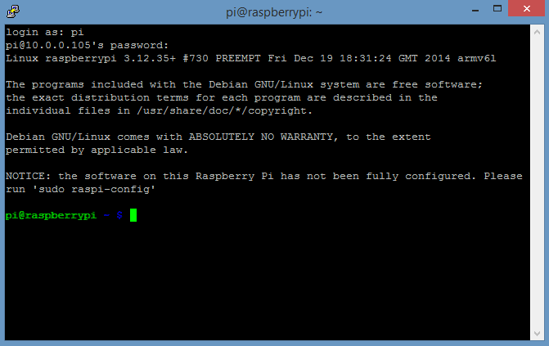
The Shell, or Bash:
Born Again SHell
Logged in as user ‘pi’
Logged into this host
Home directory (~)
Ordinary user
LXTerminal

Slide 15
Directory Tree
/
bin
boot
dev
etc
home
lib
Lost+found
media
mnt
opt
proc
root
run
sbin
selinux
srv
sys
temp
usr
var
Selinux – security enhanced Linux
srv – sometimes used for storing data (like for FTP)
sys – used for Linux OS files
temp – temporary files
usr – for standard users for programs and files
var – files that vary in size (like DB and logs)
Media – for managing removable storage devices
mnt – for managing removable storage devices that you mount
opt – optional software
proc – processes used by the Linux kernal
root – root user directory (top level admin)
Run – programs store data here for ready recall
sbin – software reserved for the root user
Bin – binaries – small programs that behave like commands in the shell
Boot – Linux kernel – heart of the OS
Dev – devices – a list of devices
Etc – various configuration files for all users
Home – directory for each user
Lib – libraries – used by different programs
Lost+found – corrupted files

Slide 16
Moving around in the directory structure
Absolute and relative paths
cd (change directory)
Relative path is like giving directions (refers to a subdirectory)
An absolute path is like giving a street address
cd [option] [directory]
cd /home/pi (absolute path, relative to root)
cd ~ (home directory, relative to home location)
cd ../../boot
cd.. (close directory)
cd – (go to previous directory)

Slide 17
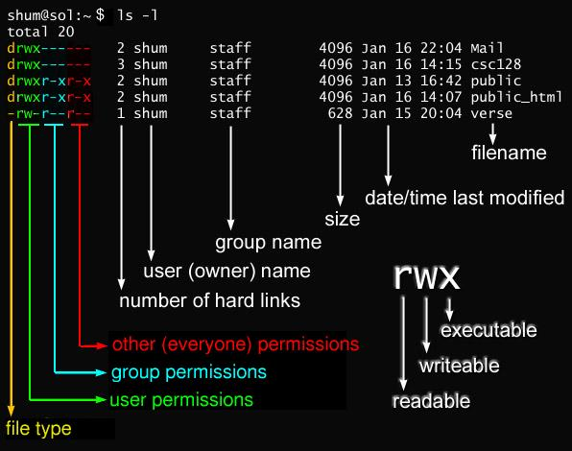
Command lines
Command –options argument (pi@raspberrypi ~ ls –X ~/python_games)
ls – to list directories and files
Remember this one:
ls –lh (list, long, human)

Slide 18
Command lines for ls
-1 = results in a single column instead of a row
-a = display all (including hidden)
-F = put a symbol beside the filename to indicate file type
-h = long format (human readable)
-l = long format
-m = list separated by comma’s
-R = recursive (show directories and contents as well)
-r = display in reverse alphabetical order
-S = sort results by size
-t = sort by date and time last modified
-X = sort by file extension

Slide 19
Moving around
CTRL + C (end task)
Autocomplete with the [TAB] key
↑↓ to cycle through previous commands you have entered
Turn screen output into a file using the > symbol (use >> to add something to an existing file)
Echo (displays whatever you write after it on screen, use $ to solve maths equations), date, cal

Slide 20
Exercise
echo I made this file on > testfile.txt
date >> testfile.txt
cal >> textfile.txt
echo $((8+30+31+30+17)) Days until my Birthday! >> testfile.txt
Less testfile.txt
Note: keep names simple (capitals, hyphens, symbols can all have meanings)

Slide 21
More commands
Mkdir (make directory, can do multiple –p option to make a folder in a folder, -v for verbose)
Rm (remove directory, -i for interactive = Y/N for each file, -R for recursive, -f for force)
*.txt or testfi*= wildcard
[] to match characters (e.g. [abc]*, [^abc]*, [a-c]*, photo[4-9].jpg)
cp (copy paste)
mv (move, also = rename)
Cat (list the content of files)
wc (word count) – gives # of lines, # of words, # of characters

Slide 22
Is your software up-to-date?
Sudo = Super User DO
Root can be considered a security risk/hole
Package manager is called apt in the shell
sudo apt-get update
sudo apt-cache search games | less
sudo apt-get install name
Help can be found in many places… try type, help, man (manual), apropos, whatis, info
https://wiki.debian.org/ShellCommands
https://www.raspberrypi.org/documentation/usage/terminal/

Slide 23
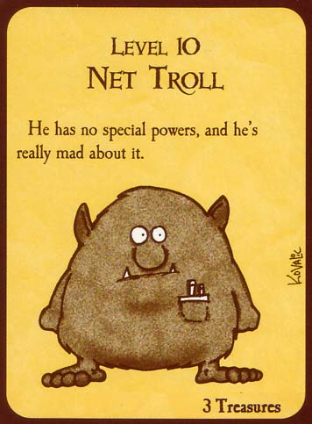

Trolled….
Watch out for:
rm –Rf /*

Slide 24
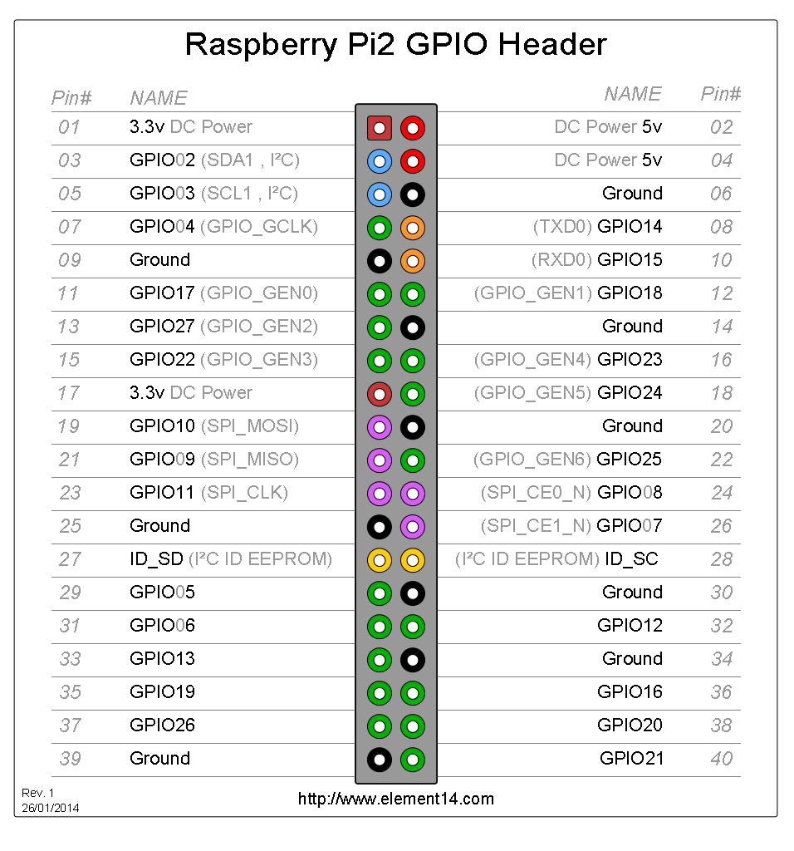

Slide 25
Title and Content Layout with Chart

Slide 26
Two Content Layout with Table
 | Group A | Group B
Class 1 | 82 | 85
Class 2 | 76 | 88
Class 3 | 84 | 90
First bullet point here
Second bullet point here
Third bullet point here

Slide 27
Two Content Layout with SmartArt
First bullet point here
Second bullet point here
Third bullet point here
Group A
Task 1
Task 2
Group B
Task 1
Task 2
Group C
Task 1

