Slide 1
Networking
An introduction to working on the web

Slide 2
Teacher notes
Aimed at Year 12-13
Not curriculum linked
Prior learning/knowledge: none
Learning objectives/outcomes:
Students understand that all devices have a unique physical address – MAC
This is linked to an IP address, that TCP/IP has a suite of tools (such as HTTP)
What is a gateway?
What does DNS do? Why?
Limits of TCP/IP v4, an awareness of NAT and DHCP, why LAN groups?
Why firewalls and software updates
Understanding some basic tools, such as ipconfig and ping
This is a large number of learning objectives, therefore consider this an introduction and thus not currently integrated into a proper lesson and plan

Slide 3
Advanced organiser/resources
Computer access
Web access
Permissions to use command line tools
Whiteboard (to draw up network as you go)
Pad and paper for students to map out their own network

Slide 4
Turn it on….
Electronic devices talk to each other
How do they know who to talk to? How to find them? What to say to get the answer they are seeking?
We use a combination of things:
A hardware address
An Internet Protocol address
We use a common language – TCP/IP

Slide 5
What is a Computer Address?
Every electronic device that connects to a network has a unique identifier
The device uses a NIC (Network Interface Card)
Hard coded to your NIC is a unique identifier. This is your MAC address (Media Access Control), a 16 digit identifier
34-E6-D7-3D-33-CC (hexadecimal)
A MAC has an Organizationally Unique Identifier (QUI) well-known manufacturers at the star, some are:
Dell: 00-14-22 Nortel: 00-04-DC Cisco: 00-40-96 Belkin: 00-30-BD

Slide 6
More on the MAC:
MAC is also called:
The Burned In Address (BIA)
Hardware Address
Physical Address

Slide 7
TCP/IP
ARP (address resolution Protocol) translates between your MAC and you IP Address
What is your IP address?
Internet Protocol (IP)
Transmission Control Protocol (TCP)
IP just sends the message out, doesn’t care if you get it all (uses UDP)
TCP has a parity check to make sure you got all the information sent

Slide 8
TCP/IP and MAC
So now our computer device has a link between its physical address and one for talking on a network.
Most devices uses TCP/IP today
There used to be a number of protocols in common use, not so much anymore (NETBEUI, WINS, NWLink, IPX/SPX, XNS…)

Slide 9
Why TCP/IP?

Slide 11
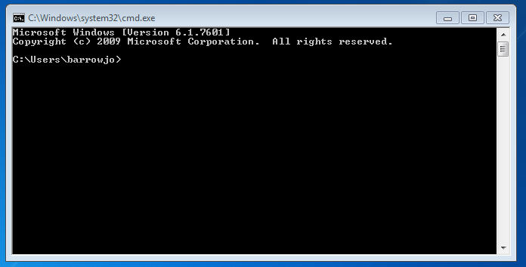
ARRRGGGHHH! Enough! Lets do….
Bring up the command line/DOS prompt (start, type in cmd, open)

Slide 12
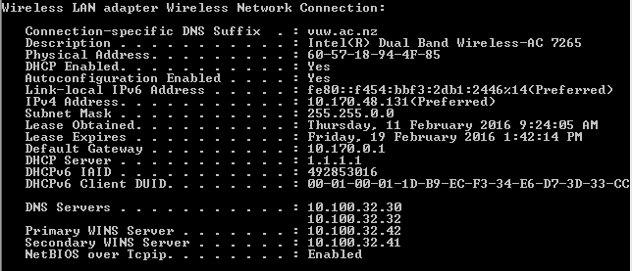
ipconfig /all

Slide 13
If in Linux, sudo ifconfig

Slide 14
DNS
Domain Name Server
Translates IP address’s into names and back again
E.g.
Servers can hold multiple web address for an IP address in DNS

Slide 15
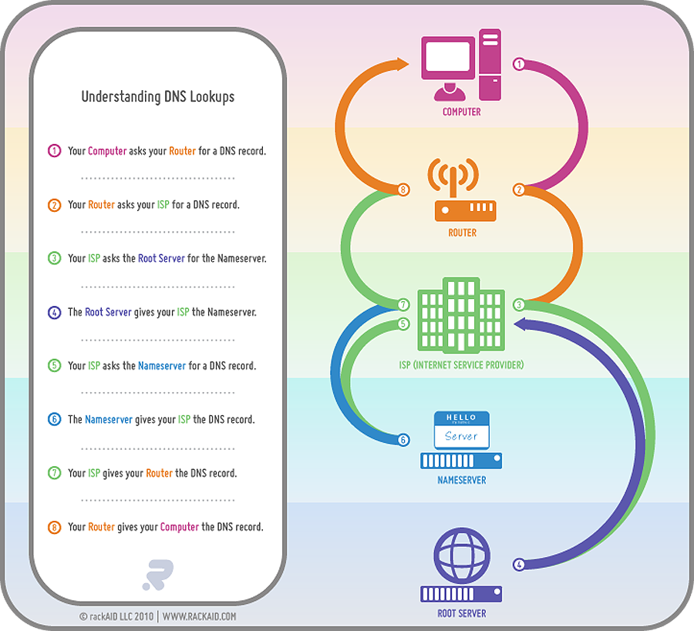

Slide 16
Next in the list
Physical MAC address
DHCP (more to follow) – this is where we got our IP address from
IPv6 (this follows on from DHCP/NAT and IPv4 – more to follow)
Our IPv4 IP address (192.168.10.x)
Subnet – helps define the IP address – a grouping
Lease – from DHCP
Gateway – where the computer should go to get to the outside world
DNS Servers
Legacy protocol support (WINS, NetBios)

Slide 17
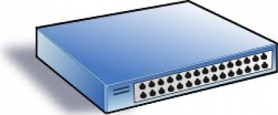
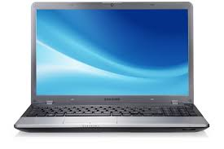
So what have we got so far?
Wherever working on any network start by drawing it up:
WINS
10.100.32.41
WINS
10.100.32.42
Gateway
10.170.0.1
DHCP
1.1.1.1
DNS
10.100.32.30
DNS
10.100.32.32
10.170.48.131
255.255.0.0
MAC: 60-57-18-94-4F-85

Slide 18
Yours looks more like this:
Gateway
192.168.1.1
DHCP, WINS, DNS
192.168.1.10
192.168.2.103
255.255.255.0

Slide 19
School network…
BYOD
LAN 4
192.168.4.x
Gateway
192.168.1.1
Admin
Teachers
Students
LAN 1
192.168.1.x
LAN 2
192.168.2.x
LAN 3
192.168.3.x

Slide 20
DHCP
Dynamic Host Configuration Protocol
A pool of IP address's that can be assigned by DHCP server
Why?
With IPv4 we started to run out of IP address’s globally
So we use some reserved addresses as ‘internal’ ones
We use NAT (network Address Translation) to convert our ‘internal IP’ address to an ‘external one’ that can surf the web
We get our external IP address from our ISP (internet Service Provider)

Slide 21
DHCP
Multiple pools
Subnets (masks)
Assign DNS, Gateway address’ automatically
Lease time
Home connection (DSL, VDSL, Cable) from ISP: DHCP
A company needs a fixed IP to host a web site: so pay the ISP for a fixed IP ($$$, and yes, being the internet there are ways around this)

Slide 22
IpGoat.com

Slide 23
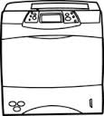
Now where are we at with our Map?
10.170.32.15
LAN: BYOD
ISP (VUW)
130.195.192.0/18
LAN: ecs.vuw.ac.nz
External IP:
130.195.199.185
130.195.9.60
LAN: BYOD
External IP:
130.195.253.23
Internal IP:
130.195.199.82
ECS
VUW
External IP:
130.195.253.19
130.195.199.196
DNS: 130.195.5.12 WINS: 130.195.5.200 SUBNET: 255.255.255.0
SSID: Victoria
Gateway 10.170.0.1
130.195.199.82
Gateway:
130.195.9.1
DHCP: 130.195.6.10
DNS: 130.195.6.10 SUBNET: 255.255.255.0
WINS
10.100.32.42
vuwindrdhcp001
130.195.197.141
LAN:
Staff wireless
DHCP
1.1.1.1
RELAY
HPLJ600 M602
130.195.6.247
DNS
10.100.32.32
vuwindrdns001
Fuji-Xerox
Apeos Port IV 3375
130.195.7.241
WINS
10.100.32.41
vuwincodhcp001
10.170.48.131
255.255.0.0
MAC: 60-57-18-94-4F-85
DNS
10.100.32.30
vuwincodns001
Fuji-Xerox
Apeos Port IV 7080
130.195.7.240

Slide 24
PING and Tracert
Two very handy tools
Ping 192.168.1.1
Ping www.name.com
Will show you a response from the targeted name/IP
tracert 192.168.1.1
tracert www.name.com
Tracert will show you the hops to the targeted name/IP
Tracert also does a DNS lookup for you - handy

Slide 25
Add in Global DNS
DNS follows a hierarchy
Top level maintained by IANA
(Internet Assigned Numbers Authority)
Delegates down to people like Google
Google DNS: 8.8.8.8 and 8.8.4.4 (remember this)
ISP’s also have DNS
Configured automatically as part of DHCP for home connections
You can add other DNS servers from other ISP’s

Slide 26
Security
Passwords
Anti virus
Software updates/Patches
Firewall
IPS – intrusion prevention/detection

Slide 27
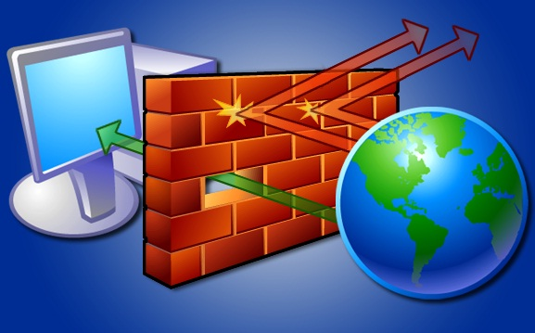
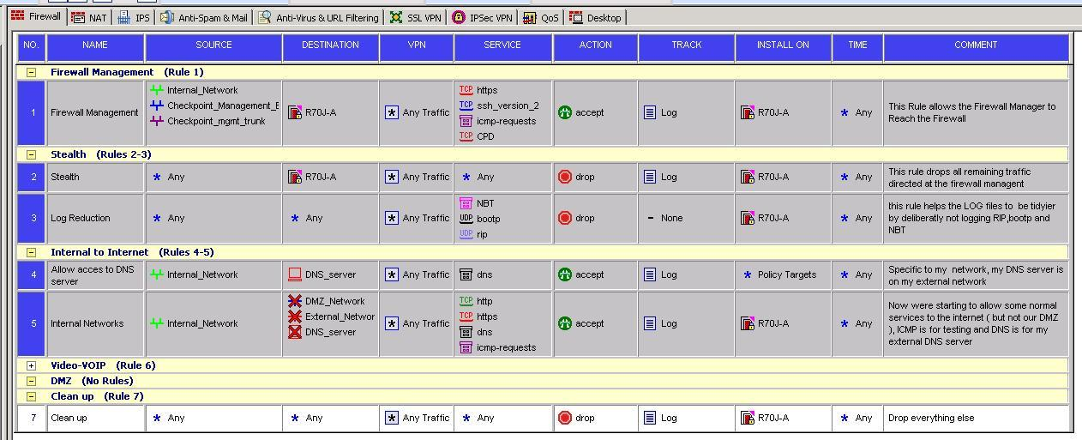
Add in a firewall
What is a firewall?
It controls traffic into and out of an organisation
It allows a LAN, server or group to communicate with another LAN, Server or group on SPECIFIC protocols
The last rule is always the clean-up rule (drop it if it doesn’t match any rule)

Slide 28
How to hack…
Ping test – are you there?
This is called sniffing
Port scans (what is a port?)
Do you have port 110 open? Yes 110 = POP3 (Post Office Protocol) which is used by email servers, 80 = HTTP, etc..
Vulnerability testing
Password crackers (brute force)
The biggest threat is still physical access – I can then take all the time I want to crack your system
Reconnaissance, Initial Exploitation, Establish Persistence, Install Tools, Move Laterally, Collect Exfil, and Exploit

Slide 29
How often do you get scanned?
Home user – every 15 minutes
Business - at least once every 5 minutes
Big corporate – every minute

Slide 30
How to stop hackers
Make sure you AV is up-to-date
Make sure your software is patched up-to-date
Have a firewall
Good passwords (more than 8 characters, alpha-numeric)
Don’t give out your passwords EVER
Don’t open stupid links (hover over HTML links and it will tell you the destination, often fake…)
Nigeria isn’t your friend and they don’t have millions to transfer – i.e. if it is too good to be true then it is rubbish…

Slide 31
Other security issues
So I cracked into your system what can/will I do?
Not so much delete your files, that’s destructive and childish….
Key logger to get CC details, passwords, etc.
Steal information (financials, pay details..)
Control essential services
Zombies (DOS attacks)
This is big business
Banking and financial sector
Big Global demand for staff, good at maths?

Slide 32
I am not kidding
Vodafone built backdoor access into Greece's cell phone network for the Greek government; it was used against the Greek government in 2004-2005
Google kept a database of backdoor accesses provided to the U.S. government under CALEA; the Chinese breached that database in 2009.
https://www.schneier.com/
http://www.theregister.co.uk/
France rejects backdoors in encryption products. And for the right reasons, too. http://www.theregister.co.uk/2016/01/15/france_backdoor_law/
France joins the Netherlands on this issue. https://www.schneier.com/blog/archives/2016/01/michael_hayden_.html
Apple's Tim Cook is going after the Obama administration on the issue. https://theintercept.com/2016/01/12/apples-tim-cook-lashes-out-at-white-house-officials-for-being-wishy-washy-on-encryption/
Fitbit – picking up on when you are pregnant, or breaking up with a partner….
Geolocation data – ISIS drone strike

Slide 33
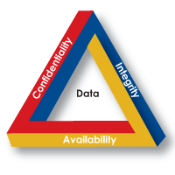
Future considerations
Electronic voting
Control of military drones
Hijacking of cars and houses
Manipulation of data flow (traffic, stock markets…)
Skimming
Changing personal data

Slide 34
Note
I have gone over the basics of networking
I have covered the basics of hacking
I have not covered how not to get caught
Do not try this, there is a number of fish hooks, such as where you get tools will most likely infect your device
It is fundamentally unethical and often illegal – so don’t do it

Slide 35
Homework
http://www.imdb.com/title/tt2084953/
http://www.imdb.com/title/tt2177843/?ref_=tt_rec_tti

Slide 36
Title and Content Layout with Chart

Slide 37
Two Content Layout with Table
First bullet point here
Second bullet point here
Third bullet point here
 | Group 1 | Group 2
Class 1 | 82 | 95
Class 2 | 76 | 88
Class 3 | 84 | 90

Slide 38
Title and Content Layout with SmartArt
Step 1 Title
Task description
Task description
Step 2 Title
Task description
Step 3 Title
Task description
Task description
Task description

