Slide 1
Automatic Device Selection and Access Policy Generation based on User preference for IoT Activity Workflow
Presenter: Ian Welch
Authors: Mohammed Al-Shaboti, Aaron Chen, Ian Welch
SCHOOL OF ENGINEERING AND COMPUTER SCIENCE FACULTY OF ENGINEERING
VICTORIA UNIVERSITY OF WELLINGTON
/35

Slide 2
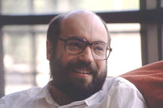
Context: Ubiquitous computing
Ubiquitous computing is the method of enhancing computer use by making many computers available throughout the physical environment but making them effectively invisible to the user.
Mark Weiser (1988)
Xerox PARC
By http://www.parc.xerox.com/csl/members/weiser/, Fair use, https://en.wikipedia.org/w/index.php?curid=1680591
Notes:
Weiser is widely considered to be the father of ubiquitous computing, a term he coined in 1988.
Within Silicon Valley, Weiser was broadly viewed as a visionary and computer pioneer, and his ideas have influenced many of the world's leading computer scientists.

Slide 3
Context: Smart home in the future
Notes:
https://www.gartner.com/en/newsroom/press-releases/2014-09-08-gartner-says-a-typical-family-home-could-contain-more-than-500-smart-devices-by-2022

Slide 4
Programming the smart home
How do write applications for the smart home and other IoT environments?
Proposed visual programming environments based around workflows.
Drag and drop available devices in the environment to create a program.
Examples: Node-RED, Visunio, wia etc.
Notes:
https://citeseerx.ist.psu.edu/viewdoc/download?doi=10.1.1.73.1251&rep=rep1&type=pdf

Slide 5
Problem: dealing with evolution
Many devices might be installed.
Many different manufacturers.
Devices come and go as consumers upgrade and replace installations.
Workflows are fragile because bound to specific IoT devices.
https://au.pcmag.com/lighting/30286/the-best-rgb-keyboards

Slide 6
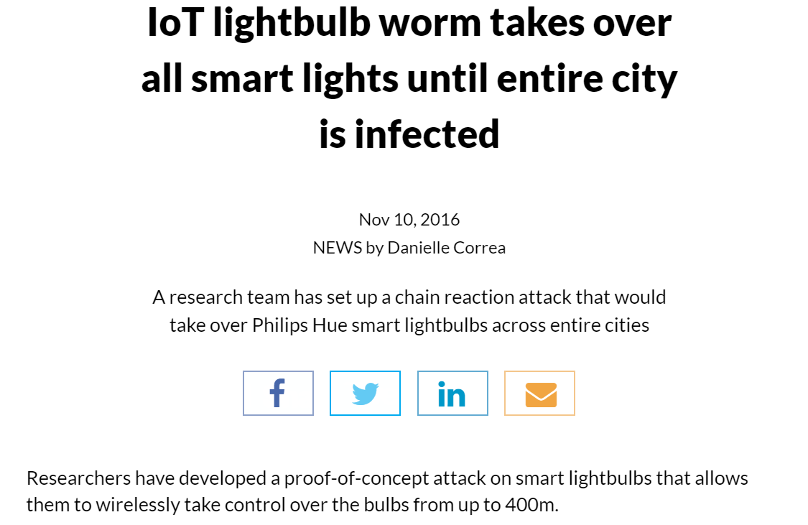
Problems: security concerns
Even lightbulbs are general purpose computing devices.
Might have different levels of trust.
Manufacturer Usage Descriptions (MAC) restrict interactions and permissions accordingly.
Problem – still coarse grained access control allowing misuse of permissions to launch attacks.

Slide 7
Goals
Abstract away from specific instances of device when specifying workflows.
Take customer preference regarding trust etc. into account when choosing particular devices.
Reduce risk of misuse of privileges by only granting permissions as required to carry out user tasks.
Automatically generate fine-grained access control policies to enforce least privilege on IoT devices.

Slide 8
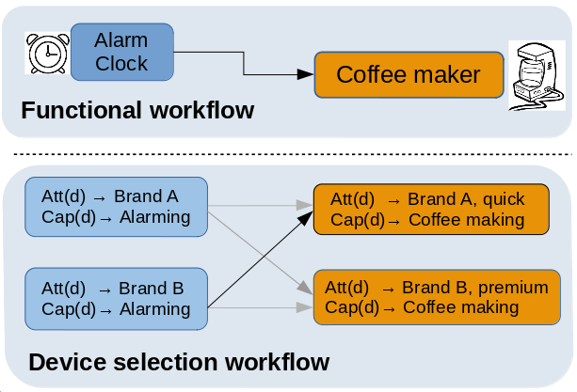
Problem formulation
A device is descried by a set of attributes and a set of capabilities each associated with network requirements.
A network is a collection of devices.
Activity workflow is a functional representation of the desired activity.
A user preference model to quantify user preference of using any set of devices for a particular set of activity functions.
Treat as an optimization problem.

Slide 9
Methodology
Find the set of devices that fulfill workflow functions and maximize user preference.
Heuristic search algorithms used to find the set of preferable devices.
Hill-Climbing (HC) - Local optimization
Simulated Annealing (SA) -Local optimisation
Genetic algorithm (GA) – (global optimisation)
A simple policy generation algorithm used device capability network requirements to generate access policy for the selected devices.

Slide 10
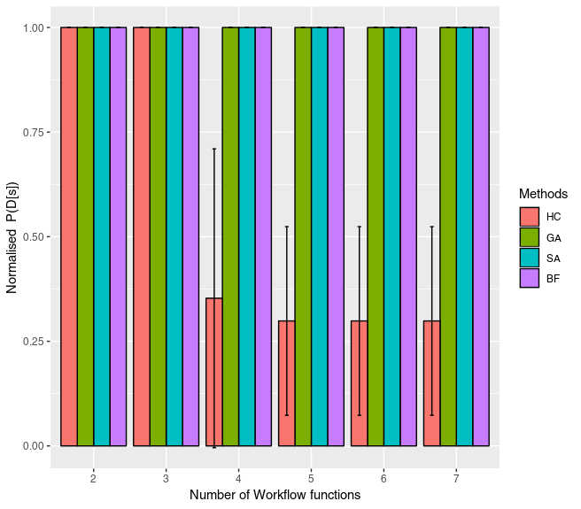
Empirical evaluation (satisfaction)
Empirical evaluation.
Multiple workflows randomly chosen (2-7 functions).
Assume seven alternative devices for each function.
Randomised preference model with known optimum choice.
All but Hill Climbing found optimum.

Slide 11
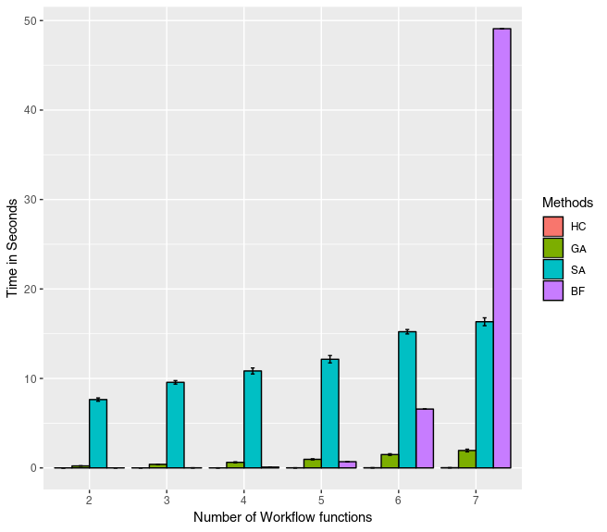
Empirical evaluation (time)
How long does it take?
Hill climbing is fastest.
Hill climbing doesn’t find the optimum though.
Genetic algorithm comes second while finding the optimum.
Our winner for algorithm to use in this case.

Slide 12
Network access control policy
Once the devices have been selected.
Generate ACLs:
<srcIP, dstIP, Protocol, dstPort>
Earlier work we designed SDN-based enforcement mechanism based on Faucet controller.

Slide 13
Summary
Automatic approach to generation of fine-grained access control policy based upon:
User requirements (workflow)
User preferences (trust or habit).
Novel use of optimization techniques to achieve this.
Future work: implementation, other user context information.

Slide 14
Thank you!
14

