Slide 1


Cybersecurity at VUW
Ian Welch, School of Engineering and Computer Science
Te Kura Maatai Puukaha, Puurorohiko,
University of Victoria
16th May 2014
Notes:
What we do and why ... issues that we are trying to solve.
Current state of the art (so to speak).

Slide 2
BSc and BE in Cybersecurity
The proposed changes provide two distinct pathways for students who are interested in working or doing research in cybersecurity.
The BE(Hons) degree provides a technical degree with a strong professional connection.
The BSc degree specialisation allows students to combine cybersecurity with courses focusing on other areas of computer science.
Build on strong programming and networking expertise.
Languages: Java (100-level up), C & C++ (200-level and up), Javascript (300-level and up), C++ (malware course).

Slide 3
Graduate Attributes
1 Be able to apply secure programming techniques, software development methods, cryptographic mechanisms, human factors, networks and operating systems to develop secure computer systems, security mechanisms and assessment tools.
2 Be able to apply adversarial thinking, security evaluation techniques, risk assessment methodologies and incident handling best practices to the operation, maintenance and analysis of computer systems including hardware, software, networks and people.
3 An understanding of the role of integrity, ethical behaviour, legal constraints, relevant professional standards, local and international standards in practicing as a computer security professional.
4 Be equipped with a range of fundamental principles of security engineering that will provide the basis for future learning and enable them to adapt to the constant rapid development of the field.
5 Have experience of working in teams to build, operate, analyse and test the security of computer systems. Sensitivity to gender, ethnic, cultural and other differences.
6 Communicates effectively, comprehending and writing effective reports, policies and procedures, summarizing information, making effective oral presentations and giving and receiving clear oral instructions.

Slide 4
High-level view

Slide 5
Our Research
Detecting pages containing malicious code.
(1) Honeypots.
(2) Machine learning.
(3) Attacker behaviour.

Slide 6

(1) Honeypots
Notes:
What we do and why ... issues that we are trying to solve.
Current state of the art (so to speak).

Slide 7
Client Honeypots
Security devices that seek out and identify malicious servers.
Concentrate on client side of client/ server relationship
Purpose
  Find malicious servers
  Blacklisting (e.g. DNS Blackholes)
  Empirical studies
Notes:
Capture HPC

Slide 8
Spectrum
High-interaction:
    Behaviour based (misuse rules).
  Virtualised environments.
  Whole operating systems and clients.
  Low false positives but slow.
Low-interaction:
  Content based (signatures, decision-trees or statistical machine learning).
  Higher false positives but fast.
Notes:
Capture HPC – 2008.

Slide 9
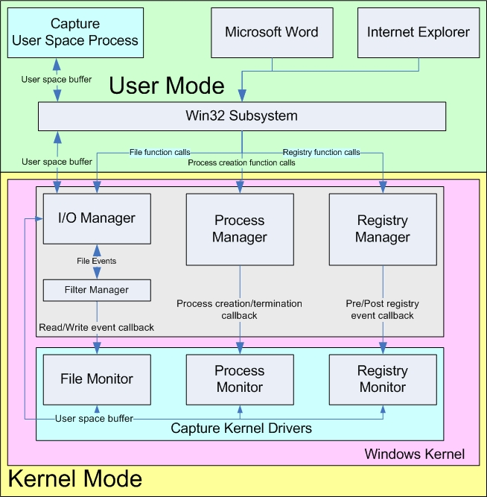
1.
Misuse-based Detection using Capture-HPC
Dr Christian Seifert

Slide 10
Application/extensions
Management - David Stirling MSc 2008
  Use the Grid to host
  Application of Taverna workflow engine
Speed - Christian Seifert PhD 2009
  Divide-and-Conquer algorithm
Reliability - Jan von Mulert Hons 2012
  Metasploit testing
Malware analysis - Vicky Gao Hons 2009
  Clustering of attacks
Empirical measurement studies (2007-2010)
Android client honeypot (Pacharawit Ngarm 2013/2014)
Notes:
Capture HPC

Slide 11
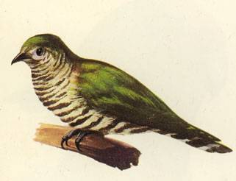

Updating Capture-HPC
Capturing Cuckoo
(SG Poly interns 2013/2014).
Zombie Beatdown
(Micah Cinco 2014).
Notes:
Capture HPC

Slide 12
(1) Future directions - honeypots
Internet of Things (IoT) highly vulnerable
Hard to patch, rushed to market
Have been used for large scale attacks (Mirai)
Many problems around privacy
Can we use honeypots to help understand and even protect us from attacks?
PhD Candidate Mr Junaid Haseeb supervised by Dr Masood Mansoori
Notes:
Capture HPC

Slide 13
(2) Static analysis using machine learning
Problem is you spend 10 seconds accessing each page.
Van Lam Le thesis work (2010-2013)
Context of a hybrid honeyclient architecture
  Low interaction as a filter
  Low FN ideally and tunable
Evaluation of machine learning techniques
Use of information gain to evaluate features
Statistical-based threshold-based technique
Notes:
Capture HPC

Slide 14
(2) DDoS and Software defined networking
How to detect low intensity distributed denial of service attacks
    Problem – not enough traffic to trigger detectors
    Applied machine learning to correlate patterns of attack
    Implemented using software defined networking (new paradigm in network engineering)
    Dr Abigail Koay PhD research (2019).
Notes:
Capture HPC

Slide 15
(2) Future directions – Ransomware
Ransomware is a large problems businesse.s
Costs $11.5 US Billion a year.
Denies you access to your computer.
Problem – many different types and always evolving.
Problem – evades detection
Apply machine learning to this problem
Mr Shabbir Abbasi PhD candidate (2019-)
Notes:
Capture HPC

Slide 16
(3) Analysing attacker behaviour
Dr Masood Mansoori (2018)
What? Target users using:
    Geographical location
    Common language
    Similar environments (e.g. industry, education)
    Social and cultural elements
    Popular trends
    Browser Information: User-agent
    Subnet and Network Information
Why? Evade malware detection systems as well as maximise revenue generation

Slide 17
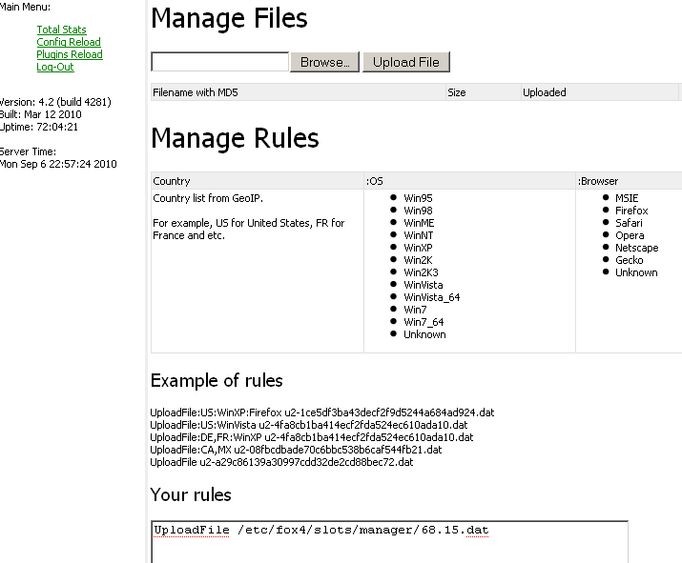
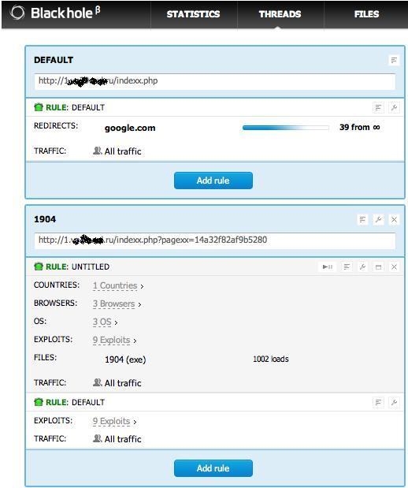
(3) Analysing attacker behaviour
Browser exploit kits automate attacks

Slide 18
(3) Analysing attacker behaviour
Anecdotally attackers deliver different malware to different targets.
Exploit kits support this.
Do they actually use it?

Slide 19

Empirical Analysis using Distributed HPs
Visitor’s
  HTTP and Browser Header Information
    Referrer (Google.co.nz)
    User-Agent
      Language
    Time-Zones
  Network Information
    Subnet
    IP Address
  Geo-Location Algorithms
    Ping and Delay based approach

Slide 20
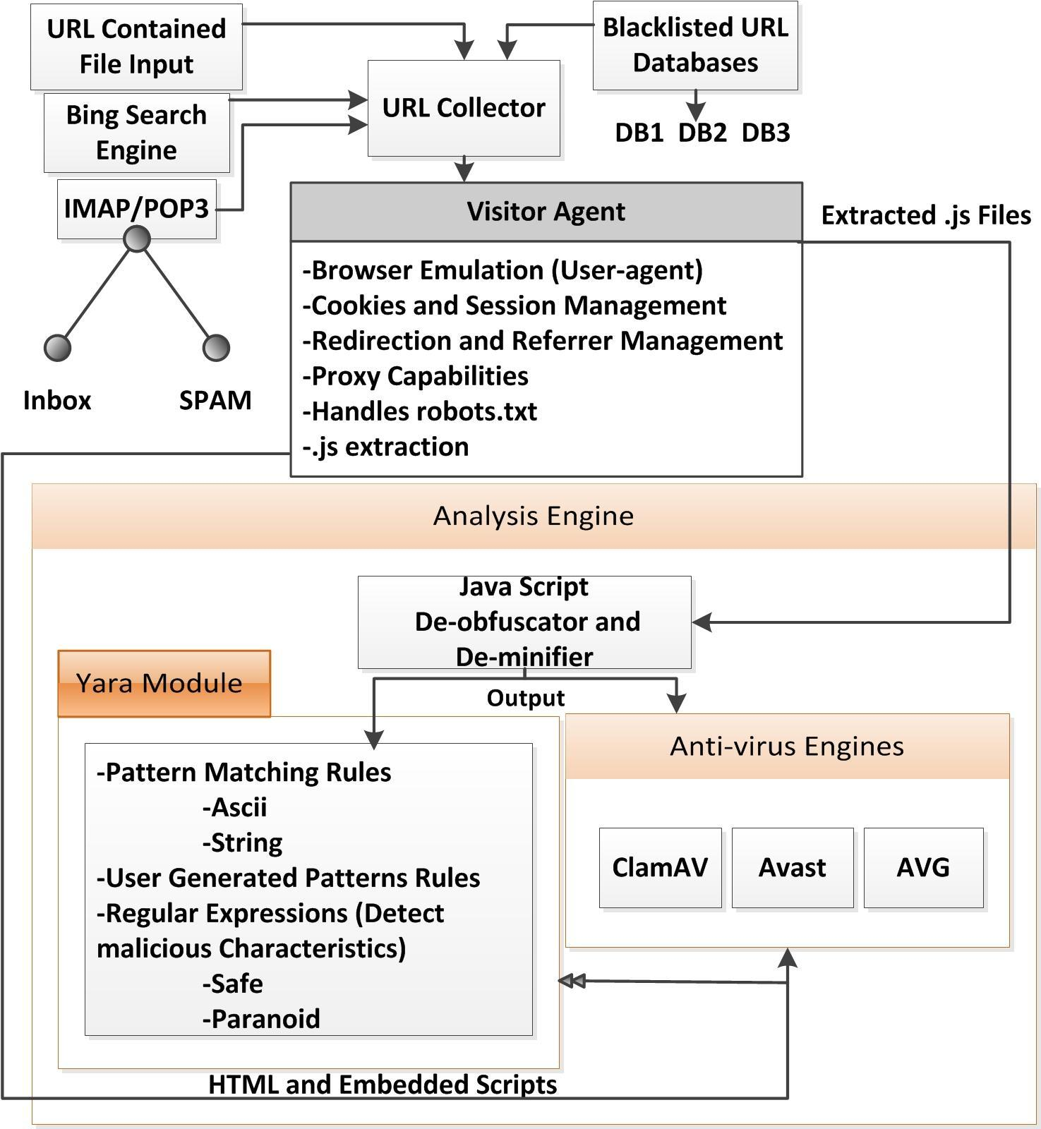
YALIH (2014)
Queuer
Simulated
Browser
Analysis
Module

Slide 21
(3) Future directions
Many projects suitable for undergraduates to assist with and can publish code through NZ Honeynet project
Machine learning
  Statistical classifiers.
  Supervised learning.
  Automatic so more scalable.
Most approaches use language features (AST).
expressions & assignments
What about other machine-learning techniques?

Slide 22
Wrap up
Provided an overview of our courses.
Research done here at VUW.
Questions?
Tour of facilities

