Slide 1
A Graph Database Supported
GA-Based Approach
to Social Network Analysis
Arnold Ariadi, Tao Shi, Hui Ma, Alexandre Sawczuk da Silva, Sven Hartmann
School of Engineering and Computer Science, Victoria University of Wellington, New Zealand
Department of Informatics, Clausthal University of Technology, Germany

Slide 2
01
Introduction
CONTENTS
02
Proposed Approach
03
Evaluation
04
Conclusions
1/10

Slide 3
Introduction
Community Detection for Social Network Analysis
Hierarchical Clustering (Dendrogram)
can detect known structures with high reliability and sensitivity
does not scale well for very large graphs
Partitional Clustering
K-means
the number of clusters must be specified at the beginning
Propagation-based Clustering
extremely fast and requires little prior knowledge about the network
non-deterministic, difficult to ascertain the actual structure
Modularity-based Clustering
higher accuracy
store the network in memory

Slide 4
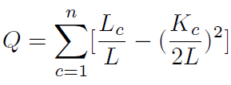
Introduction
Modularity Metric
Modularity measures the strength of division of a graph network into clusters
n: represents the number of partitions in the network;
Lc: denotes the number of links or edges within partition c;
L: represents the overall number of edges in the network;
Kc: denotes the total degree of all the nodes in the partition c.
High Q: dense connection within clusters but scarce connections between nodes in different clusters.

Slide 5
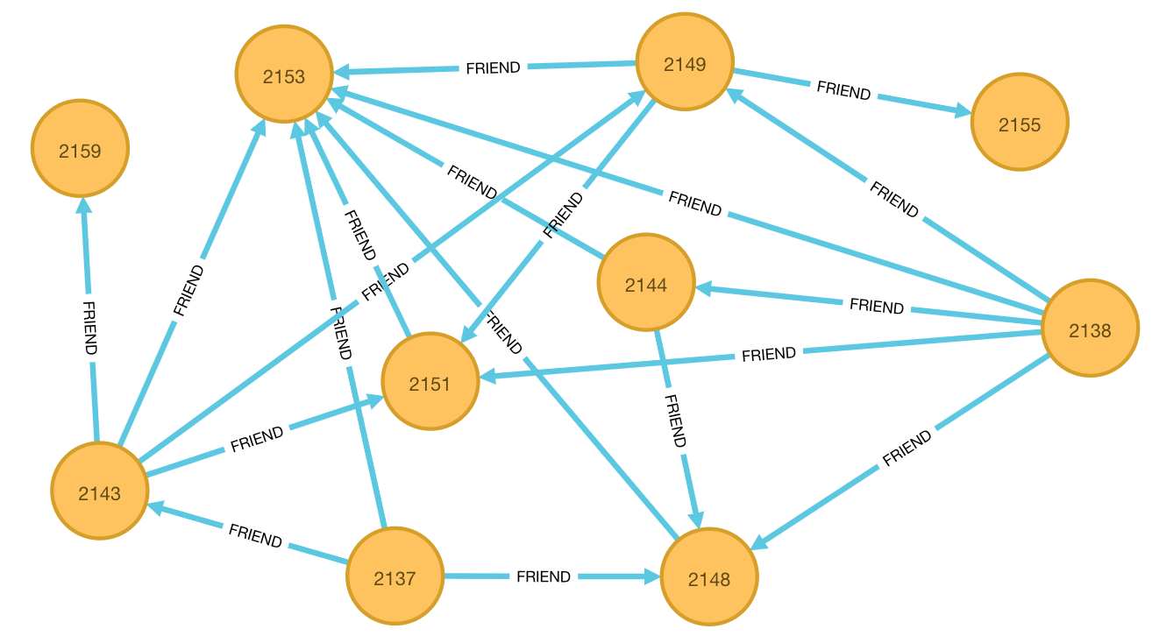
Introduction
Graph Databases and Neo4j
Graph database
NoSQL database
can contain, represent, and query a graph consisting of a set of vertices and a set of edges
Neo4j, OrientDB, Titan, and DEX (now known as Sparksee)
Neo4j
fast traversal, retrieval and navigation of data

Slide 6
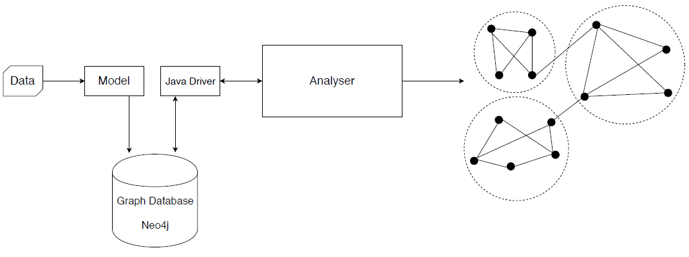
Proposed Approach
Graph Database-supported GA-based Approach (GDGA)
specify what information
is represented as nodes and edges
storing the datasets that are used for the analysis

Slide 7
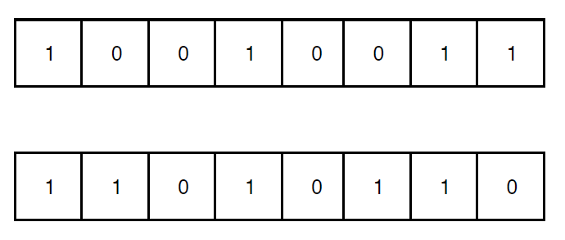
Proposed Approach
Graph Database-supported GA-based Approach (GDGA)
Population Initialization
Label Propagation Algorithm (LPA)
Genetic Representation
direct encoding
Fitness Function
modularity computation formula
Mutation and Crossover
random resetting mutation
uniform crossover

Slide 8
Evaluation
Datasets, Baselines, and Parameter Settings
Datasets
Baselines
Parameter Settings
Population size: 30
Maximum generations: 30
Roulette wheel selection
Crossover rate: 0.8
Mutation rate: 0.2
Elitism setting: 2
ego-Facebook dataset from Stanford Large Network Dataset Collection
Dolphin Social Network datasets collected from New Zealand
Zachary Karate club
LPA
Louvain algorithm
GraphLPA

Slide 9
Evaluation
Results

Slide 10
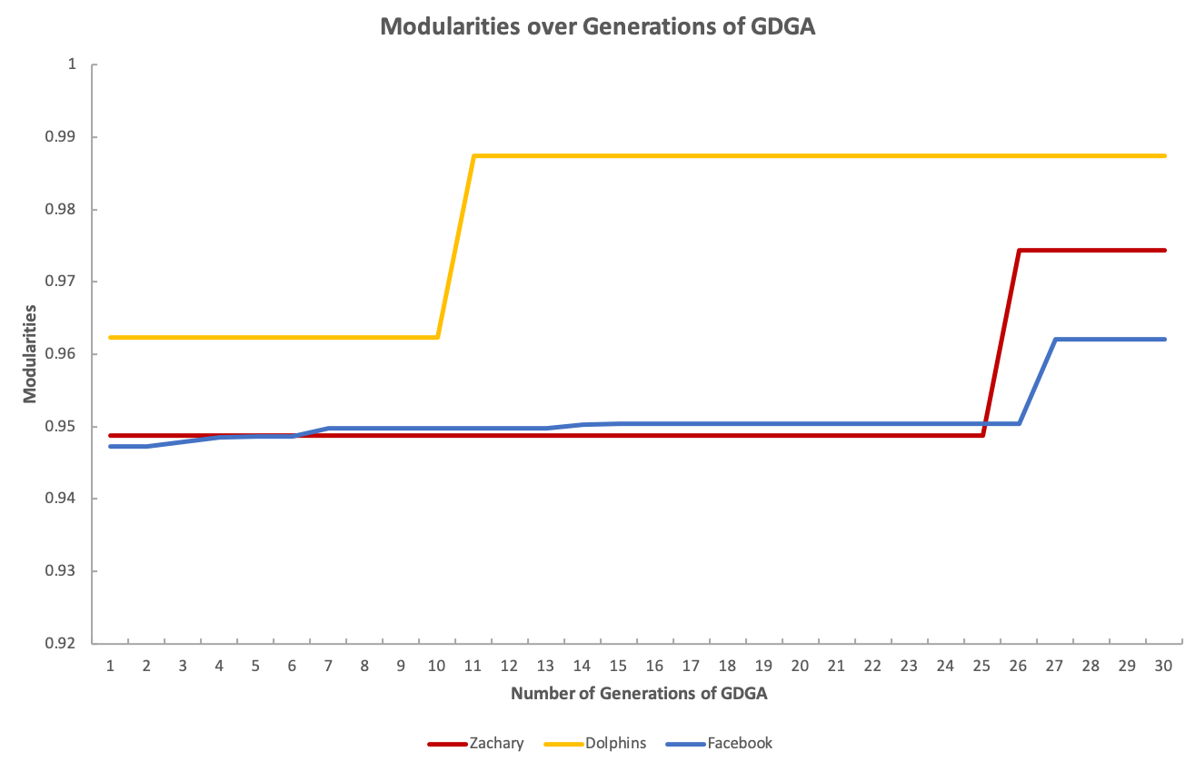
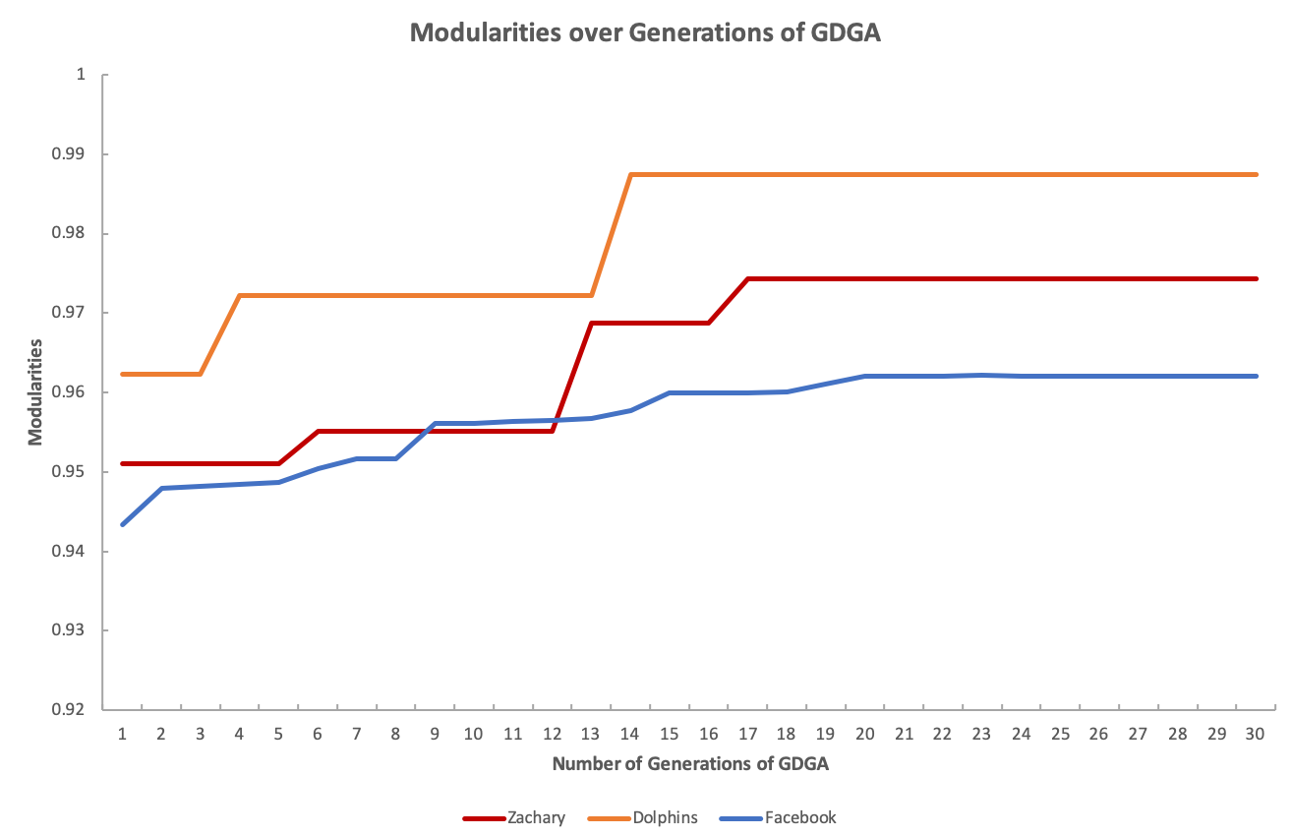
Evaluation
Analysis on Mutation Rate
Mutation rate = 0.2
Mutation rate = 0.3

Slide 11
Conclusions
Thank You
Q&A
Presenter: Tao Shi
Emails: tao.shi@ecs.vuw.ac.nz

