Slide 1
Location-Aware and Budget-Constrained Application Replication and Deployment in Multi-Cloud Environment
Tao Shi, Hui Ma, Gang Chen
School of Engineering and Computer Science
Victoria University of Wellington, New Zealand
Sven Hartmann
Department of Informatics
Clausthal University of Technology, Germany
IEEE ICWS 2020
Notes:
1

Slide 2
Overview
Background
Related Work
Problem Description
Proposed Approach
Evaluation
Conclusions

Slide 3
Background
Notes:
3

Slide 4
Public Cloud Market and Multi-cloud
41% Enterprise Workload
US$ 308,500,000,000
High Service Quality
Low Operation Cost
Avoid Vendor Lock-in

Slide 5
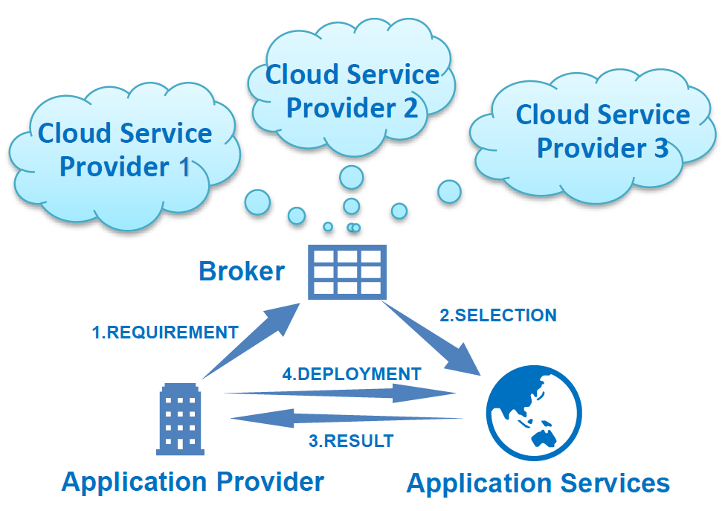
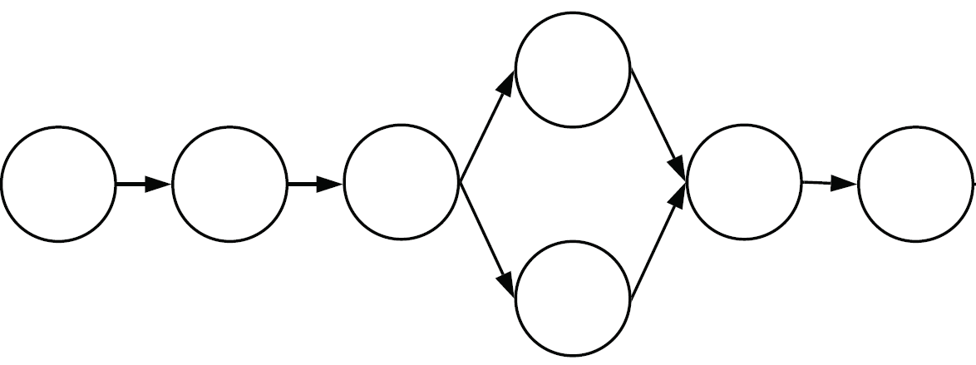
Application Deployment in Multi-Cloud

Slide 6
Related Work
Notes:
6

Slide 7
Application Replication and Deployment
Federated cloud application deployment:
Existing works: execution time and cost
Our work: average response time and budget
Multi-cloud service brokering problem:
Existing works: independent services
Our work: workflow-based applications with inter-dependent services
Data placement and replication problem:
Existing works: optimize data replica locations
Our work: decide both the locations and the types of cloud resources
France Central
$0.104/hour
East US
$0.0832/hour
Japan East
$0.12/hour
Azure VM B2MS
Australia East
$0.106/hour
Brazil South
$0.134/hour
South Africa West
$0.14/hour

Slide 8
GA-based Approaches
Data placement and replication problem:
Decoding what and where to replicate some of the data objects at multiple sites
Web service location-allocation problem:
Decoding locations for deploying multiple instances of atomic web services
Neither take no account of services selection at the same location

Slide 9
Problem Description
Notes:
9

Slide 10
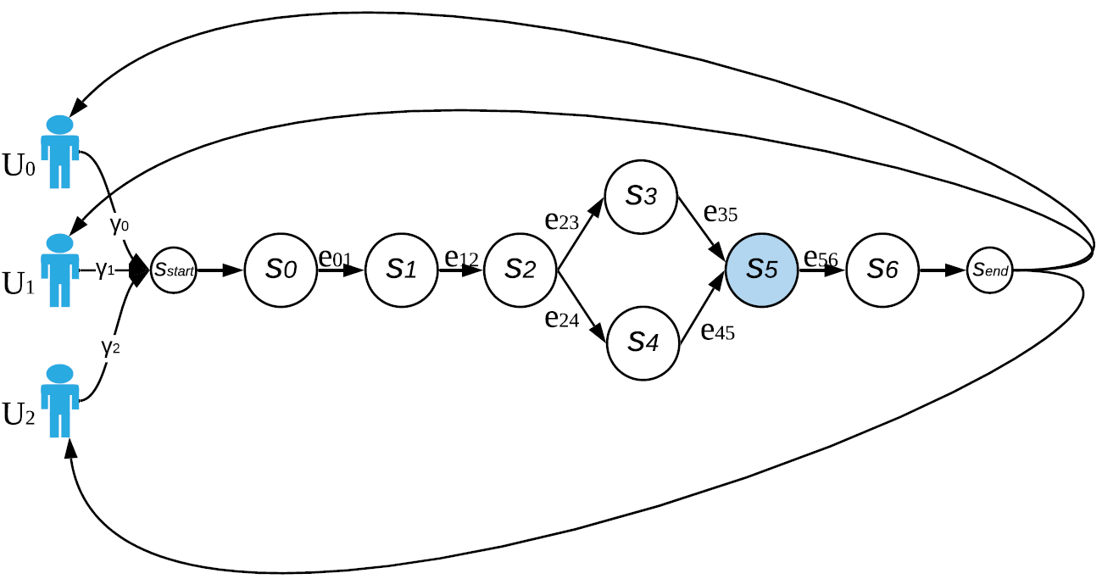
Business Application and Assumptions
New application requests from user centres are generated according to Poisson distributions.
An application is replicated as one cohesive unit in different data centres.
All user requests are served by the application replica with the lowest network latency

Slide 11
Calculation of Average Response Time
The aggregated workload of services in the application replica:
The capacity of a service instance (the amount of requests processable per time unit):
The average request processing time of service:
The average response time of the application replica:

Slide 12
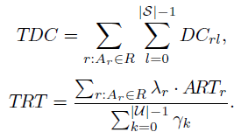
Replication and Deployment Problem
The total deployment cost (TDC) and total response time (TRT) can be calculated as follows:
Our budget-constrained application replication and deployment problem:

Slide 13
Proposed Approach
Notes:
13

Slide 14
Challenges to Effectively Apply GA
First need to determine the application replication plan, including both the amount and the locations of application replicas.
Then cloud resources selection for service deployment involves large and complex search space.
Randomly generated initial population of GAs cannot produce high-quality final solutions reliably in our experiments.

Slide 15
Two-level Optimization under GA Framework
First level optimization, i.e. application replication, is realized by GA.
Second level optimization, i.e. VM types selection for service deployment, is performed based on the Gain heuristic in the fitness evaluation process of GA.
Greedy-based population initialization

Slide 16
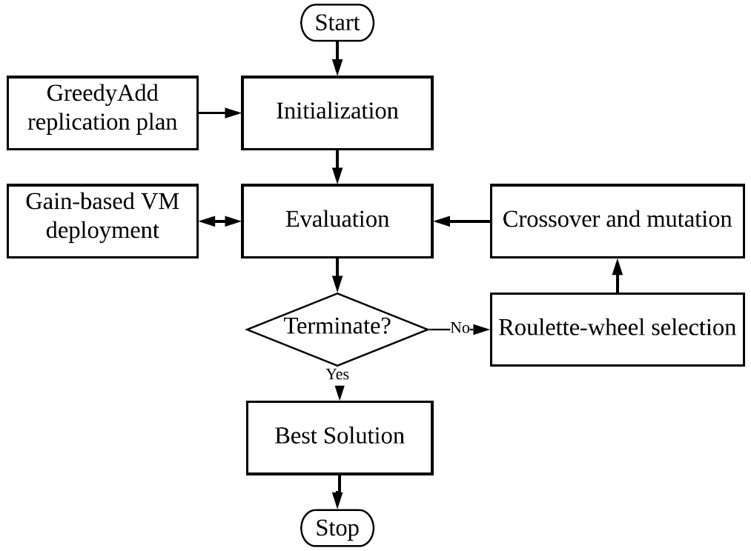
Framework of GA-based Approach

Slide 17
Fitness Measurement: Gain-based Service Deployment
Deploy all service instances to the cheapest capacity feasible VM types
Calculate the benefit for each service instance by upgrading its current VM type to one with higher capacity, e.g., from AWS m5.large to m5.xlarge:
Upgrade the service instance with the largest benefit iteratively until the TDC reaches the given budget b

Slide 18
Initial Population
One greedy-based solution in initial population (GreedyAdd):
Generate the cheapest replication plan, i.e. deploying the first copy of the application to the cheapest data centre, e.g., US East.
Progressively, one additional replica is allocated to one of the remaining data centre locations with the highest reduction in TRT until no better plans can be found within the given budget.
The remaining population will be initialized randomly.

Slide 19
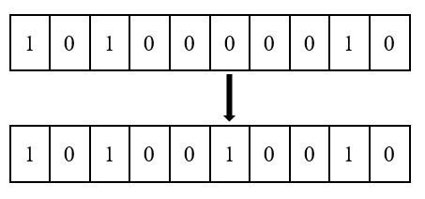
Genetic Operators
Single-point crossover
Flip-bit mutation

Slide 20
Evaluation
Notes:
20

Slide 21
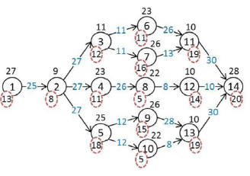
Datasets
24 VM types
15 data centre locations
10 business applications
1 dataset: Virginia (US East)
82 user centres from 35 countries on 6 continents
real-world observations of network latency from Sprint IP backbone network databases

Slide 22
Simulation Settings and Parameter Settings
1/1000th Facebook subscriber
Each user makes 25 requests on average daily: close to 400 requests per second.
5 budget factors: 0.1, 0.2, 0.3, 0.4, and 0.7.
Population size: 100
Maximum generation: 50
Crossover rate: 0.9
Mutation rate: 0.1
Each experiment: 30 runs

Slide 23
Baseline approaches
GA-ARP: GA-based approach to the Application Replication and deployment Problem
Two common application placement strategies:
NearData: deploying the application at the data centre where the dataset is stored.
NearUsers: deploying application replicas at all datacentre locations to ensure all users close to the application
H-GA: our recently proposed hybrid GA approach for budget-constrained composite applications deployment

Slide 24
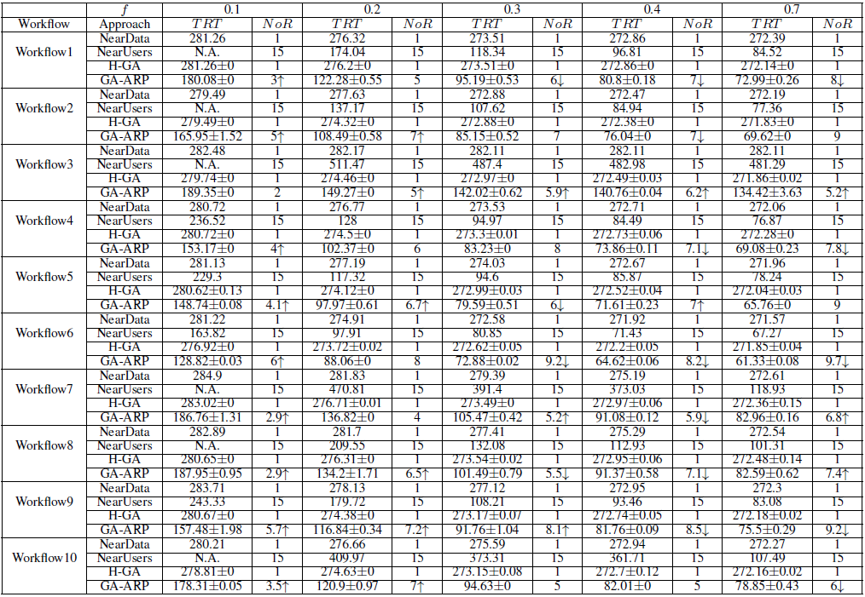
Approach Performance Comparison
4.51% better than GreedyAdd by replacing the data centres in Singapore and Seoul with Tokyo and Mumbai

Slide 25
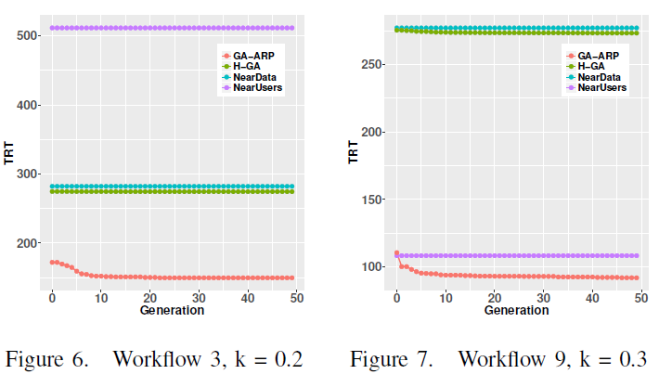
Further Analysis
Average computation time: 100 - 3000 seconds
Applicable scenarios: applications have stable or predictable demand, e.g., user distribution and request rates.
Evolutionary process:

Slide 26
Conclusions
Notes:
26

Slide 27
Main Contributions
we formally define the application replication and deployment problem in multi-cloud with the goal to minimize the average response time subject to a budget constraint.
we propose a novel GA-based approach to the Application Replication and deployment Problem (GA-ARP), featuring a newly designed and domain-tailored solution representation, fitness measurement, and population initialization.
Extensive experiments using the real-world dataset demonstrate that GA-ARP can significantly improve application performance comparing with the common application placement strategies and our recently proposed approach for budget-constrained application deployment.

Slide 28
Thank you
谢谢
IEEE ICWS 2020
Notes:
28

