Slide 1
Recursion COMP 112 2018T1 #6

Slide 2
Overview
What is recursion?
How dose iteration relate to recursion?
Why use recursion?
Make some problems are easier to solve
Makes some problems quicker to solve
Recursion is more important now we have Java 8
Ideally you should be able to decide if recursion is appropriate or not for the problems that you have to solve.
Functions over infinite domains frequently use recursion.

Slide 3
Recursion as Problem Solver
We will look at a classic problem that is easy to solve with recursion.
This introduces a Design Patten
Divide and conquer!
Try to understand and solve prior to coding!

Slide 4
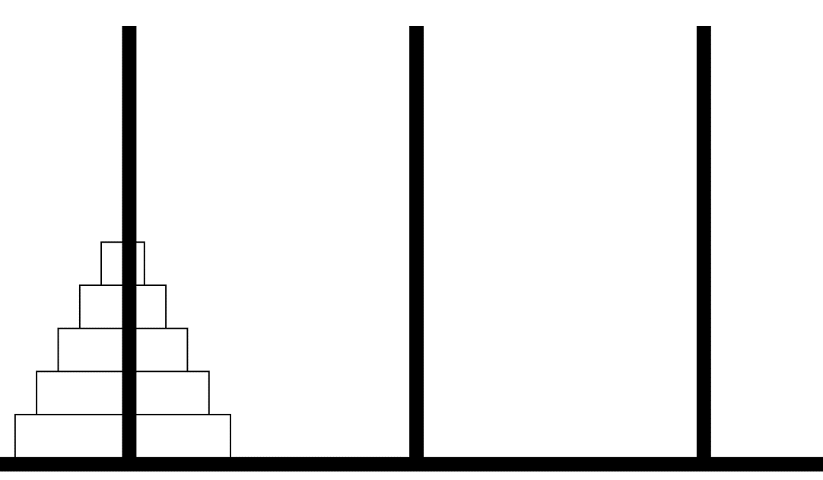
Towers of Hanoi (run demo)
Goal is to move discs to the right hand place
Rules:
Move only one disc at a time
Do not place any disc on top of a smaller disc
Try to design an algorithm that will work no mater how many discs there are but with out recursion (using iteration)

Slide 5
Recursion – what is it.
A recursive method is a method that calls itself.
Even with out recursion Java is functional complete.
That is you do not need recursion to solve any problem. But thinking recursively can greatly help.
Java maintains a call stack – see BlueJ debugging
Calling method Move adds Move to the call stack
If method Move calls itself a new call to Move is added to the stack before the initial call terminates and is removed from the stack

Slide 6
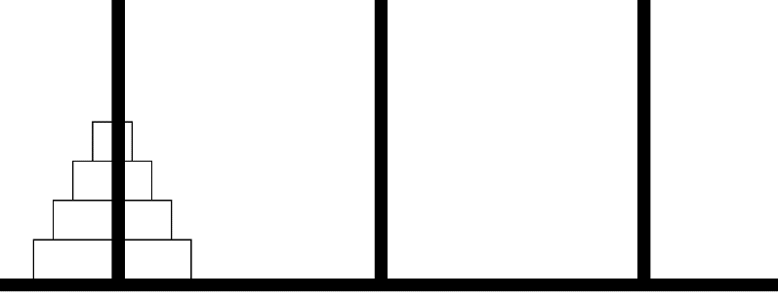
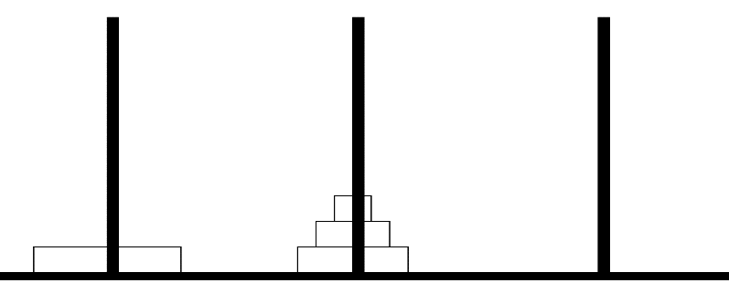
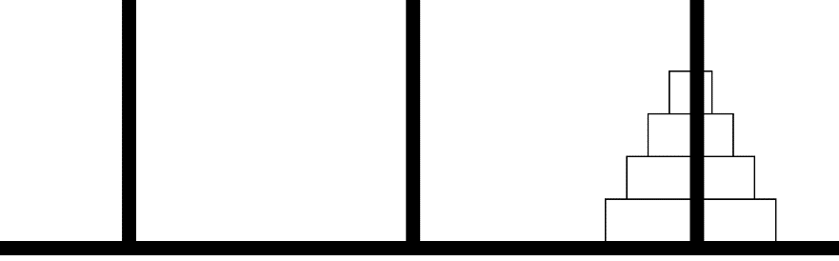
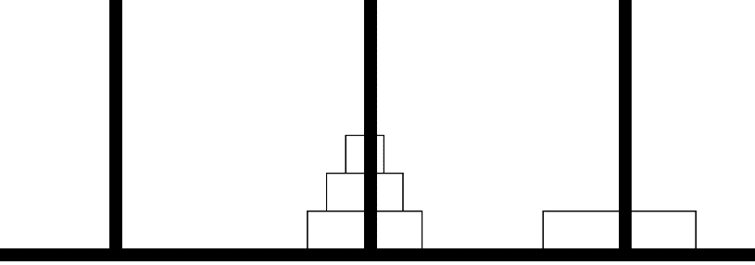
Divide and conquer
A classic problem solving metaphor is
Divide and conquer
The size of the TofH problem is n the number of discs.
A solution for TofH-n can be constructed assuming a solution for TofH-(n-1).
L
M
R
Move 3 L discs to M
n = 4
Move 1 L disc to R
Move 3 M discs to R
Notes:
----- Meeting Notes (16/03/14 10:52) -----
WE HAVE BROKEN DOWN A 4 DISC MOVE into
two 3 disc moves and a one disc move
ALSO
we have broken a 3 disc move into
two 2 disc moves and a one disc move

Slide 7
How is divide and conquer a solution
We can solve TofH(n) if we can solve TofH(n-1).
Code TofH(int n) and in it call TofH(n-1).
Clearly TofH(1) can be solved directly.
So we know the recursive call must terminate
With out writing the code –do you believe this is a solution?
There is still some wiring of the method calls to define

Slide 8
TofH( n, ?, ? )
TofH(n,L,R) = TofH(n-1,L,M);
TofH(1,L,R);
TofH(n-1,M,R);
L
M
R
Move 3 L discs to M
n = 4
Move 1 L disc to R
Move 3 M discs to R
Given two posts
compute Other-post
Notes:
----- Meeting Notes (16/03/14 10:52) -----
WE HAVE BROKEN DOWN A 4 DISC MOVE into
two 3 disc moves and a one disc move
ALSO
we have broken a 3 disc move into
two 2 disc moves and a one disc move

Slide 9
A constructive approach
Divide and conquer decomposes a large problem into smaller problems
Alternatively use solution to smaller problems to build solutions to larger problems
Solution with 2 discs -
Move 1 disc L2M and 1 disc L2R and 1 disc M2R
Solution with 3 discs -
Move 2 discs L2M and 1 disc L2R and 2 discs M2R
Solution with 4 discs -
Move 3 discs L2M and 1 disc L2R and 3 discs M2R
See the pattern?
Solution with n discs -
Move n-1 discs L2M and 1 disc L2R and n-1 discs M2R

Slide 10
Solution then Code
We have not written a line of code
But we think we have a solution
Coding our solution will either:
Give us confidence in out problem solving ability
Improve our understanding of the problem
Just hacking a solution means we learn little or nothing.

Slide 11
Towers of Hanoi
This problem can be solved in three lines of recursive code.
Plus a lot of boiler plate.
Note the only method that actually moves any disc is moveonedisc();
Method move() sets up when moveonedisc()is called.

Slide 12
Recursion for design and speed
Hanoi recursion for easy of design
Sorting recursion for speed

Slide 13
Big O notation - Order n
For an array with n elements The algorithm to:
read each element one at a time is O(n)
read each element and then for each element read each element again is O(n²)
As n becomes large n² becomes very very large

Slide 14
Problem Size - Big O notation
Given a 2D square array with n cells on each side.
Adding the elements in each of the n² cells requires n² additions.
complexity O(n²) “order n^{2”}
Adding the cells in the top right triangle cells requires n²/2 additions. If further you add one row of cells you have performed n²/2+n additions.
complexity O(n²) “order n^{2”}
We ignore both the
constants ½
lower order factors +n

Slide 15
Divide and conquer for Speed
Find an element in a sorted list of size n
Look at each element in turn until you find the element.
complexity O(n)
Divide the list into two parts and search one of the shorter lists. Which depends on the value at the split.
Do this recursively until there is one element.
How many recursive calls can you make?
n = (1/2)^{r} or log(n) = r
complexity O(log(n))
What is this log(n)?
How much faster is log(n)/n ?

Slide 16
Log(n) for large n (data sizes)
data with 1,099,511,627,776 elements can only be split in two 40 times. Recursive call stack depth 40.
O(log(n)) algorithms become very very much faster than O(n) algorithms
This is truly algorithm efficiency that is worth the effort!
recursively splitting a problem in 2 can be VERY efficient
m | 2^{m}
1 | 2
2 | 4
3 | 8
4 | 16
5 | 32
6 | 64
7 | 128
8 | 256
9 | 512
10 | 1024
15 | 32,768
20 | 1,048,576
30 | 11,073,741,824
40 | 1,099,511,627,776
log n | n

Slide 17
Sort
Bubble sort is of complexity O(n²)
Repeat until no element switched
For each element e=list[i] in list
If e=list[i+1] switch e and list[i+1]
Using divide and conquer design a faster O(nlog(n)) algorithm!
Merge sort:
Recursively split unsorted list into two parts until list is a one element sorted list. Then merge sorted lists and return.

Slide 18
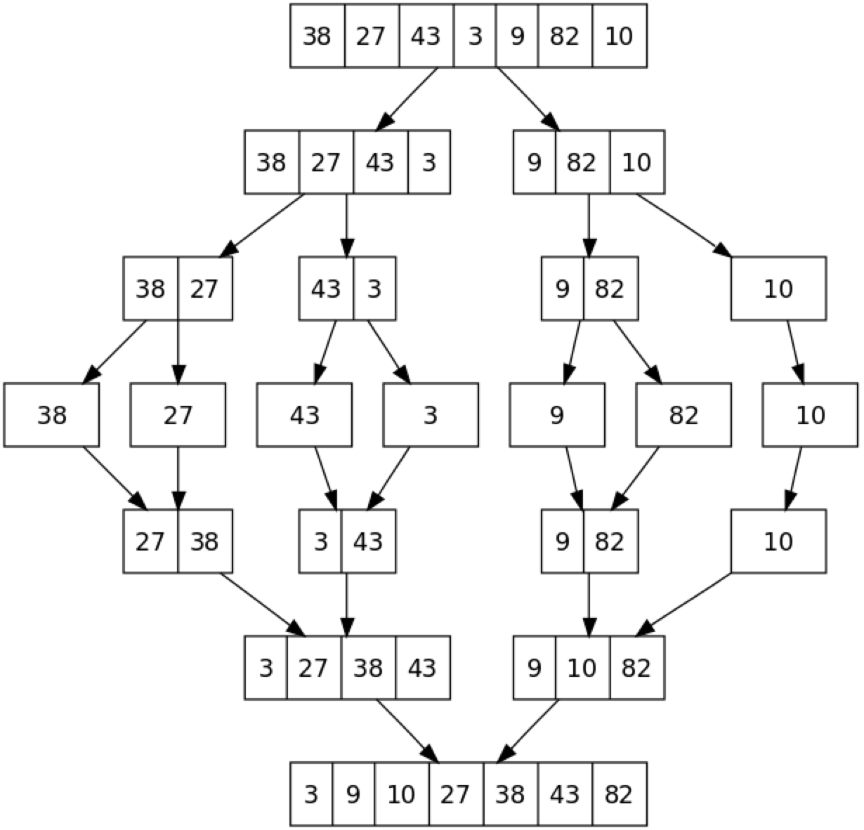
Merge Sort (Wikipedia)
2³ = 8
1
2
3

Slide 19
Summary
Recursive methods call them selves
Recursion can be used
To solve some problems cleanly
To solve some problems quickly
Recursion can be implemented with iteration and a todo list. That is hand code the call stack.

