Slide 1
Images and 2D Graphics (1) COMP 112 2018

Slide 2
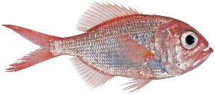
Overview
Graphics
Understanding and Representing Colours
Images and image manipulation
Using Google and the Java API
Arrays
Reference type
Immuteable Objects – and compact colored images

Slide 3
Immutable Objects
An object is immutable if it can not be changed
How do you make immutable objects
All instance variables are private final
Only constructors write to instance variables
What common Java objects are immutable
String
Color
…..
Why make an object immutable?
Why make an object mutable?

Slide 4
Images
Images can be built from 3D objects using:
Color,
transparancy,
reflexivity,
texture,….
But an image is no more than a 2D array of colored pixels
How do you represent the colour of a pixel?
Lots of things you want to do to images
crop, rotate, zoom, change resolution,
change the brightness or colour
blur, sharpen, refocus, join up, morphing,….
compress, decompress,…
image recognition,……………………………

Slide 5
Pixels and Colours
Pixels:
sample of the image, typically representing the colour at or over a small region
Colors: Stored in
Black and white: 1 Bit
Grey scale: 1 integer, 8 bit, 16, 32 bit,….
Colour Palette: eg, 1 byte (8 bits) specifying a colour from a palette of 256 colours
Color: 3 numbers: RGB, HSL, HSV, CMY,…
18 bits, 24 bits, 30 bits, 48 bit”
Color + transparency: 4 numbers
Why three numbers? What is a colour?

Slide 6
Color
Light is made of waves of many different frequencies
spectrum.
Single frequency light: “pure” color.
Different combinations of frequencies are different colors.
red
violet
red
violet
red
violet

Slide 7
Why only three color components?
Human eye has only three different color detectors:
Lots of different combinations of pure colors give rise to the same perceived color
We can’t distinguish all different colors.
Screens are designed for the human eye hence only need three numbers each recording the intensity of one of the colors we can detect.
red
violet

Slide 8
Side track: Displays and Printing
Different display technologies will generate different combinations of “pure” colors, and will look different.
⇒ reproducing true colors on digital displays is very hard.
⇒ calibrating displays is challenging
Printing uses subtractive colors:
adding colors makes it darker
colors behave differently, and are very well specified
may not match what’s on the screen.
If building software, hardware, or websites where color matters, you need to learn more about it!

Slide 9
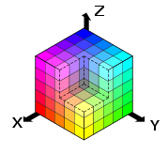
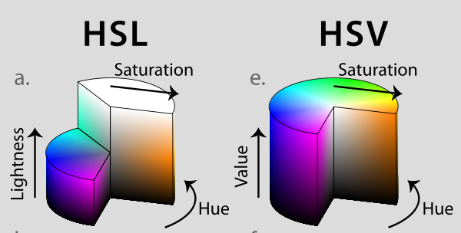
Colors: Which three numbers?
RGB:
red green blue - additive model
0,0,0 = black, 1.0, 1.0, 1.0 = white
typically 24 bits per pixel, 8 bits per component
simple, but poor correspondence to how we describe color
mechanical specification related to how devices generate it color
HSV, HSL
hue, saturation, value/lightness
a way to define color based on
how we describe color
can translate to/from RGB
Try ColorPickerSample.java
On comp112 www.
Run ColourPicker

Slide 10
Transparency (“alpha”) for overlay
Can use a 4th number to represent transparency: (α : [0,1])
Pixels on a screen only have color RGB
Transparency defines how to compute a color from two layers that may have different color.
result = α × color + (1 - α) × old-color
Transparency is useful for Layers and for Paints.
Colour choosers:
Java: javax.swing.JColorChooser
Powerpoint

Slide 11
Color in Java
Color is represented by 32 bit color = 4 bytes = 4 × 8 bits, 1 byte each for red, green, blue, alpha
Has constructors that take
3 or 4 integers (0-255)
new Color(20, 172, 230); new Color(20, 172, 230, 128);
a single integer:
new Color(1354982) ; new Color(0x14ACE6);
new Color(2148838630, true); new Color(0x8014ACE6, true);
3 or 4 floats (0.0 … 1.0)
new Color (0.0781f, 0.6718f, 0.8984f);
new Color (0.0781f, 0.6718f, 0.8984f, 0.5f);
Note: the different range of int and float parameters can result in out of range errors especially given auto type casting.
hexadecimal
literals (ints)
float .
literals

Slide 12
Java Application
Java program from ColorPickerSample.java code on course home pages.
final ColorPicker colorPicker = new ColorPicker();
colorPicker.setValue(Color.CORAL);
final Text text = new Text("Try the color picker!");
text.setFont(Font.font ("Verdana", 20));
text.setFill(colorPicker.getValue());
colorPicker.setOnAction(new EventHandler() {
public void handle(Event t) {
text.setFill(colorPicker.getValue());
}
});
Build object
Return chosen color

Slide 13
Images: file formats
Why so many image formats? (raster based formats)
JPEG, (lossy compression)
TIFF, (allows high quality 48 bit colour)
GIF, (palette of 256 24-bit colour, lossless compression)
PNG, (palette and 24-bit, lossless compression)
BMP, (range of formats, usually large)
PNM, (very simple, no compression, large)
WebP, (recent replacement for PNG)
…..
What is in an image file?
header: information about the image (format, size, ….)
pixel values (compressed and encoded)
Use Libraries to read and write standard file formats

Slide 14
Images: internal data structures
Good data structure for Java programs working with images?
2D array of Color
2D array of int: alpha red green blue
2D array of int [3], float [3], int [4], float [4]: {red,green,blue,α}
All that you need in this course is the 2D array of Color

Slide 15
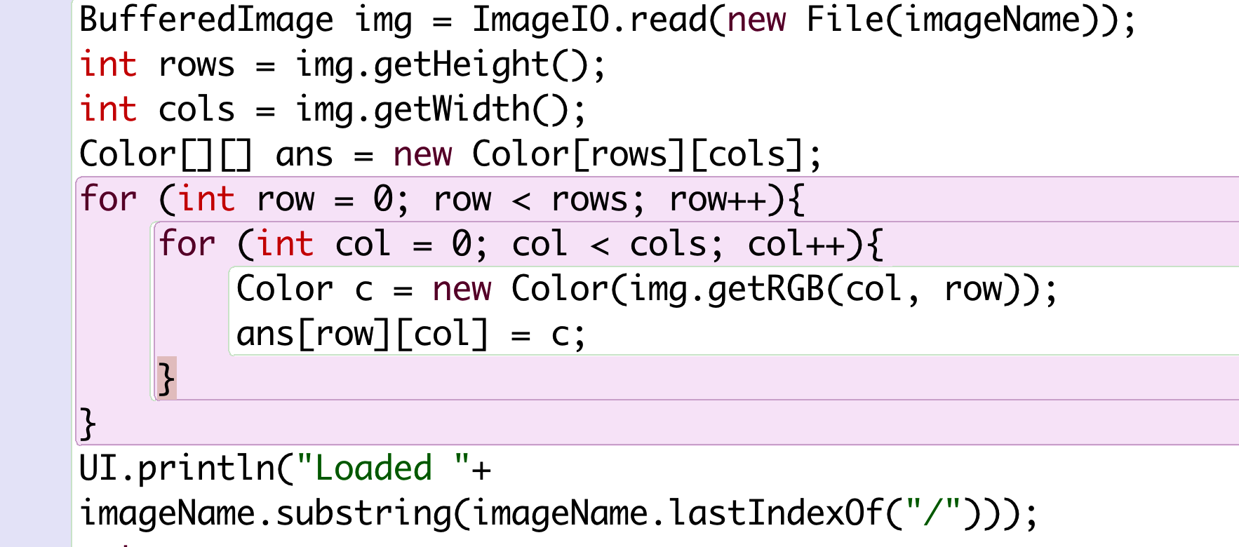
Use libraries when programming!
Google java read image from file
Use library to read standard file formats
How do I build
Colors from image?
Read Color api
Read BufferedImage api

Slide 16
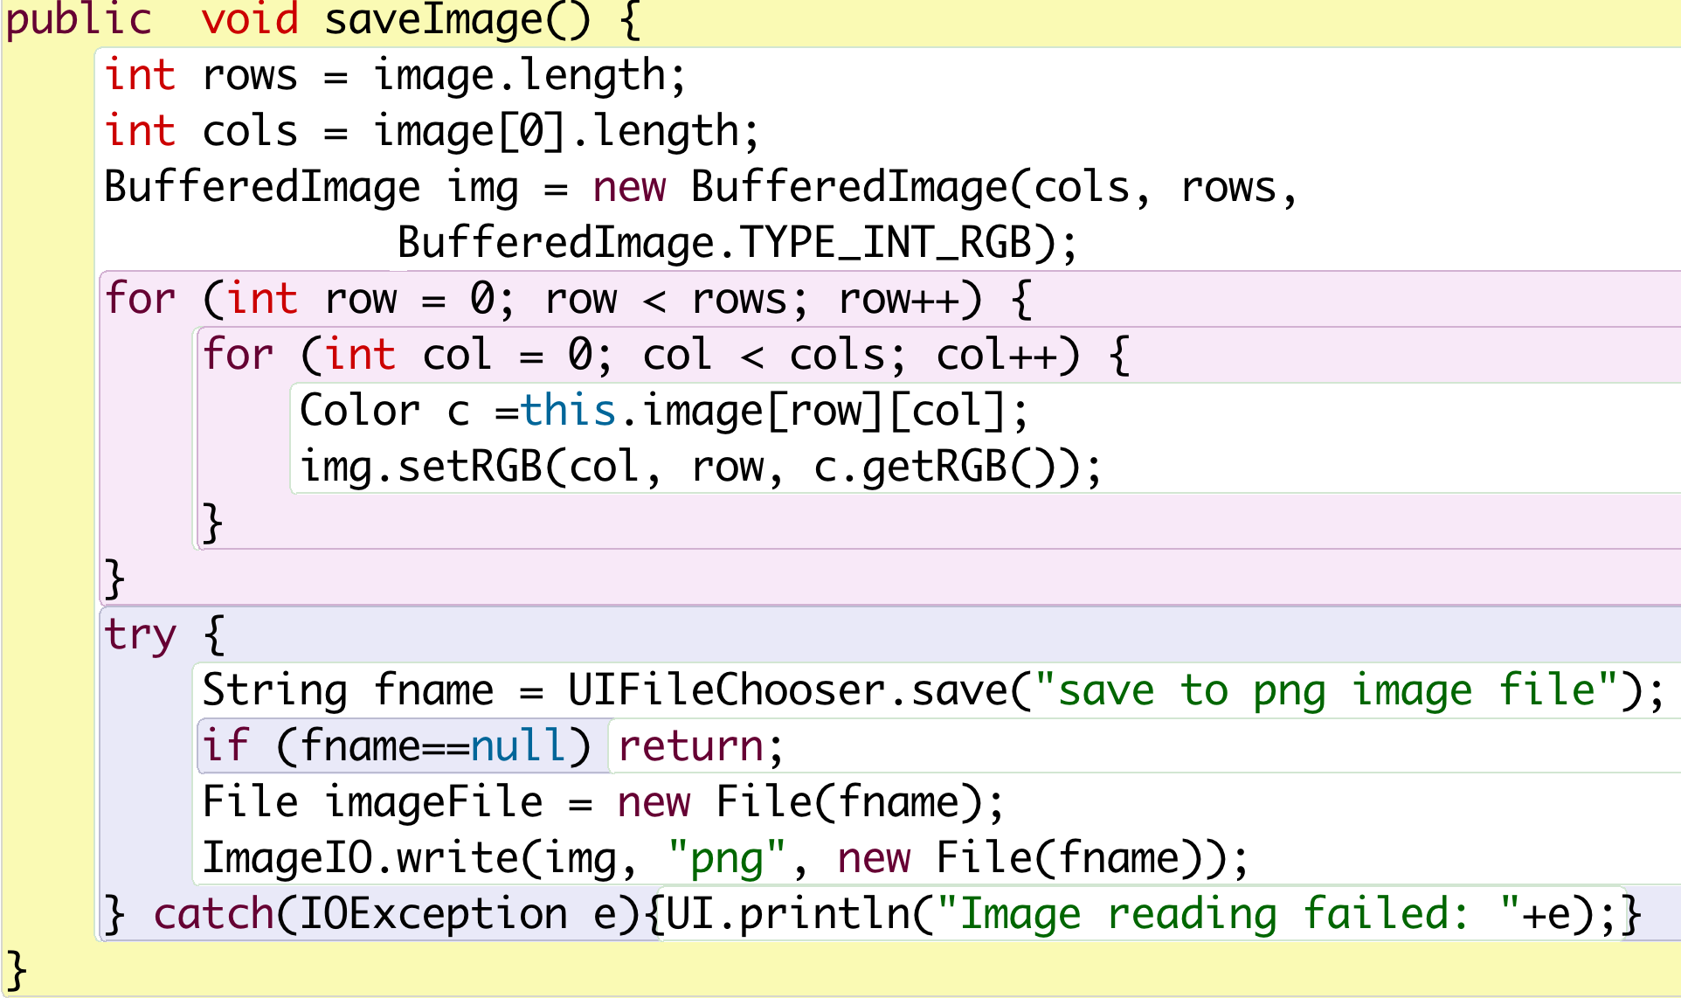
Save Color [ ] [ ] to image file
How do I build an image from Colors
Look up BufferedImage api and Color api

Slide 17
Pot Holes to fall into:
When you are in a Pot Hole ask yourself if you need to:
look up an object api
Google for a java code fragment
An image is a 2D array of pixels
Array variables are reference
Color is an Object hence reference type but is immutable
Color can be built by three variables red, green and blue they can either be three ints or three floats. But the range of the int and float is different. + java can convert an int to a float when used in a computation.

Slide 18
Pothole
An image is a 2D array of pixels
Image A point to an array of rows.
A row points to an array of pixels
A pixel points to a Color object
Rows 0,1,.. i
A
i
Color
Cols 0,1,.. j

Slide 19
Pothole
An image is a 2D array of pixels
Will changing A change B?
B = A;
B = for(int i = 0; i< A.length; i++) { B[i] = A[i] }
Rows 0,1,.. i
A
i
Color
Cols 0,1,.. j
B
B
i

Slide 20
Pothole
An image is a 2 D array of pixels
Will changing A change B?
B = for(int i = 0; i< A.length; i++) {
for(int j = 0; j< A[0].length; j++) { B[i][j] = A[i][j] }}
Is this a problem?
Rows 0,1,.. i
A
i
Color
Cols 0,1,.. j
B
i

Slide 21
Immutable & repeated images
Rows 0,1,.. i
If Color was mutable changing A[i][j] would change B[i][j].
Color is an immutable object. Hence it is safe for A and B to share pixel Color objects.
Indexed color extends this idea to pixels of the same color in a single image.
A[i][j]
A
i
Color
Cols 0,1,.. j
B
i

Slide 22
Immutable & indexed color
Rows 0,1,.. i
Color is an immutable object hence multile pixels that have the same color can share the same Color object.
Store an image with a color palette. Each pixel contains the index into the palette and not the color itself.
Indexed color is used to save memory and file storage while speeding up display refresh and file transfer rates
A
i
Color
Cols 0,1,.. j

Slide 23
Quick Overview
Java Colors are:
Immutable objects
Have different representations
Objects are of reference type.
Arrays of objects are references to references
Cloning an array requires deep coping.
Immutable objects allows sharing both:
Within an array
Between arrays

