Slide 1
Networking and Concurrency COMP 112 2018

Slide 2
Menu
Recall the many client problem for the Echo Server
You need to:
Understand what the problem is
How the solution works
Recognise a similar problem and apply the same solution
(Echo Server ----- IRC Client)

Slide 3
The two Client problem!
What dose the server look like if there are two clients
Unknown action order
A
B
Wait input
Display
Wait input
Display
Wait echo
send to server
Wait echo
send to server
Receive from B Send to B
Receive from A
Receive from A
Send to A
Receive from B
S
Receive from B
Send to B
Send to B
Send to A
Send to A Receive from A

Slide 4
Problem!
Cope with unknown execution order!

Slide 5
Building blocks for solution.
Computers appear to execute two programs at once
A process has state and a thread of execution
Two processes have disjoint state
One processes can have multiple threads of execution
Process
State
State
Each thread shares the same state as all other threads of the same process
This can introduce very subtle errors!
Thread
State
State

Slide 6
Echo Server
The Server may have lots of Clients and needs to process each Client with no apparent delay
Client processing should be independent of each other
Server canot wait for Client A to respond else Client B may have to wait utill after A reponds
Echo Server has one process listening for new clients and one process listening for client comunication.
The process listening for client comunication has one thread for each Client
Basic Server design:
Listen to the port. (unknown number of clients)
Start a new thread for each client (unknown action order)

Slide 7
Concurret Echo server
Server
Client B
Client A
Server and Client are distinct processes
Client connects to server (main thread)
Server main thread runs a new thread to communicate with each Client
Distinct clients are distinct processes
The sever runs separate threads for each client

Slide 8
Concurrent Echo Server Design
Main Program
Listen to the port.
Loop
Wait for a new client to try to connect
create a new socket for the client connection
start a thread to process the client
Thread processing the client
Loop
listen for input from client
echo it back
quit if the message was QUIT

Slide 9
Problem + Solution
Cope with unknown execution order!
Use more than one thread

Slide 10
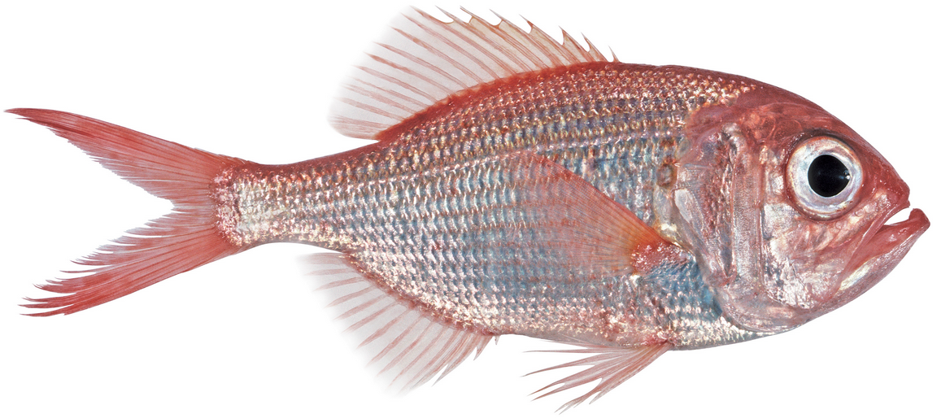
Echo Server: Listening for clients
Executed when
calling EchoServer
public class EchoServer{
public static final int PORT = 6667; // The port the server will listen on
public static void main(String[] args) {
try{
ServerSocket serverSocket = new ServerSocket(PORT);
System.out.println("Waiting for clients to connect...");
while (true) {
Socket socket = serverSocket.accept();
System.out.println("Found client");
EchoService echoService= new EchoService(socket);
new Thread(echoService).start();
}
}catch(IOException e){System.out.println("Failed to connect" + e);}
}
}
One port
One port
Many sockets
wait for a client
Builds new socket
new thread
Executes constructor
Executes
the run method

Slide 11
Echo Service: per client
class EchoService implements Runnable {
private Socket socket;
private Scanner clientIn;
private PrintStream clientOut;
public EchoService(Socket socket) {
this.socket = socket;
try {
clientIn = new Scanner(socket.getInputStream());
clientOut = new PrintStream(socket.getOutputStream());
}
catch (IOException e) {System.out.println(“Connection failed." + e);}
}
Constructor only sets up streams for socket

Slide 12
Echo Service: per client
For each client this is Executed in a separate thread
public void run() {
while (clientIn.hasNext()) {
String message = clientIn.nextLine();
System.out.println("Received: "+ message);
if (message.equals("QUIT")) { break;}
clientOut.println("ECHO: "+ message);
clientOut.flush();
}
try{ socket.close();}
catch (IOException e) {System.out.println("Error socket close" + e);}
System.out.println("Client disconnected.");
}
}
Shared memory
Note flush stream

Slide 13
Synchronous or Asynchronous?
Two different echo clients are asynchronous
Each echo client:
While(true)
get message from user
send message to server
get reply from server
display reply
How do you want an IRC client to behave ?
IRC client:
messages may come from the server to be displayed to the user
messages may come from the user to be sent to the server
client must be concurrently listening to user and server
each client must have two threads!
Each client is Synchronous:
one thread sending and receiving.
Fixed cycle of interaction
NO Fixed cycle of interaction
Each client is Asynchronous:
one thread sends user input to server
another receives data from server and displays .

Slide 14
Reuse solution.
Cope with unknown execution order!
Use more than one thread
Similar problem similar solution
Echo server. - IRC Chat client

Slide 15
The Asynchronous Client problem!
What dose async client look like!
One thread one waiting for user input
Another waiting for server input
What about output?
Assume fast so put any where
Keep
All sever IO in Server thread
All user IO in User thread
Communicate via shared memory
Evaluate!
S
Wait On
Server input
Output to
User
U
String out
User
output
Wait On
User input
Output to
Server

Slide 16
Asynchronous client
public class AsynchClient {
private static final String SERVER = "localhost";
private static final int PORT = 6667;
private Socket socket;
private Scanner input;
private PrintStream output;
public static void main(String[] args) { new AsynchClient(); }
public AsynchClient(){
try {
socket = new Socket(SERVER, PORT);
new Thread(new Runnable(){ public void run(){
listenToServer();
}}).start();
listenToUser();
}catch(IOException e){UI.println("IO failure "+ e);}
}

Slide 17
Asynchronous client
public void listenToUser(){
PrintStream output = new PrintStream(socket.getOutputStream());
while (true) {
String toSend = UI.askString(">");
output.println(toSend);
output.flush();
}
}
public void listenToServer(){
Scanner input = new Scanner(socket.getInputStream());
while (input.hasNext()){
String line = input.nextLine();
UI.println("SERVER: "+ line);
}
}

Slide 18
Threads
What is a thread?
Like a separate CPU running a program (or part of a program).
independent of all the other threads (could be faster or slower).
Java threads all have access to the same memory
Two threads accessing the same location can cause conflict and error
Safe Programming with threads is HARD.
Harder to debug.
No problems if the different threads don’t share any resources
You should expect some odd things to happen if the threads do share resources (eg, the same window!)

Slide 19
How do you get a Thread?
The main method is called with one thread
anything it calls is executed in that thread:
main → constructor
The GUI events are executed in a separate thread called by the Java language not you, the application programmer.
repainting, responding to mouse, buttons etc.
You can create a new Thread object and call run() on it.

