Slide 1
An Arduino Workshop
A Microcontroller

Slide 2
What is Arduino?
An open source platform (from Italy)
At its heart is a microcontroller, a computer on a chip
It is in effect a small computer
A microcontroller (sometimes abbreviated µC, uC or MCU) is a small computer on a single integrated circuit containing a processor core, memory, and programmable input/output peripherals.
The majority of microcontrollers in use today are embedded in other machinery, such as automobiles, telephones, appliances, and peripherals for computer systems
www.Arduino.cc – Free 140MB download

Slide 3
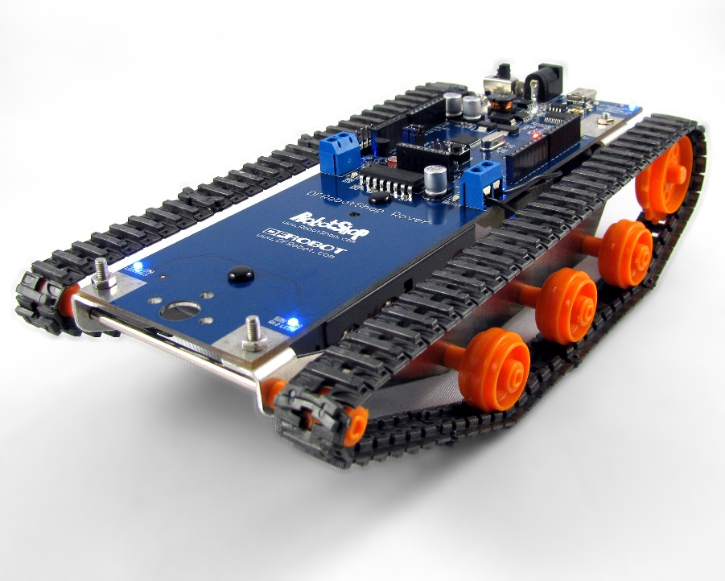
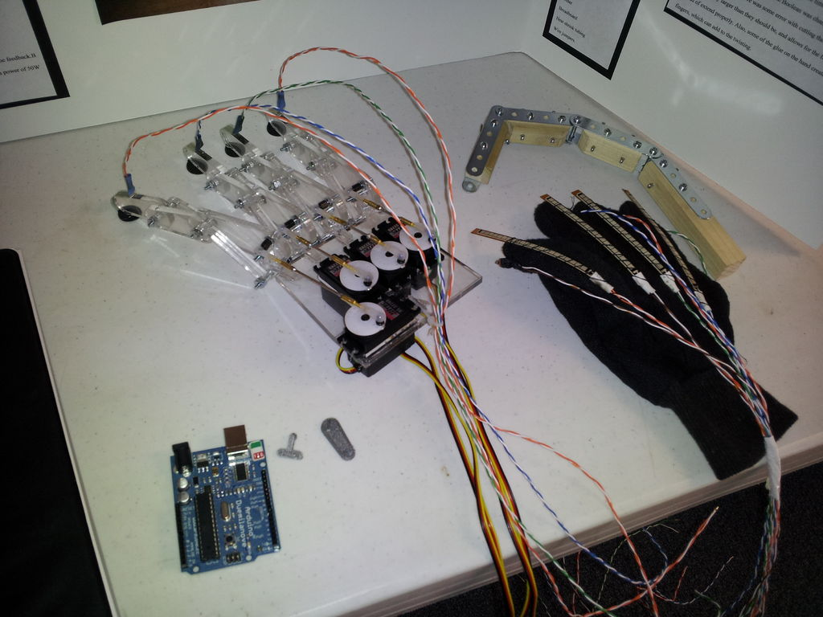
Robotics at University

Slide 4
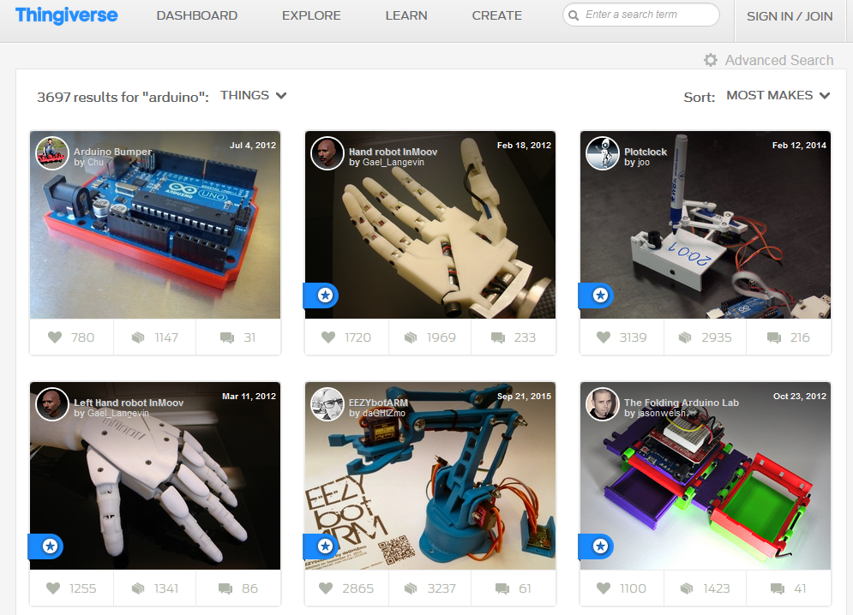
Thingiverse.com

Slide 6
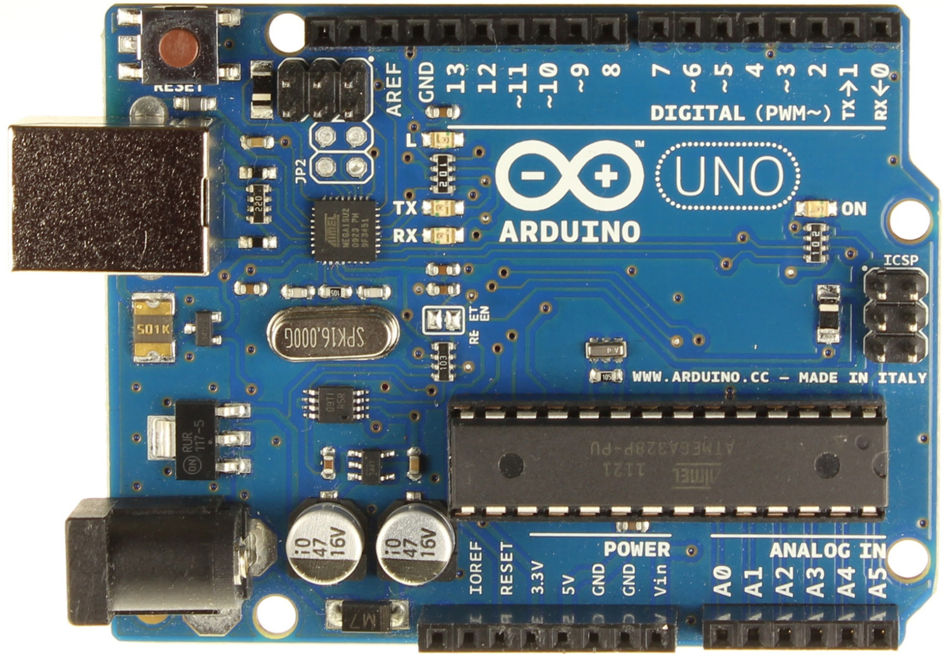
USB Interface chip
Digital Connections
Transmit (TX) Receive (RX)
Reset Button
USB Port
Serial Programming
Connector
Crystal
5V regulator
Microcontroller
(Atmega 328)
Power
(7-12V DC input)
Power Connectors
Analog Inputs

Slide 7
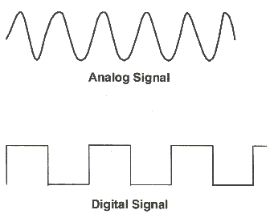
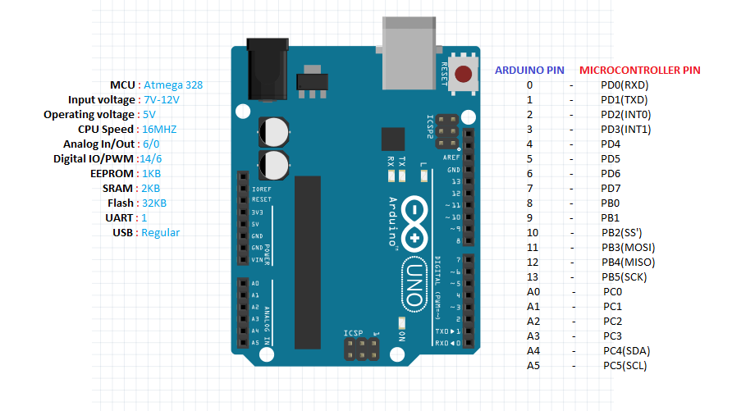
In more detail
Digital pins 3,5,6,9,10 & 11 can do pulse with modulation PWM (variable output) can be noted ~
Arduino can do 16 million instructions per second (16MHz)
‘add 14’

Slide 8
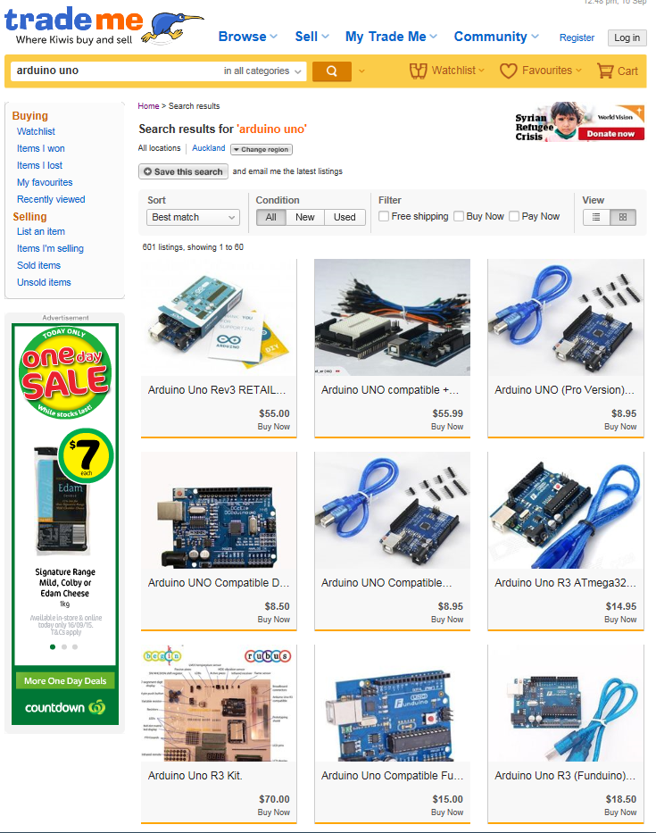
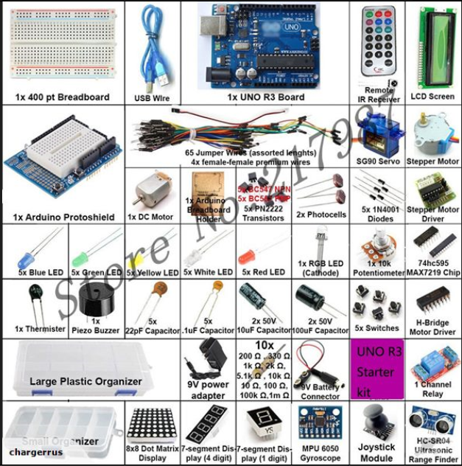
How much do they cost?
$75 for a kit

Slide 9
Where to start?
Come up with your own little project
Explore some crazy ideas
Look it up on the internet
Modify others’ blocks of code to your purposes
Then expand, get a kit, learn some more tools and try some more projects

Slide 10
There is more than a few types….

Slide 11
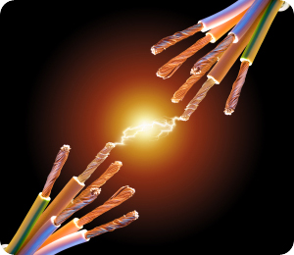
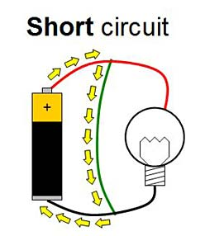
Before we start, handling the boards…
Once they are powered up please don’t touch the boards
Our fingers can create a short circuit on the board and ZAP it

Slide 12
‘Hello’ – of in our case Mr Blinky
We are going to plug our Arduino into the computer.
Then we create or load a sketch (program) and then upload it to the Arduino.
A lot of software programs use a hello command as a test when you first start.
The programming language we use with Arduino is called C
In our case we are going to do a blink test.

Slide 13
Blink test
We need to tell the computer software what kind of Arduino we have:
<Tools>, <Board>, <Arduino UNO>
We need to tell the computer software where the Arduino is plugged in:
<Tools>, <Port>, <comx\Arduino> for Windows OS
<Tools>, <Serial Port>, <dev/ttyUSB0> for Linux OS
Then we load an example sketch:
<File>, <Examples>, <01.Basics>, <Blink>
The sketch (program) is now loaded into the window….
It make the LED blink (Light Emitting Diode)

Slide 14
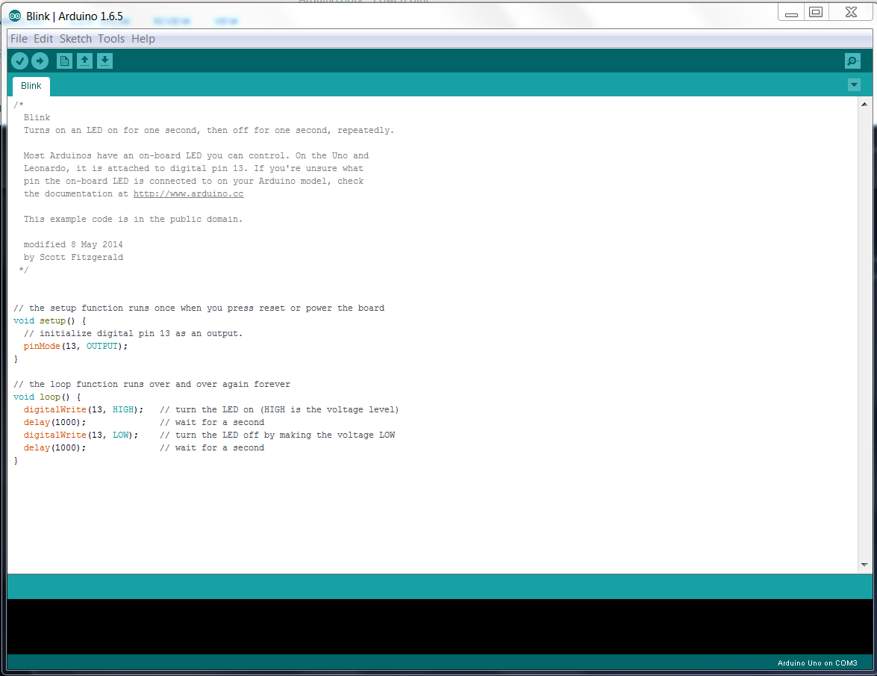

Slide 15
‘ello, ‘ello, ‘ello, wot ‘ave we here….
*/ is a comments section
// are comments (the sign of good coding practice!)
Void setup is run once at the start to set up the environment
Void Loop is where the sketch program is mainly written and does all the work

Slide 16
What does it all mean?
Arduino is a 5V system, if we plug in a 9V battery we fry things (up in smoke)
pinMode sets a particular pin to be either an input or an output
HIGH means ‘give all she's got Scotty’ = 5V
LOW means turn ‘off’ = 0V
Delay means to wait for ‘x’ milli seconds
digitalWrite is a name of something

Slide 17
Programming Language (jargon)
pinMode is an Output in this example (rather than an input)
HIGH and LOW are arguments. They are passed to a function when it is called.
Delay is a singular argument. We can split arguments up with comma’s
digitalWrite is a name of a built-in function, it needs to know where to pass the information to when it is called. We put this in parentheses {} to define what is being called.
The parentheses and the code in between them are know as a block of code
We then compile our code and upload it to the Arduino

Slide 18
Compile and Upload

Slide 19
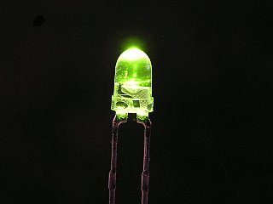
So lets mix it up
What might happen when you change the delay times?
Try it
Change the delay time and upload it to the Arduino
Observe what happens to the blink rates

Slide 20
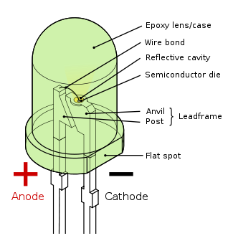
Just plug a LED onto the board….
Careful as we can cook the LED
Plug it into GND
And Pin 13
Wrong way around?

Slide 21
IR Sensor
<File>, <Examples>, <01.Basics>, <AnalogReadSerial>
Black = ground
Red = power
Other (white) = A0
Our sensor uses near I/R (black & white)
Far I/R = heat sensor

Slide 22
Serial Monitor
Open the serial monitor, the small magnifying glass in the top right hand corner
What do we see?
What happens when you move your hand towards the sensor?
Why does it stop if you put your hand on it and leave it there?

Slide 23
Make the LED…..
<File>, <Examples>, <05.Control>, <IfStatementConditional>
What happens now?
The LED comes on as we trigger the sensor

Slide 24
Time to get moving….
<File>, <Examples>, <Servo>, <Sweep>
180 servo, what does that mean?
Red/yellow = power
Black/brown = ground
‘other’ (orange) = comm’s
Which pin do we use for the orange connector?
Pin 9

Slide 25
Move when I move….
<File>, <Examples>, <Servo>, <Knob>
The servo now changes drive direction based on you triggering the sensor

Slide 26
The problem with servos….
They make bad wheels!
Replace the 180 servo with an unlimited servo

Slide 27
Lets make some noise
Replace the LED with a speaker
<File>, <Examples>, <0.1Basic>, <Blink>
Why does it work?
How does it work? What are sound waves?

Slide 28
Sounds good to me…
<File>, <Examples>, <02.Digital>, <toneMelody>
Read the sketch
Change the numbers and modify the tune

Slide 29
Ta Da!
We have added sensors and had things respond to the world around them
We have modified code
We have repurposed code to what we want it to do
https://circuits.io/

Slide 30
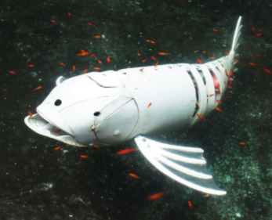
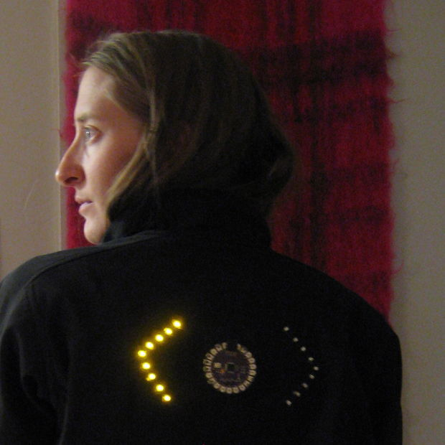
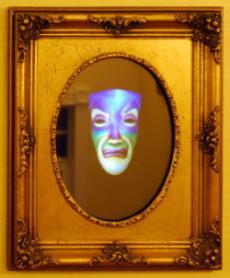
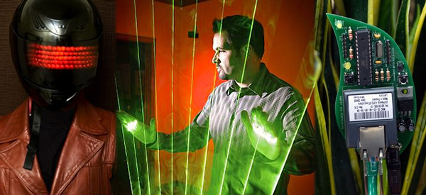
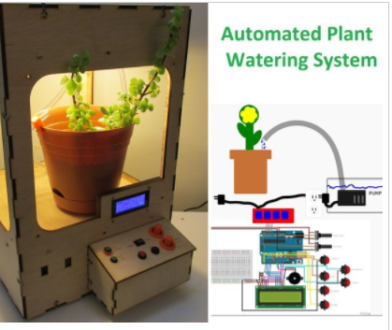
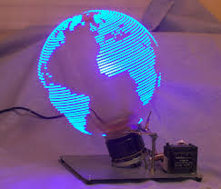
Crazy projects….
https://www.instructables.com/id/Arduino-60/
http://hacknmod.com/hack/top-40-arduino-projects-of-the-web/

