Slide 1
Sound Effects with Arduino
A Microcontroller

Slide 2
Notes
This material has been put together by the Outreach coordinator of the School of Engineering and Computer Studies (SECS) at Victoria University of Wellington (VUW), New Zealand.
It is free to distribute and pass on to all who may find it useful.
The author of this presentation and supporting documents can be reached at: john.barrow@vuw.ac.nz

Slide 3
Learning Objectives
Students can configure and use a piezo electric speaker
Students can configure and use a melody

Slide 4
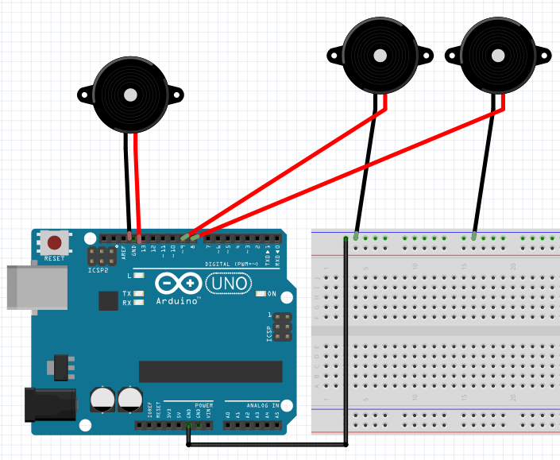
More free form setup
Plug a piezo electric speak in
It needs a GND and power, which it will draw from a Pin, in this case pin 13 , 9 and 8 in the diagram
We can add multiple speakers as required, as long as the pin is specified in the sketch and connected as such
We just need one to start with

Slide 5
Blink test repurposed
As mentioned at the end of the last lesson names are handles for people to read and make sense of
We can repurpose code and apply its concepts to other functions
<File>, <Examples>, <0.1 Basics>,<Blink>
We will get a regular pulse/beat sound out of the speaker

Slide 6
Tone melody
<File>, <Examples>, <02. Digital>, <tonemelody>
Read it, where is the speaker to be plugged into?
Pin 8 and GND
Can you modify the tune?
How?
If you have worked it out explain it to a friend
Try modifying the code to get a different tune/tone(s)
Got it? Try tone multiple if you are ahead of the others

Slide 7
Tone multiple
<File>, <examples>, <02 Digital>, <tonemultiple>
Try 3 speakers (so you will need to do this in a small group)
Where are they connected to? Read the Script

Slide 8
Another one to explore
<File>, <Examples>, <SIK_Guide_Code_32>, <Circuit_11>
It should be no trouble to pick which pin to use

Slide 9
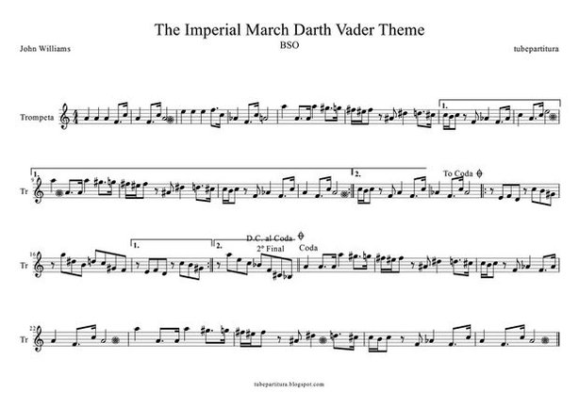
Star wars tune – look it up and try it
http://www.instructables.com/id/How-to-easily-play-music-with-buzzer-on-arduino-Th/
http://forum.arduino.cc/index.php?topic=259450.0

Slide 10
Explore
Play with the tones and tunes
See what you can modify, experiment and play

