Slide 1
Welcome to Arduino
A Microcontroller

Slide 2
Teaching and planning

Slide 3
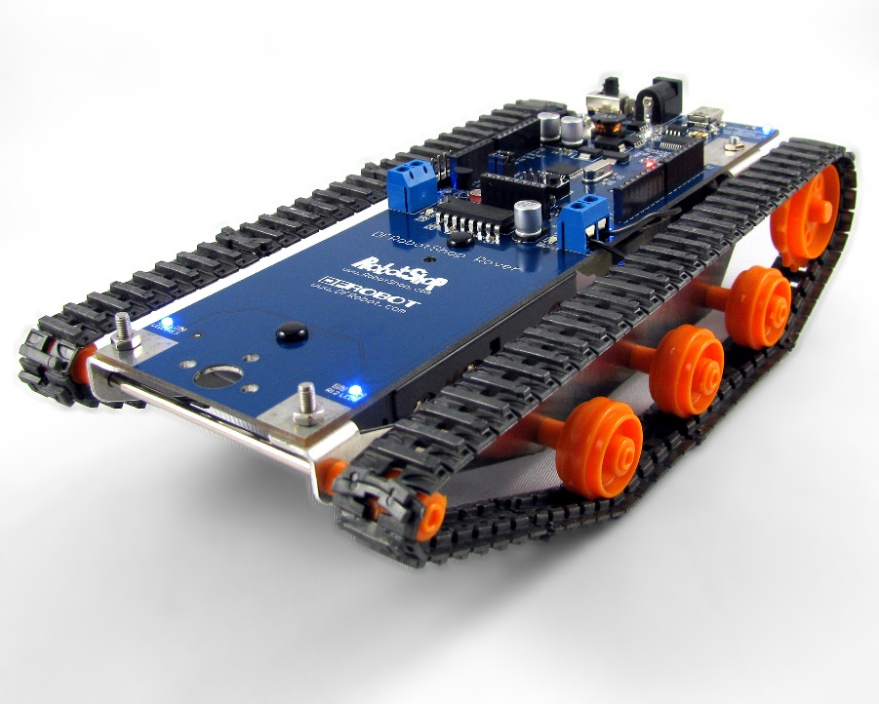
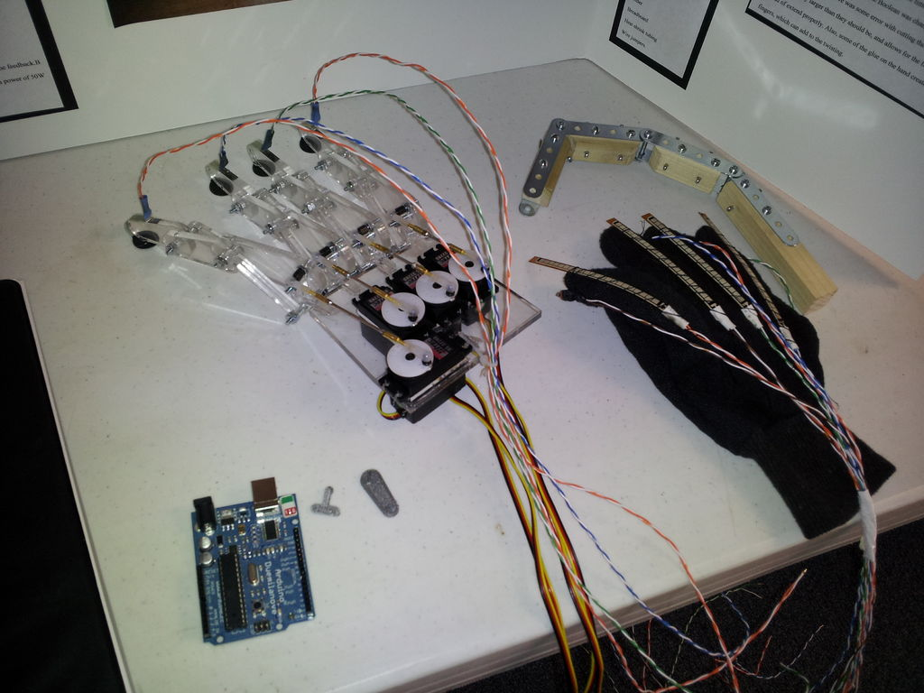
Robotics at University

Slide 5
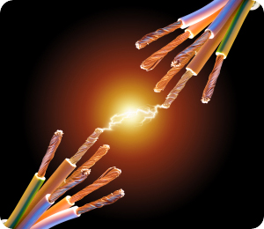
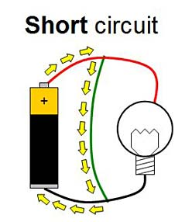
Before we start, handling the boards…
Once they are powered up please don’t touch the boards
Our fingers can create a short circuit on the board and ZAP it

Slide 6
Make sure we are good to go…(from last lesson)
Standard install, nothing complicated
We need to tell the computer software what kind of Arduino we have:
<Tools>, <Board>, <Arduino UNO>
We need to tell the computer software where the Arduino is plugged in:
<Tools>, <Port>, <comx\Arduino> for Windows OS
<Tools>, <Serial Port>, <dev/ttyUSB0> for Linux OS
(most likely as the UNO is the standard board, otherwise specify as required)
Good to go!

Slide 7
‘Hello’ – of in our case Mr Blinky
We are going to plug our Arduino into the computer.
Then we create or load a sketch (program) and then upload it to the Arduino.
A lot of software programs use a hello command as a test when you first start.
The programming language we use with Arduino is called C
In our case we are going to do a blink test.

Slide 8
Blink test
We load an example sketch:
<File>, <Examples>, <01.Basics>, <Blink>
The sketch (program) is now loaded into the window….
It will make the LED blink (Light Emitting Diode) when we upload it
We are looking at….

Slide 9
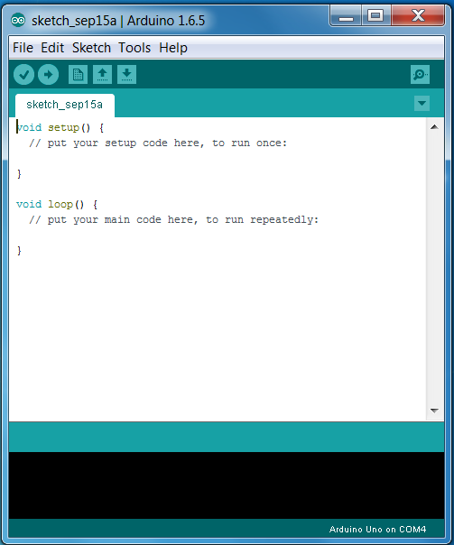
IDE
Integrated Development Environment, has 3 main parts:
Tools
Sketch
Window
Board and Serial connection details
Message
Window

Slide 10
IDE
Screen dump this (CTRL + PRTSCR) or use the snipping tool
(For MS Windows: click on <start>, in the <run> window type ‘snipping’ and select the app)
Print the IDE out TWICE (one blank, one with the blink sketch)
Stick both in your journal with room to label them
Label it with the main IDE window functions

Slide 11
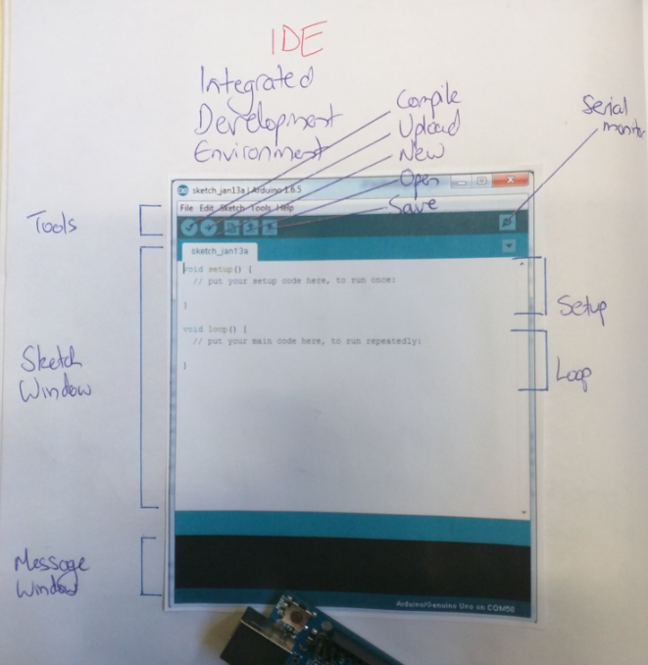
Journal entry:
Will look something like…
Use one to label the IDE
Use the second (with blink) to label the sketch (later)

Slide 12
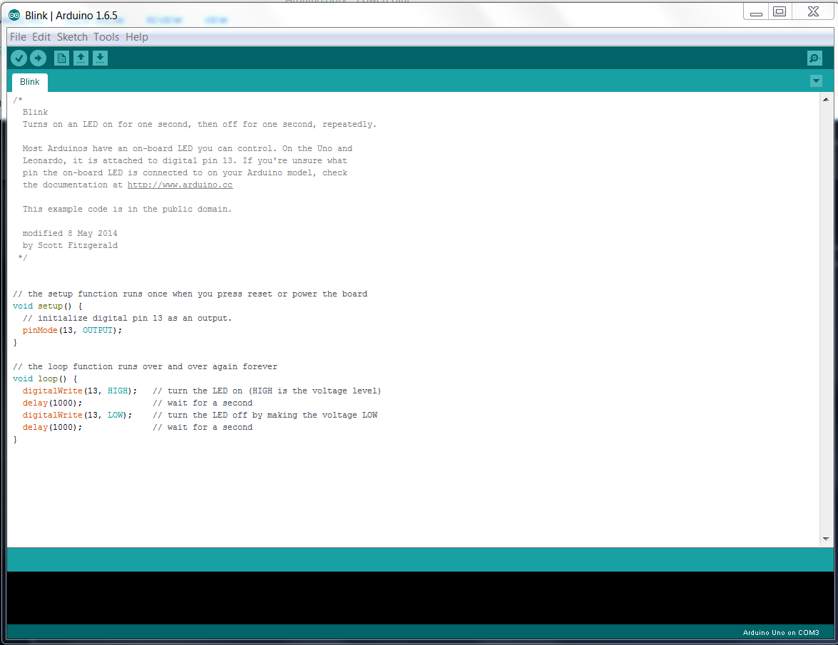

Slide 13
‘ello, ‘ello, ‘ello, wot ‘ave we here….
*/ is a comments section
// are comments (the sign of good coding practice!)
Void setup is run once at the start to set up the environment
Void Loop is where the sketch program is mainly written and does all the work

Slide 14
What does it all mean?
Arduino is a 5V system
pinMode sets a particular pin to be either an input or an output
HIGH means ‘give all she's got Scotty’ = 5V
LOW means turn ‘off’ = 0V
Delay means to wait for ‘x’ milli seconds
digitalWrite is a name of something

Slide 15
Programming Language (jargon)
pinMode is an Output in this ‘blink’ example (rather than an input)
HIGH and LOW are arguments. They are passed to a function when it is called.
Delay is a singular argument. We can split arguments up with comma’s
digitalWrite is a name of a built-in function, it needs to know where to pass the information to when it is called. We put this in parentheses {} to define what is being called.
The parentheses and the code in between them are know as a block of code
We then compile our code and upload it to the Arduino

Slide 16
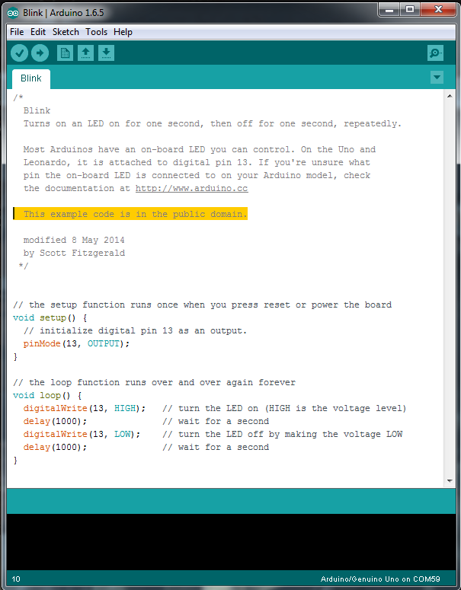
Compile and Upload
Compile/Error check
Upload
New
Open
Save
Open Serial Monitor
Add this to the first journal picture

Slide 17
IDE labels
To the second IDE picture in your journal add:
Void loop section
Void setup section
Note a comments section (*/…./*)
Note a comment (//)
Note an Output (or input)
Note an argument (high/low)
Note a singular argument (delay)
Note a name (digitalwrite)

Slide 18
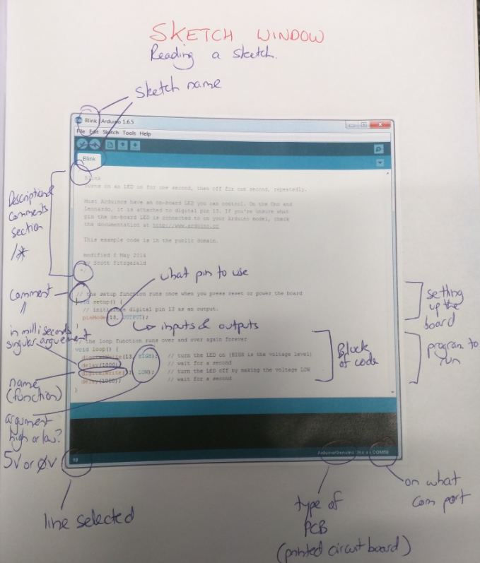
So…

Slide 19
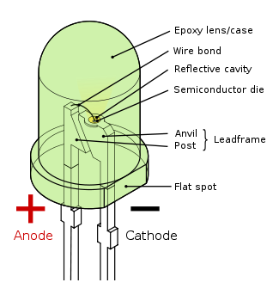
Does it work?
Check where the pins are plugged into
Turn the LED 180º
The long leg is positive

Slide 20
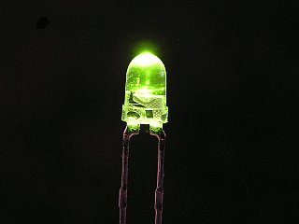
So lets mix it up
What might happen when you change the delay times?
Try it
Change the delay time and upload it to the Arduino
Observe what happens to the blink rates

Slide 21
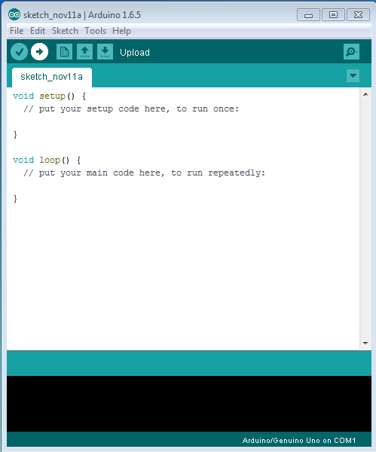
Another blink test…
Time to write your own code from the beginning, open the Arduino console:

Slide 22
Enter….
//My 1st Project – LED flasher
int ledPin = 9;
Voide setup() {
pinMode (ledPin, OUTPUT);
}
Void loop() {
digitalWrite(ledPin, HIGH);
delay(1000);
digitalWrite(ledPin, LOW);
delay(1000);
}
NOTE:
The sketch/program is CASe sNESitive and S P A C E sensitive
That is the key point of this exercise

Slide 23
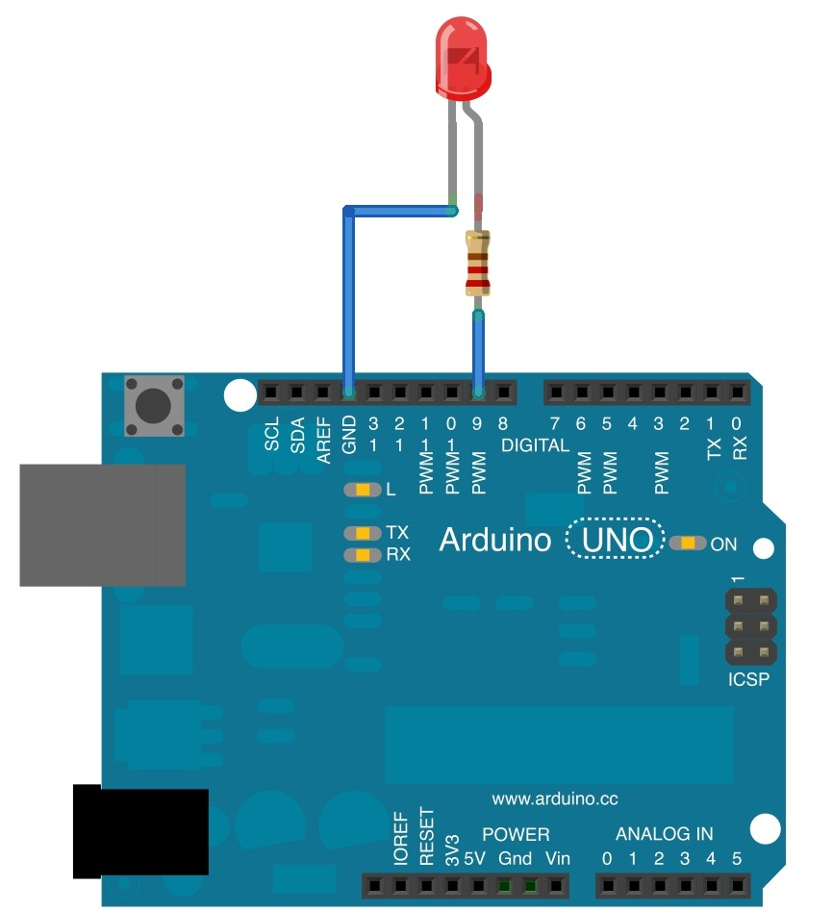
Take the LED and….
Problem – you can burn out the LED
So add a 100 Ω resistor…
Connect and insert it into….
Pin 9
GND

Slide 24
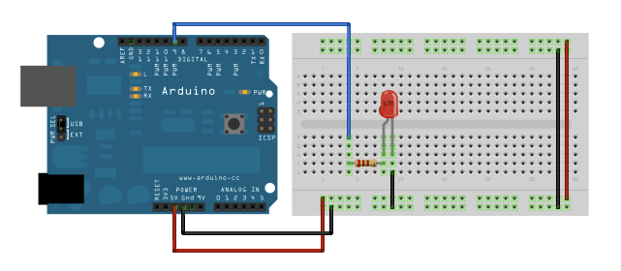
This leads to:
Adding a breadboard (note diagram uses Pin 9 like our code)
More on breadboards in the next lesson.

Slide 25
Fritzing diagram
http://fritzing.org/home/
Used this last lesson
Create the diagram
Save the diagram with a name such as LED project 1, LED project 2
Print the 2 diagrams
Add the diagrams to your journal

Slide 26
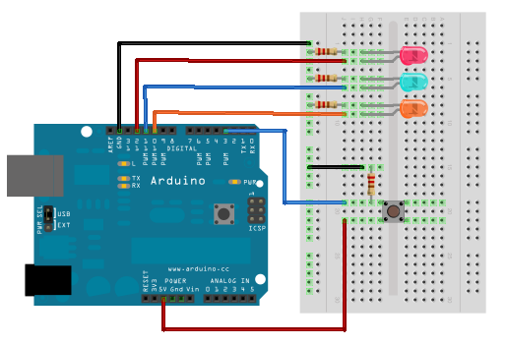
This way was can add more LED’s…
The next project:
http://arduino.sundh.com/

