Slide 1
Automatically Evolving Difficult Benchmark Feature Selection Datasets with Genetic Programming
Andrew Lensen, Dr. Bing Xue, and Prof. Mengjie Zhang
Victoria University of Wellington, New Zealand
GECCO ’18: Evolutionary Machine Learning (EML) Track

Slide 2
Feature Selection
Many datasets have a large number of attributes (features).
Feature Selection (FS) is often used to select only a few features:
Reduce the search space for data mining.
Improve interpretability of evolved models (less complex).
What features should be removed? Two main types:
Irrelevant/noisy: add little value to the dataset, or even mislead.
Redundant: Share high amount of information with other features.

Slide 3
Evaluating FS Algorithms
How do we know how good a FS algorithm is at identifying each type of “bad” feature?
Identify noisy/redundant features in an existing dataset, then see how well our algorithm detects these.
But doing so is equivalent to performing FS → NP-hard…
Or, add some generated “bad” features to an existing dataset.
How?

Slide 4
Generating “Bad” Features
Generating noisy features is relatively straightforward:
Use a Gaussian/uniform/… feature generator.
Can vary the level of noise.
Ways of generating redundant features (rfs) are much less apparent.
Naïve approach: duplicate or scale existing features (+noise).
But makes easy-to-detect features: e.g. Pearson's correlation!
Also not representative of real-world redundancy interactions.

Slide 5
How to generate redundant features then?
In our previous work (Lensen et al. EuroGP ‘18) we proposed a Genetic Programming (GP) approach to do so.
Evolved mappings from existing (source) features in a dataset to new redundant features.
Fitness function used mutual information to encourage creating diverse features with maximal redundancy to source feature.

Slide 6
Our previous approach: GPRFC

Slide 7
GPRFC: Multiple Trees
Use t trees per GP individual, to give t created redundant features.
Similar representation to using GP for feature construction.

Slide 8
GPRFC: Limitations?
We only considered univariate feature redundancies – i.e. one source’s redundancy with one created features.
Real-world datasets often have multivariate (MV) redundancies.
Fitness function was a bit of a rough proxy/surrogate: it minimised MI between created features to encourage diversity.
Won’t work well in a MV approach as created features much more inter-connected.

Slide 9
Goals of GPMVRFC
Develop a new multi-tree GP approach to create multi-variate redundant features with a refined fitness function.
What GP representation to use for a MV approach?
Which fitness function can work well with a MV approach?
How good are the created rfs?
How does this approach compare to existing GPRFC?

Slide 10
Terminal & Function Sets
Multiple terminals: each source feature used. Between 2 and 5 source features depending on dataset size.
Range of functions used to maximise ability of GP to find different types of redundancies:
Unary: $\sin\left(a\right),\tan\left(a\right),\tanh\left(a\right),\log\left(a\right), e^{a}, \sqrt{a},a^{2},a^{3},−a$.
Binary: $a+b, a ×b,\min\left(a,b\right),\max\left(a,b\right),a^{b}$.
Ternary: $if(a,b,c)$: if a is +ve, output b; otherwise output c.
Notes:
Explain why 2-5 – i.e. balance between enough/complex created rfs and complexity of search space.
We purposefully exclude cos(a) due to its similarity to sin(a). While a^2 and a^3 can be easily constructed in a GP tree, we include them as useful “building blocks”.
We exclude a − b and a ÷ b as they are the complements of addition and multiplication, and as they were found to negatively affect the learning process by easily producing constant values (i.e. X − X = 0, X ÷ X = 1).
if, in addition to max and min, allows complex conditional behaviour and non-continuous functions to be generated.

Slide 11
Fitness Function (1)
Want to (1) maximise redundancy between created rfs and source features, and (2) make created rfs to be distinct from each other.
We use mutual information (MI) as a proxy for redundancy.
Maximise the MI between the source and created feature sets. (1)
Use Kraskov’s approach to estimate continuous MV MI.

Slide 12
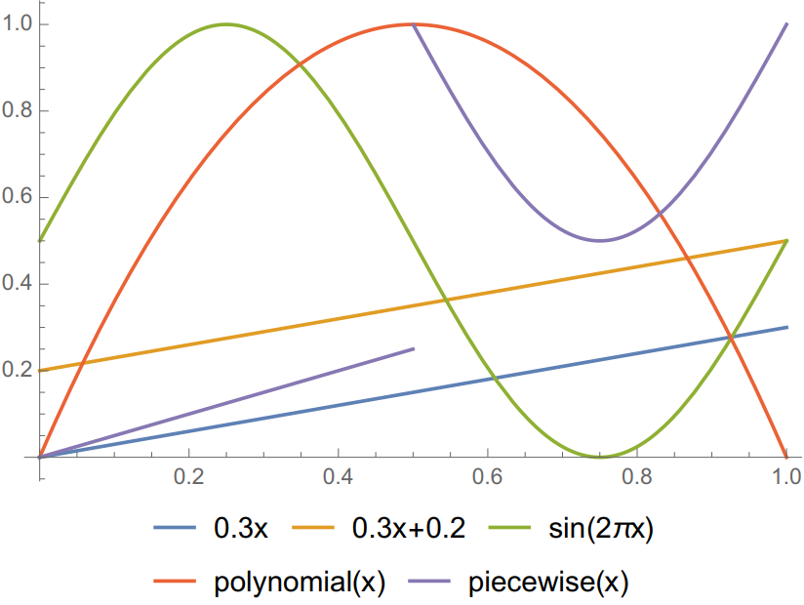
Fitness Function (2)
How to measure the diversity of the created features? E.g. how they represent different types of redundancy with the sources?

Slide 13
What are some potential redundancies?
Notes:
Linear, sine, polynomial clearly different.
Two linear functions exactly same “type” but different x-offset.
Piecewise and sin are similar for half the space – not the other half.

Slide 14
Fitness Function (2)
How to measure the diversity of the created features? E.g. how they represent different types of redundancy with the sources?
Compare the gradients of the created features to measure their “semantic” difference.
Also compare to the source features to avoid creating the identity function

Slide 15
Fitness Function (3)
For each created feature A find the minimum difference between it and each other created feature, called RFDiff_{minA}
Also find the minimum difference between it and each source feature, called SourceDiff_{minA}
Find the worst case:

Slide 16
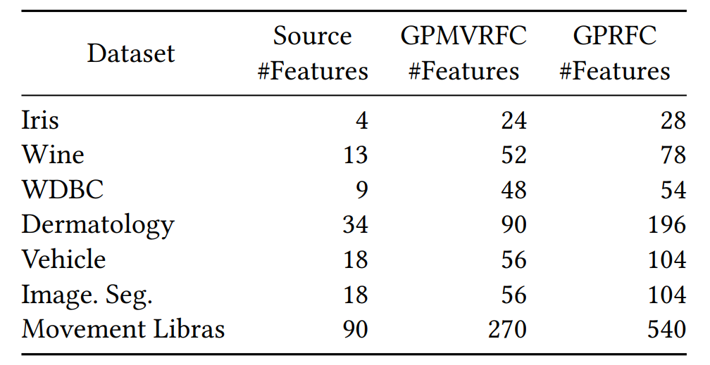
Datasets
Generated rfs for a number of datasets using both approaches.

Slide 17
Experiment Design
We use t = 10, i.e. 10 rfs created per set of source features.
More than GPRFC as fewer GP runs and more possible rfs.
One GP run per each set of source features.
Repeat the whole process 40 times.
Max depth of 15; 40% mutation; 60% crossover, top-10 elitism; pop size of 1,024; Θ = 0.7. (Same as GPRFC).
Notes:
High max depth → complex functions needed.
High mutation → diverse functions.

Slide 18
Evaluating the created RFs
Tested a range of FS methods on the augmented (+original) datasets to see how well they do.
Filter: ranked according to Information Gain, then classified with the top n features while varying n. Also used the l1SVC and JMI filter FS approaches.
Wrapper: Used sequential searches wrapped around a classifier.
Embedded: Evaluated the performance of a Decision Tree on the augmented datasets.
Notes:
l1SVC is l1-norm in a linear SVM which performs sparse feature selection.
JMI is joint mutual information based search.

Slide 19
Notes:
Only show some representative results!!
TEST ACCURACY.
ranking: clearly suffers from RFs, but after a certain point (~15), enough good features found selected.
DT is particularly interesting, as performance actually improves from adding the RFs. So GPMVRFC is actually creating more powerful features?? Hmm…maybe it’s finding feature interactions.
- SFFS/SFBS very similar results, but GPMVRFC creates fewer RFs so SFBS selects fewer.
l1SVC – under selecting, particularly on proposed, confused.
JMI – harder to interpret, but both methods mean extra features selected…

Slide 20
Notes:
Only show some representative results!!
ranking: same pattern, and slow drop off as #features goes up.
DT/SFBS/l1SVC proposed selects fewer features, and worse performance than GPRFC.
JMI – under selects compared to original dataset.
SFFS exception, selects fewer features.

Slide 21
Why does GPMFRC create better features sometimes?
Lets take a closer look at the Dermatology dataset…

Slide 22
Notes:
Only show some representative results!!
ranking: better accuracy with created RFs???
Bottom 4 set of results (filter/wrapper) all show selecting fewer features than GPRFC while getting better ccuracy than original quite often…
Seems bad, but are creating fewer feature than GPRFC (weak) and combining multiple source features means created RFs are inherently more likely to be misleading & more likely to be useful for the class label…
Have we discovered unsupervised feature construction to improve supervised learning results???

Slide 23
Unsupervised FC improving classification?
Dermatology results showed often increased performance on the test set.
Are the FS methods selecting RFs which are inadvertently better features as they combine multiple useful source features?
If so, then can we improve supervised learning results without using the class label…?

Slide 24
Final Remarks
Proposed a new method to automatically create multivariate-ly redundant features for benchmarking FS algorithms.
Designed a more appropriate and efficient fitness function:
Less MI calculations, fewer GP runs…
Results showed interesting patterns:
Sometimes beats previous method;
Sometimes creates better features than original dataset?

Slide 25
Future Work
Investigate this phenomenon of creating better features further.
Adopt an adversarial (supervised?) approach to directly produce RFs that decrease the performance of common FS methods.

Slide 26
Thank you!
Go to CEC 2019 please
Notes:
- :D

Slide 27
Other Considerations…
Unfortunately, life isn’t that simple. Few tweaks needed:
All features are scaled [0,1], but 0s kill training speed. So add a small ε to all feature values.
Real-world data often has duplicate values, which make it hard to create granular rfs. Add small amount of noise to features.
Scale and round the created rfs for visualisation, performance, and storage purposes.

