Slide 1
Using Particle Swarm Optimisation and the Silhouette Metric to Estimate the Number of Clusters, Select Features, and Perform Clustering
Andrew Lensen, Dr. Bing Xue, and Prof. Mengjie Zhang
Victoria University of Wellington, New Zealand
EvoIASP (in EvoApplications), EvoStar 2017

Slide 2
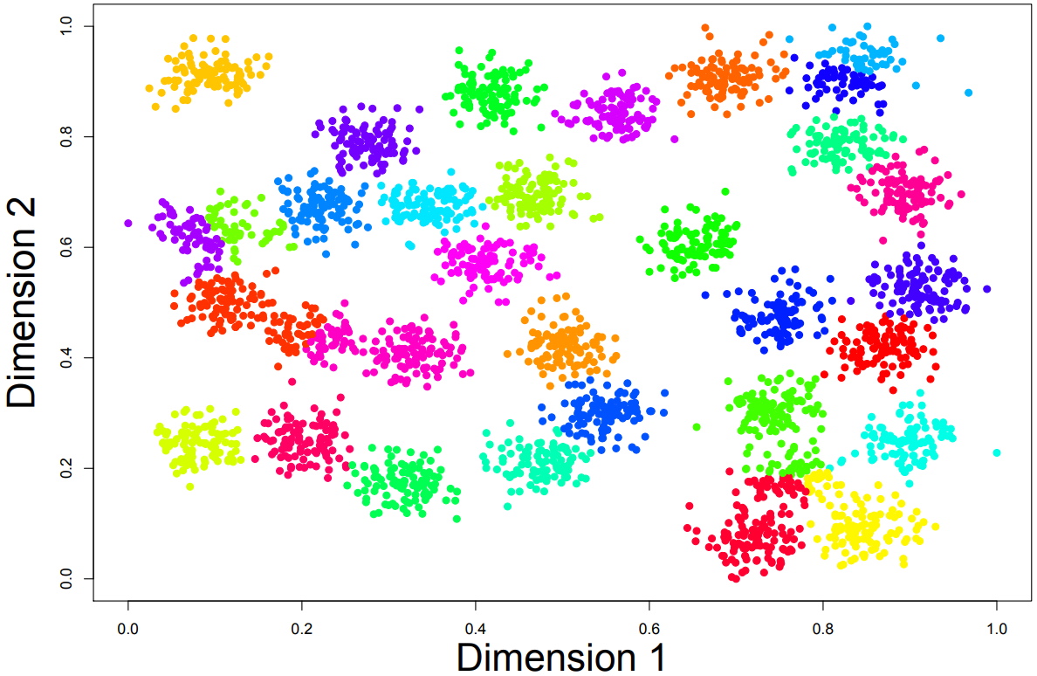
Clustering
Group related instances into a number of natural clusters.
Unsupervised – no test set as we are finding the groupings.
Many challenges:
Very large search space (NP-hard): many instances and features.
Number of clusters (K) – unknown.
More features encourage more clusters.
K-means (median) on r31 dataset.

Slide 3
Feature Selection (FS)
Features may be misleading/redundant/vary in discernibility.
Instead select a subset of features to use in clustering.
Reduces complexity, improves interpretability of solutions.
EC shown to be very capable for FS in classification tasks; very limited work applying EC-based FS to clustering.
Simultaneously clustering and performing feature selection (C+FS) allows features chosen to be tailored to clusters produced.

Slide 4
Existing Work
Our previous work [1] compared a number of PSO representations for performing simultaneous clustering and FS.
Found a medoid representation outperforms commonly used centroid.
Can automatically search for K using a fixed-length PSO encoding.
But…
Struggled to find K accurately on harder datasets. ($2≤K≤\sqrt{n}$)
Selected more features than necessary.
Clustering performance could be further improved.

Slide 5
PSO Medoid representation (unknown K)
First m dimensions correspond to m features being selected or not.
Final n dimensions correspond to the n instances.
A medoid is an instance acting as a cluster prototype.
Use a threshold (Θ) to decide when an instance is a medoid.
All instances with position > threshold → medoid.

Slide 6
Goals
We seek to address the limitations of our existing approach through a number of extensions:
Designing a two-stage approach, where an estimate of K (called K_{est}) is made in the 1st stage using the Silhouette metric. 2nd stage then refines this estimate, while also performing clustering and FS simultaneously.
Proposing a (optional) 3rd stage which does a “pseudo-local” search to fine-tune clusters further.
Enhancing the existing fitness function to improve FS performance, and encourage K values nearer to K_{Est}.

Slide 7
First Stage
Silhouette Criterion: how well an instance (i) fits into its cluster.
a(i): average distance from i to every other instance in the same cluster.
b(i): minimum average distance from i to all instances in each other cluster. In other words, the other cluster that i most belongs to.
$Silhouette\left(i\right)= \frac{b\left(i\right)−a\left(i\right)}{max⁡\{a\left(i\right),b(i)\}}$ such that value of 1 is best, -1 is worst.
For each K in $\left[2,\sqrt{n}\right]$run k-means and find average silhouette. Choose best K.
Repeat 30 times and take median K as K_{est} to reduce variation.

Slide 8
Second Stage
No changes (excluding the fitness function) to the previous work.
Uses the medoid representation discussed earlier.
Clustering is performed by assigning each instance to the nearest medoid.
Each cluster is guaranteed to have at least one instance.
Cluster centres are restricted to being “sensible”.

Slide 9
Fitness Function
Three key criteria for measuring the goodness of solutions:
Cluster performance (unchanged from [1]) should be maximised. Measures the ratio of between- and within- cluster variation (SSE).
Number of features (m’) should be minimised.
Number of clusters (K) should be reasonably close to K_{Est}.
The design of the second two criteria are discussed in the following slides.

Slide 10
FF2) Measuring FS performance
Generally, FS performance is measured by the % of features used (lower = better)
Tends to select fewer features at expense of clustering perf.
“easier” to select fewer features.
5% and 10% of features selected are both often “good enough”
Punish fitness an increasing amount as m’ increases.

Slide 11
FF3) Restricting the search space of K.
K_{est} is an estimate – we want EC process to refine it.
Shouldn’t vary too far from it.
Use a Gaussian function to encourage smaller variations, while allowing larger ones if really necessary.
Std. dev. should be relative to our estimate to scale well.

Slide 12
Third (optional) stage: pseudo-local search
Medoid approach can be limited by using prototypes from dataset.
Why not use medoid for the main part of the method, then centroid to further refine the medoids found? “pseudo-local search”.
Each medoid is converted to a centroid by taking its feature values for the selected features. Velocities are randomly initialised.
Fine-tune only the clusters: mostly exploitation, not exploration.

Slide 13
Datasets
Synthetic datasets: 10d datasets are Gaussian. Others are ellipsoidal.

Slide 14
Methods tested
2-Stage Linear PSO: using linear feature weighting.
2-Stage Elliptical PSO: using elliptical feature weighting.
3-Stage PSO: 2-Stage Elliptical PSO plus the third-stage.
k-means: standard algorithm, initialised with instances from dataset. NB: assumes K is known – much easier task.
k_{est}-means: k-means using K = K_{est}.
D-PSO Scaled: our previous single-stage approach.

Slide 15
Experiment Design
Used standard PSO parameters for all PSO methods:
vmax = 6, vmin = -6, w = 0.729844, c1 = c2 = 1.49618. swarm size = 30.
Fully connected topology.
All methods run for 100 iterations.
Each method run 30 times with different random seeds on each dataset due to non-determinism.
All datasets scaled to have feature values in [0,1] to adjust for feature range effects on distance-based clustering.

Slide 16
Evaluation Metrics
6 criteria used in the paper, but we discuss 3 key ones here.
Number of features used (m’).
Number of clusters found (K).
m’ and K are fixed for k-means methods.
Use F-measure to measure clustering performance.
Analogous to F-measure in classification, but consider instances pair-wise as cannot directly map clusters to classes.

Slide 17
Results
We do not show results for all methods and metrics here…
Focus on the interesting results:
Performance (FM): 2-Stage Linear vs D-PSO Scaled vs k-means.
Number of Clusters (K): 2-Stage Linear vs D-PSO Scaled vs actual.
Number of Features vs Performance (FM vs m’): 2-Stage Linear vs Elliptical vs D-PSO.
Psuedo-local search performance (FM): 2-Stage Elliptical vs 3-Stage.

Slide 18
Performance (FM): 2-Stage Linear vs D-PSO Scaled vs k-means.

Slide 19
2-Stage beats D-PSO on 4/6.
2-Stage Beats/similar to k-means on 3/6.

Slide 20
2-Stage has best performance in majority of cases, especially on hardest datasets (50d40c,100d20,100d40c) where scales much better than k-means.

Slide 21
Number of Clusters (K): 2-Stage Linear vs D-PSO Scaled vs actual.

Slide 22
2-Stage predicts K more accurately on Move. Lib., but less accurate on Image Seg.

Slide 23
2-Stage predicts K more accurately on 7/9 datasets – but rather inaccurate on 50d20c and 100d20c. D-PSO finds ~15-25 clusters across 50d/100d…

Slide 24
Number of Features vs Performance (FM vs m’): 2-Stage Linear vs Elliptical vs D-PSO.

Slide 25
Elliptical has small improvements vs linear on wine/breast cancer/derm. 2-Stage linear generally beats D-PSO with similar number of features.

Slide 26
Elliptical 2-stage improves results on Gaussian datasets by using more features,
But not better (worse!?) on some datasets with more features.
Linear approach again generally beats D-PSO with few more features.

Slide 27
Psuedo-local search performance (FM): 2-Stage Elliptical vs 3-Stage.

Slide 28
No real difference in performance – medoids are effective enough?

Slide 29
3-Stage improves performance on Gaussian datasets.
But… much worse on some elliptical datasets!
Fitness is higher, but F-measure drops… (noise/cluster shape?)

Slide 30
Major Conclusions & Future Work
Clear performance improvement on hardest synthetic datasets.
Elliptical feature weighting & pseudo-local search further improve performance on Gaussian data – but not on hard elliptical datasets.
Third stage improves fitness, but can decrease performance – suggests fitness function needs improvement (future work).
Future work: Multi-objective approach to balance intra- and inter- cluster variation, number of features/clusters (?)
Future work: Other performance metrics (connectedness/density)

Slide 31
Thanks
Questions?
[1] Andrew Lensen, Bing Xue, and Mengjie Zhang. "Particle Swarm Optimisation Representations for Simultaneous Clustering and Feature Selection". Proceedings of the Symposium Series on Computational Intelligence (SSCI). IEEE Press, 2016. (To appear).

