Slide 1
Generating Redundant Features with Unsupervised Multi-Tree Genetic Programming
Andrew Lensen, Dr. Bing Xue, and Prof. Mengjie Zhang
Victoria University of Wellington, New Zealand
EuroGP ‘18
Notes:
- Hi :D

Slide 2
Feature Selection
Many datasets have a large number of attributes (features).
Feature Selection (FS) is often used to select only a few features:
Reduce the search space for data mining.
Improve interpretability of evolved models (less complex).
What features should be removed? Two main types:
Irrelevant/noisy: add little value to the dataset, or even mislead.
Redundant: Share high amount of information with other features.

Slide 3
Evaluating FS Algorithms
How do we know how good a FS algorithm is at identifying each type of “bad” feature?
Identify noisy/redundant features in an existing dataset, then see how well our algorithm detects these.
But doing so is equivalent to performing FS → NP-hard…
Or, add some generated “bad” features to an existing dataset.
How?

Slide 4
Generating “Bad” Features
Generating noisy features is relatively straightforward:
Use a Gaussian/uniform/… feature generator.
Can vary the level of noise.
Ways of generating redundant features (rfs) are much less apparent.
Naïve approach: duplicate or scale existing features (+noise).
But makes easy-to-detect features: e.g. pearson’s correlation!
Also not representative of real-world redundancies.

Slide 5
How to generate redundant features then?
Very little (if any?) work proposed to do so.
Two redundant features must have some mapping, i.e. a function that defines their redundancy relationship.
Genetic Programming (GP) is very good for evolving functions that map an input(s) to an output(s).
Can we use GP to evolve redundant features?

Slide 6
Goals
Develop a multi-tree GP approach to create redundant features for feature selection benchmarking.
What GP representation is needed to produce multiple rfs?
Which fitness function can be used to optimise the rfs?
How can we show that the rfs created are high-quality?
Can we understand the rfs created?

Slide 7
Overall Design of GPRFC

Slide 8
GP Representation – Multiple Trees
Use t trees per GP individual, to give t created redundant features.
Similar representation to using GP for feature construction.

Slide 9
Terminal & Function Sets
Only one terminal: the single source feature being used.
Range of functions used to maximise ability of GP to find different types of redundancies:
Unary: $\sin\left(a\right),\tan\left(a\right),\tanh\left(a\right),\log\left(a\right), e^{a}, \sqrt{a},a^{2},a^{3},−a$.
Binary: $a+b, a ×b,\min\left(a,b\right),\max\left(a,b\right),a^{b}$.
Ternary: $if(a,b,c)$: if a is +ve, output b; otherwise output c.
Notes:
Only one terminal: no point adding random noise, as won’t increase redundancy…
We purposefully exclude cos(a) due to its similarity to sin(a). While a^2 and a^3 can be easily constructed in a GP tree, we include them as useful “building blocks”.
We exclude a − b and a ÷ b as they are the complements of addition and multiplication, and as they were found to negatively affect the learning process by easily producing constant values (i.e. X − X = 0, X ÷ X = 1).
if, in addition to max and min, allows complex conditional behaviour and non-continuous functions to be generated.

Slide 10
Fitness Function (1)
Want to maximise redundancy between created rfs and source feature, but want created rfs to be distinct from each other.
We use mutual information (MI) as a proxy for redundancy.
Created rfs must be distinct (independent) if they have low MI.
So, maximise MI between created rfs and source; minimise MI shared between pairs of created rfs:

Slide 11
Fitness Function (2)
minSourceMI is the minimum MI between a created rf and the source feature, i.e. the least-redundant rf.
maxSharedMI is the maximum MI between a created rf and all other rfs, i.e. the least “distinct” rf.
But this doesn’t ensure that created rfs are redundant enough with the source feature…

Slide 12
Fitness Function (3)
If minSourceMI is below some threshold Θ, we consider the created rfs to be an infeasible solution.
In this case, should prioritise increasing all source MIs to encourage solution becoming feasible.

Slide 13
Other Considerations…
Unfortunately, life isn’t that simple. Few tweaks needed:
All features are scaled [0,1], but 0s kill training speed. So add a small ε to all feature values.
Real-world data often has duplicate values, which make it hard to create granular rfs. Add small amount of noise to features.
Scale and round the created rfs for visualisation, performance, and storage purposes.

Slide 14
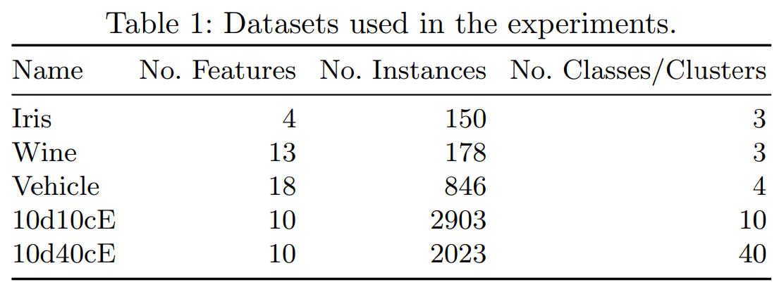
How to test GPRFC?
Used GPRFC to generate rfs for a range of classification & clustering datasets with (reasonably) small numbers of features.
We investigated the fitness achieved; classification and clustering performance; and applied FS algs to the augmented datasets.
Notes:
No known baseline to compare to….
Have 6d features after adding 5 new rfs per feature.

Slide 15
Experiment Design
We use t = 5, i.e. 5 rfs created per source feature.
One GP run per each source feature.
Repeat the whole process 30 times.
Max depth of 15; 40% mutation; 60% crossover, top-10 elitism; pop size of 1,024; Θ = 0.7.
Notes:
T = 5 best balance of more features and training perf.
High max depth → complex functions needed.
High mutation → diverse functions.

Slide 16
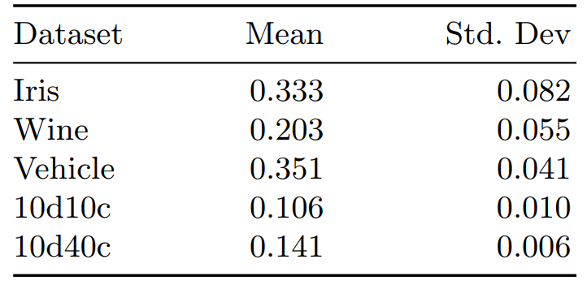
Fitness achieved by GPRFC
Notes:
A mean fitness of 0.351 on Vehicle indicates that the typical created r.f is 35.1% more redundant with the source feature than the other created r.fs.
Better on classification than synthetic clustering datasets.
Fewer features → higher std dev → more sensitive to individual features/runs?

Slide 17
Data Mining Performance
How do the RFs affect classification and clustering algorithms?

Slide 18
Classification Performance
Performance didn’t change much – but models produced are certainly more complex. KNN bit of an exception.
Datasets still fairly low-dimensionality.

Slide 19
Clustering Performance
Again, no big changes in performance. Sometimes better?
RFs won’t inherently damage clustering tasks.

Slide 20
Feature Selection
How well can FS methods discover the redundant features?

Slide 21
Feature Ranking
Ranked each feature using Information Gain (IG) on the median result on the Iris dataset.
RFs have similar ranks to their source features.
Notes:
Sometimes better than source feature.
F2e much worse than F2!
Clearly share information with source feature, but vary enough that they are likely distinct from each other.

Slide 22
Feature Selection
Applied SFFS wrapper FS (with SVM) to Iris and Vehicle datasets.
SFFS selects 12 features on original Vehicle, with 71% test acc.
Selects 7 features on augmented Vehicle, and only 47% test acc.
Selected: [F3,F9b,F12d,F12e,F13,F17,F17e].
Further investigation is needed.
Notes:
Don’t include Iris numbers due to space – similar perf, but more features selected.

Slide 23
Analysing the median RFs created on Iris (1)

Slide 24
Analysing the median RFs created on Iris (2)

Slide 25
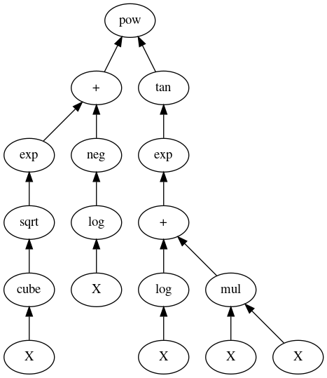
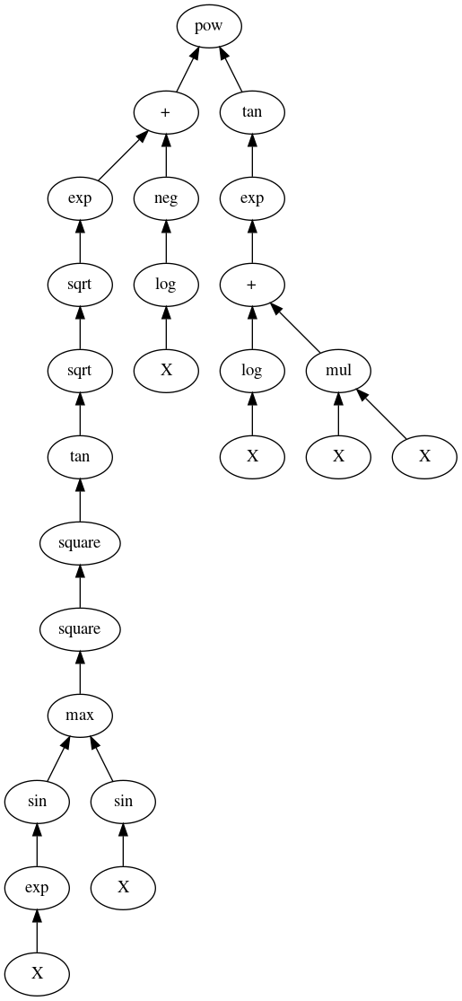
How are F3a and F3c different?
Their MI is 0.83 (high).
But only 0.14 MI to other RFs.
Fitness function could be tweaked.
Notes:
- They end up producing very similar values.
- Have a MI of 0.83 with each other – which fitness function is okay with due to very low MI with other RFs.

Slide 26
Final Remarks
We proposed the first approach to using GP to create non-trivial redundant features for benchmarking FS algorithms.
Promising initial results, with clear direction for future work:
Fitness function needs refinement. Better way to compare how “diverse” RFs are?
Currently only one source feature used. Multivariate approach?
More refined terminal/function set?

Slide 27
Thank you!
<insert CEC 2019 plug here>
Notes:
- :D

