Slide 1
ECRG High-Performance Computing Seminar
Author Yi Liu
Supervisors: Will N. Browne, Bing Xue

Slide 2
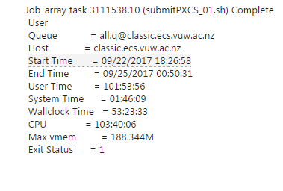
Problem Statement
Global optimal solution for 37-bit multiplexer problem
Based: 30 Agents
Without high performance computing
30 Agents per 100 hours
Total 30*100=3000 hours
Days=3000/24=125
More than 4 months
With high performance computing
3 days
saving 97.6% time

Slide 3
Overview
Parallel Computing
Parallel Computing in Python
Parallel Computing in learning classifier system
NESI
GRID

Slide 4
Parallel computing vs Serial computing
In a computer contains several cores (CPU)
1 core == 1 CPU
Serial computing uses one core
Parallel computing uses more than one cores
Serial computing: the algorithm runs serially
Parallel computing: part of the algorithm runs simultaneously

Slide 5
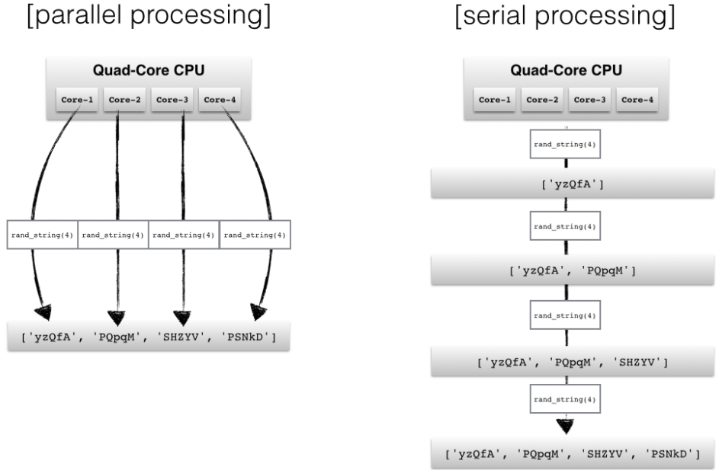
Parallel Computing
Parallel computing is a type of computation in which many calculations or the execution of processes are carried out simultaneously

Slide 6
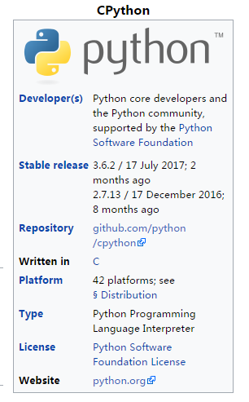
C-Python and Iron Python
C-python C based
Iron-python C# based

Slide 7
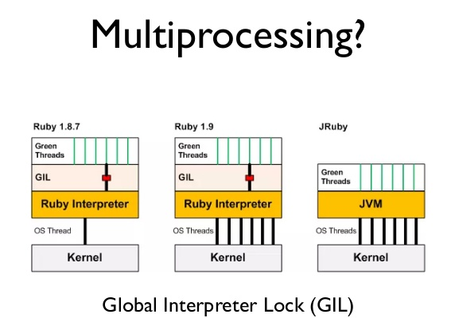
Global interpreter lock(GIL)
CPython: global interpreter lock (GIL)
Disables concurrent Python threads within one process.

Slide 8
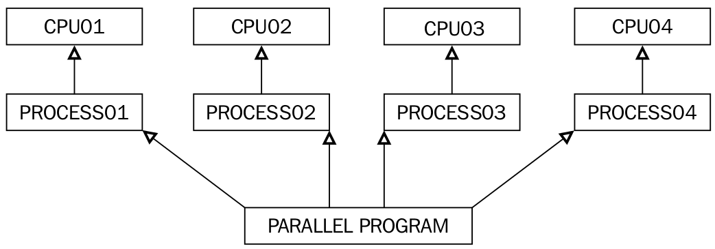
Parallel computing in Python
The multiprocessing library and the threading library
The multiprocessing library applicable
The threading library not applicable

Slide 9
Parallel computing in Python
create a multiprocessing object.
It won’t cause any error if you input the number of cores is larger than the number of cores in your computer. But just in case, it’s not a good custom to input an unrealistic core number.

Slide 10
C_Python performance
(P_time indicate parallel computing time and S_time indicate serial computing time)
Test1: Environment: CPython population: 200 iteration: 2500: unit: second （Table1）
Id | 0 | 1 | 2 | 3 | 4 | 5 | 6 | 7 | 8 | 9
P_Time | 93 | 93 | 93 | 93 | 93 | 93 | 93 | 93 | 93 | 93
S_Time | 785 | 776 | 679 | 754 | 699 | 721 | 768 | 759 | 687 | 772
P_Time: mean: 93.0s standard derivation: 0.0s
S_Time : mean :735s standard derivation: 36.53s
Parallel computing has introduced benefit in terms of speed up computing in the CPython environment , almost eight times speed up. The serial computing time varied a lot,
however, the parallel computing is very stable since the standard derivation for P_Time is 0.

Slide 11
IronPython Performance
Test2: Environment: Iron-Python population: 200 iteration: 2500: unit: second （Table2）
Id | 0 | 1 | 2 | 3 | 4 | 5 | 6 | 7 | 8 | 9
P_Time | 9 | 9 | 9 | 9 | 9 | 9 | 9 | 9 | 9 | 9
S_Time | 14 | 14 | 13 | 13 | 14 | 13 | 14 | 13 | 14 | 13
P_Time: mean: 9.0s standard derivation: 0.0s
S_Time : mean :13.5s standard derivation: 0.5s
Iron-python is much faster than the CPython,
in Iron-python when the iterations and the population are low the parallel computation could speed up the training process.
This test demonstrates parallel computation works in the Iron-Python environment.

Slide 12
IronPython Performance
Test3: Environment: Iron-Python population: 200 iteration: 8000: unit: second （Table3）
Id | 0 | 1 | 2 | 3 | 4 | 5 | 6 | 7 | 8 | 9
P_Time | 27 | 29 | 28 | 28 | 28 | 27 | 27 | 29 | 28 | 29
S_Time | 43 | 43 | 43 | 43 | 43 | 43 | 43 | 43 | 43 | 43
P_Time: mean: 28.0s standard derivation: 0.7s
S_Time : mean :43.0s standard derivation: 0.0s
In this test, the set population is as same as the test1, only the iteration is increased, both test2 and test3 speed up around 1.5 times. This is a really interesting discovery. As parallel computation can not save training time for the evaluation computation that only increased the iterations.

Slide 13
IronPython Performance
Test4: Environment: Iron-Python population: 500 iteration: 2500: unit: second （Table4）
Id | 0 | 1 | 2 | 3 | 4 | 5 | 6 | 7 | 8 | 9
P_Time | 22 | 22 | 22 | 22 | 22 | 22 | 22 | 22 | 22 | 22
S_Time | 68 | 69 | 68 | 69 | 68 | 67 | 67 | 67 | 68 | 69
P_Time: mean: 22.0s standard derivation: 0.0s
S_Time : mean :68.0s standard derivation: 0.7s
When the quantity of the population is increased, the parallel computing does bring more benefit.
In this test the parallel computation speed up around 3.0 times.

Slide 14
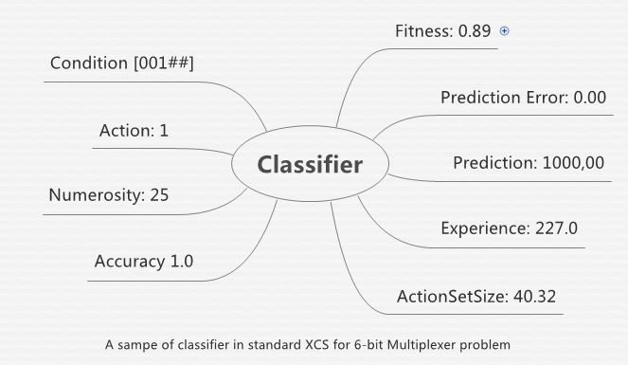
Standard XCS

Slide 15
Parallel computing in XCS
Match mechanism : Match process
Match mechanism : calculate delete weight for each classifier
Rule discovery mechanism: subsume function

Slide 16
High-performance computing (HPC): NESI
NESI (New Zealand eScience infrastructure)
Website: https://www.nesi.org.nz/

Slide 17
High-performance computing (HPC): NESI
Similar to your laptop HPC contain processors, memory, disk, operating system but more.
Logically, the number of introduced cores (CPUs) is unlimited. However, directly increased the introduced number of cores not always improve the performance. The performance depend on the topology in the HPC

Slide 18
High-performance computing (HPC): NESI
visit https://www.nesi.org.nz/apply. Fulfill an application.
Download MobaXterm (windows user)
Generate SSH keys
Send your SSH keys to the NESI group
1000 CPU hours free time

Slide 19
NESI performance (Test1)

Slide 20
NESI performance (Test2)

Slide 21
NESI performance (Test3)

Slide 22
NESI performance conclusion
increase the number of introduced cores from 1 to 8, the training speed does increase.
The training speed does not change too much among 8 to 12 cores.
Increasing the cores from 12 to 16, the training speed decreased significantly.
This result may indicate that it is difficult for NESI system to use 16 cores with python code simultaneously.
When increase the population to the double size, the parallel computing system does not increase much training time.

Slide 23
GRID
Grid computing is a collection of computer resources from multiple locations to reach a common goal. The grid can be considered as a distributed system with non-interactive workloads that could involve a large number of files.
Grid computing is distinguished from HPC in that Grid computers have each node set to perform a different task. Grid computers tend to be more heterogeneous and geographically dispersed than cluster computers.

Slide 24
How to use GRID
Website: https://ecs.victoria.ac.nz/Support/TechNoteEcsGrid
Some useful command:
need sgegrid : begin
qsub -t 1-30 test.sh :submit 30 tasks
qdel some id : delete a task
qstat : check your grid state

Slide 25
GRID Performance

Slide 26
GRID VS NESI

Slide 27
GRID Performance conclusion
The GRID’s result is quite stable.
Compared with NESI, the speed of GRID is a little faster.
To a Windows user, NESI is much more convenience in both receive the result and updating the source code.
No risk about lose objects because of someone restart computer.

Slide 28
Alternatives: Cloud computing
Google cloud platform
Advantages:
1.Better Pricing Than Competitors
2.Private Global Fiber Network
3.Live Migration of Virtual Machines
4.Improved Performance
5.State of the Art Security
6.Dedication to Continued Expansion
7.Redundant Backups
website:
https://cloud.google.com/

Slide 29
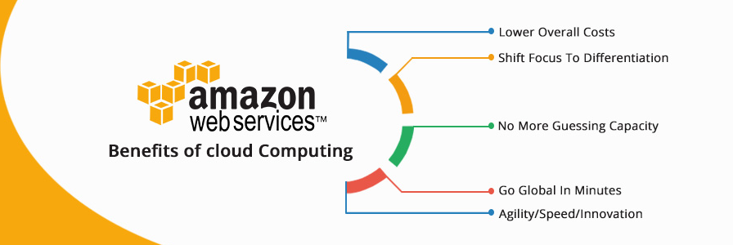
Alternatives: Cloud computing
Amazon Web Services
Advantages:
Website:
https://aws.amazon.com/?nc2=h_lg

Slide 30
Conclusion
Briefly introduce parallel computing in Python.
How to translate LCS from serial computing to parallel computing environment.
Compared the parallel computing system’s performance under HPC and GRID environment.

Slide 31
Thank You

